Slide 1
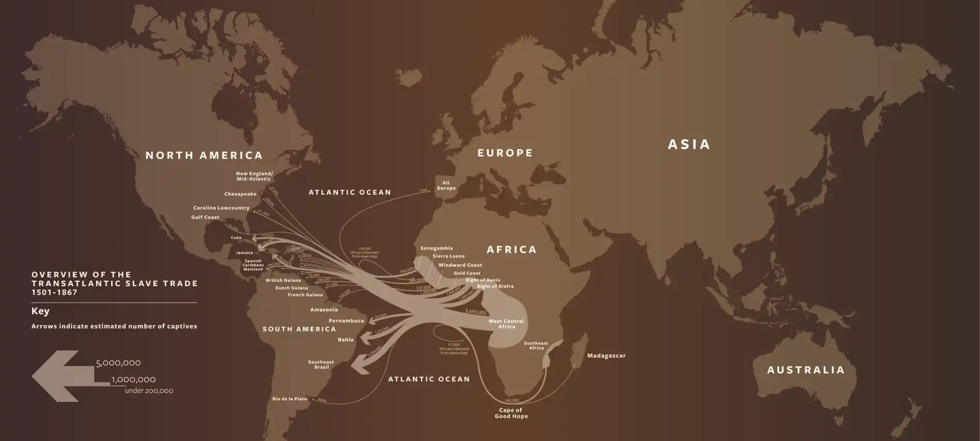
Slavery & Freedom: The African American Experience in the 17th & 18th Centuries

Slide 2
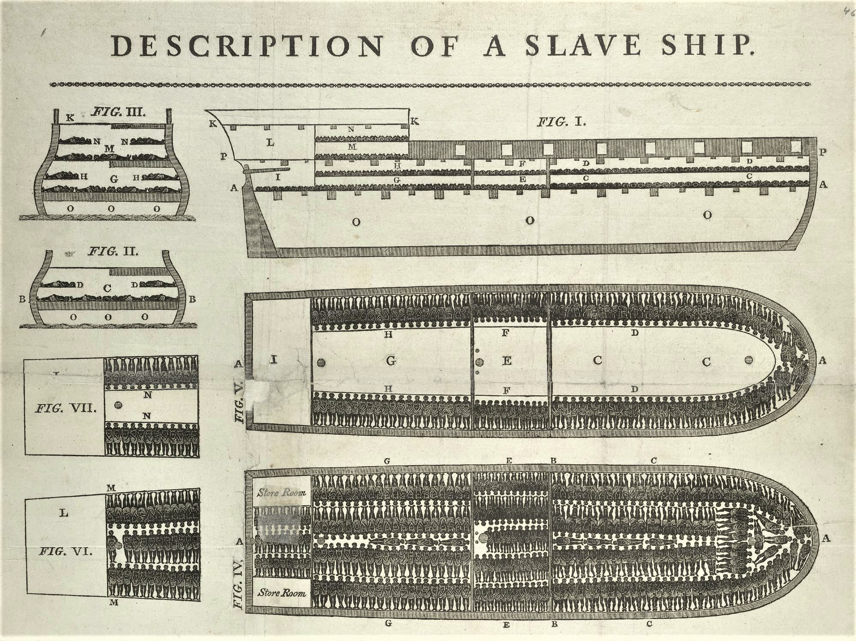
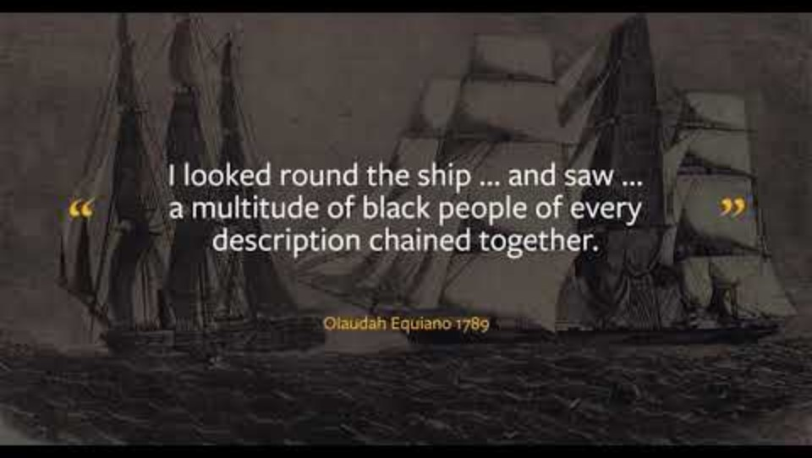
Imagine being ripped from your homeland, stripped of your identity, and forced to labor for another human being's profit
.
This was the harsh reality of slavery in America, a system that contradicted the nation's founding ideals of freedom and equality.

Slide 3
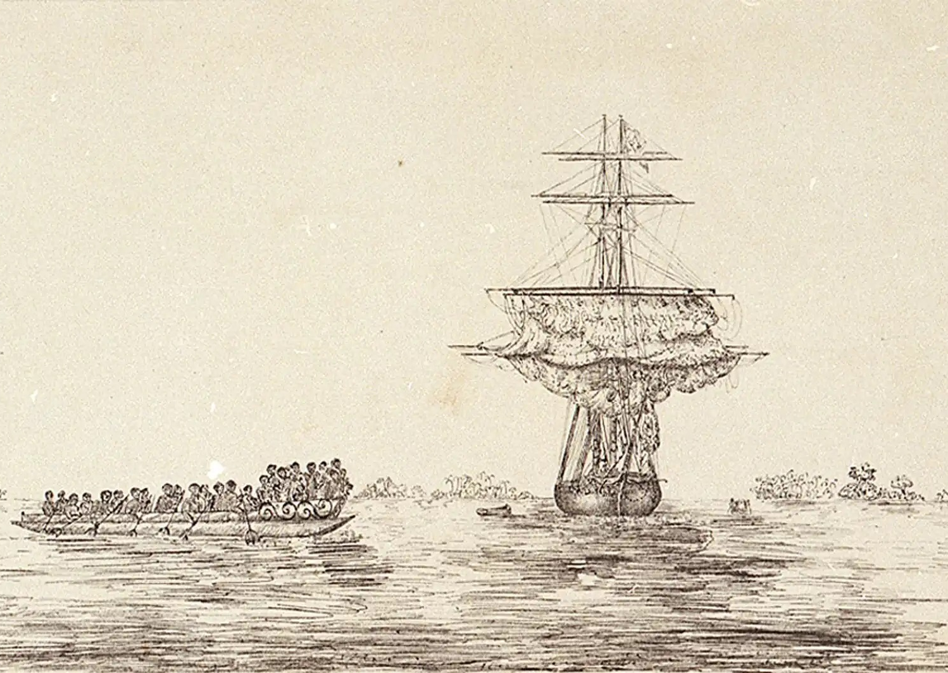
Overview
Today’s lecture will focus on:
  The harrowing origins and evolution of slavery in the Americas
  The transatlantic slave trade within a global context
  The brutal realities of plantation life in both North and South America
  Resistance and cultural preservation employed by enslaved people

Slide 4
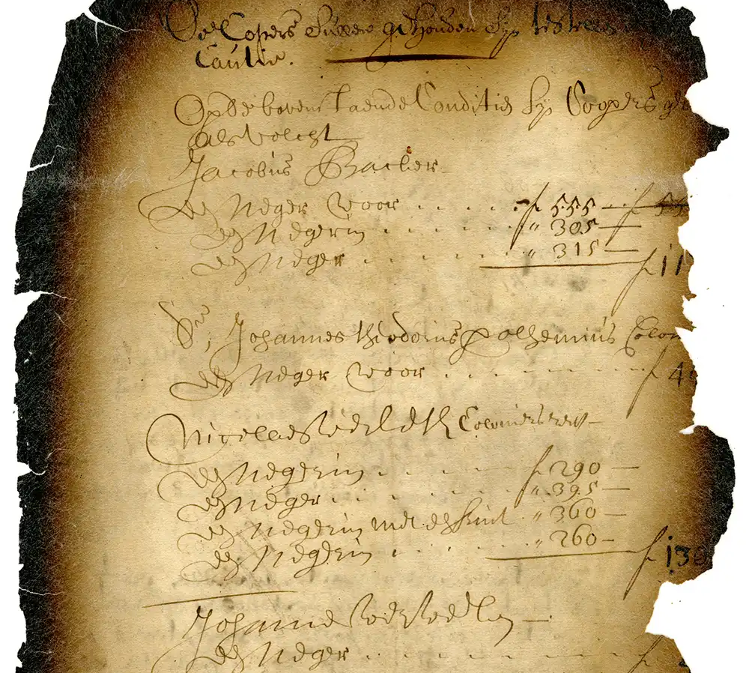
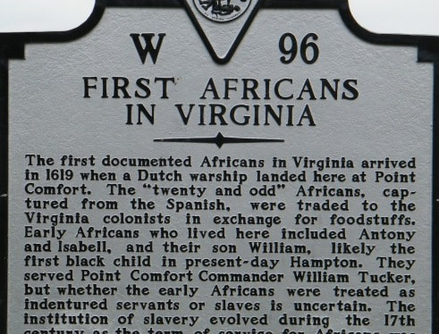
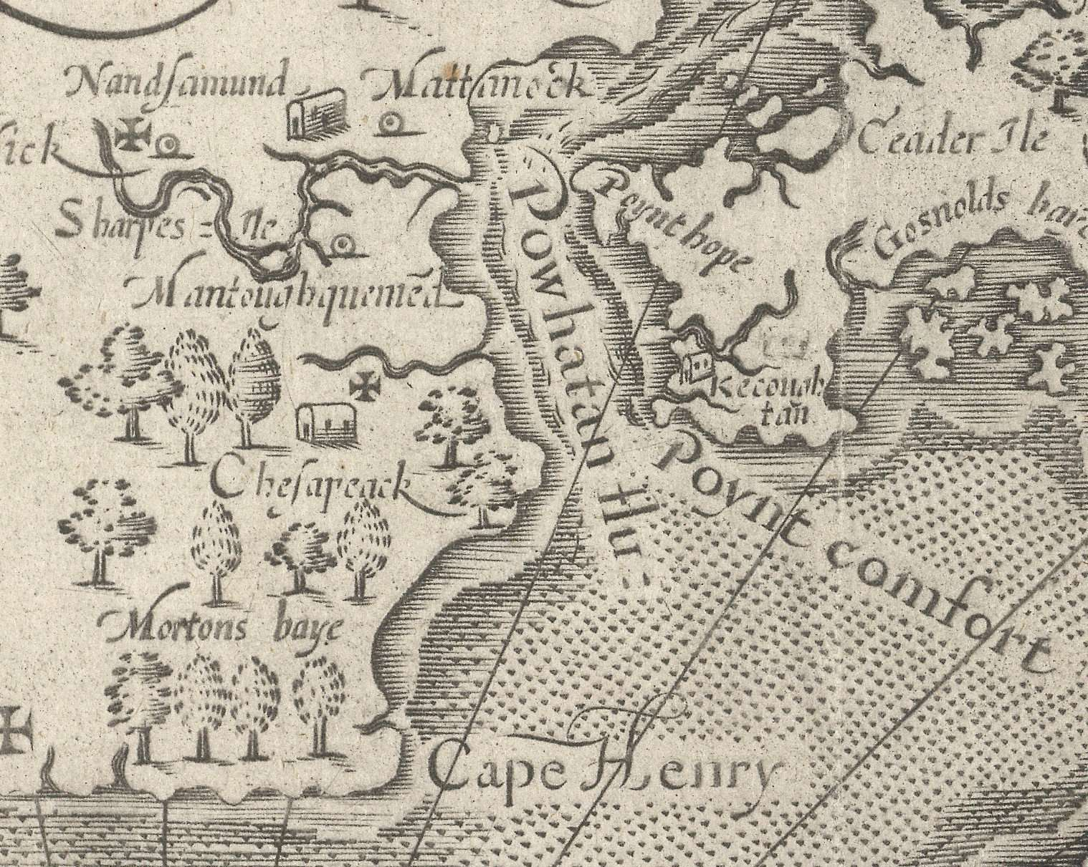
The Arrival of the First Africans
In August 1619, the White Lion arrived in Point Comfort, Virginia, carrying "20. and odd Negroes.“
These individuals were likely captured in Angola and brought to America to work on tobacco plantations.

Slide 5
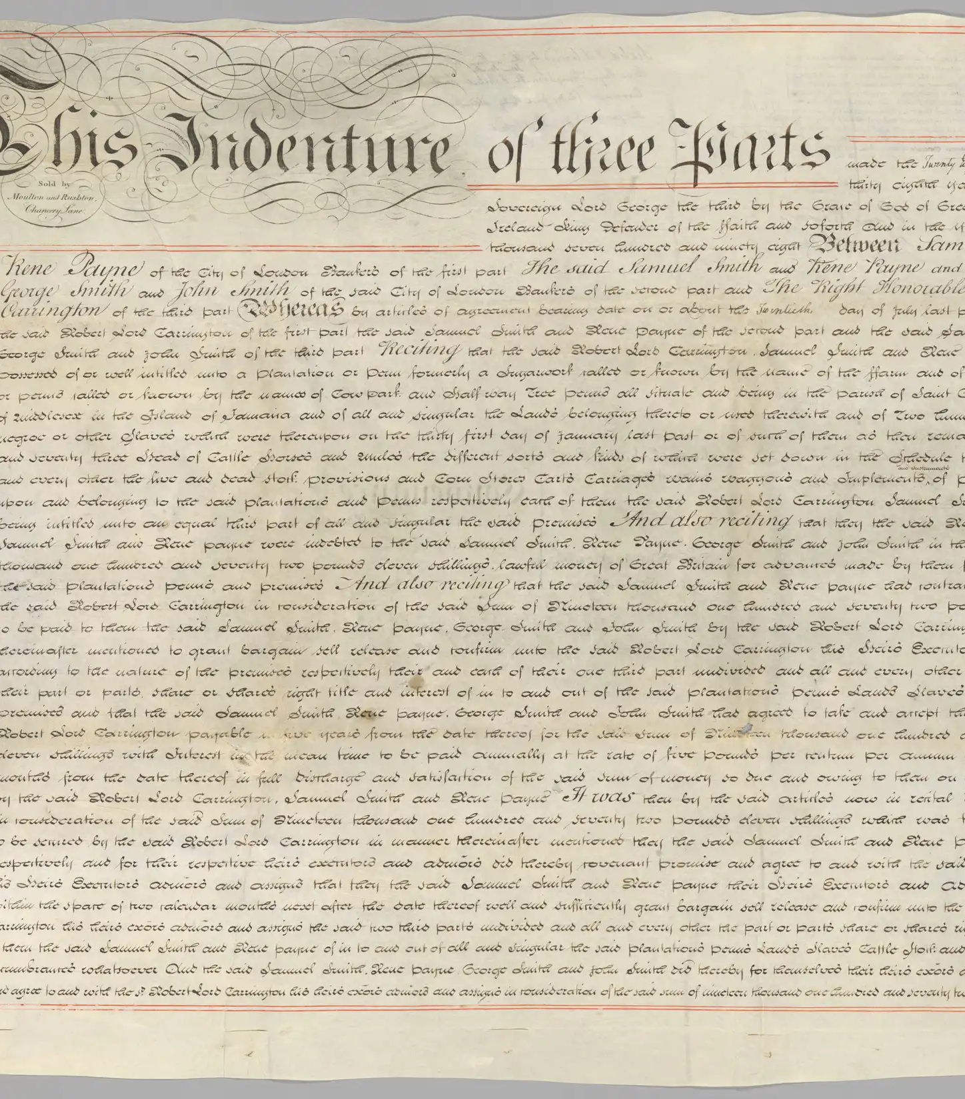
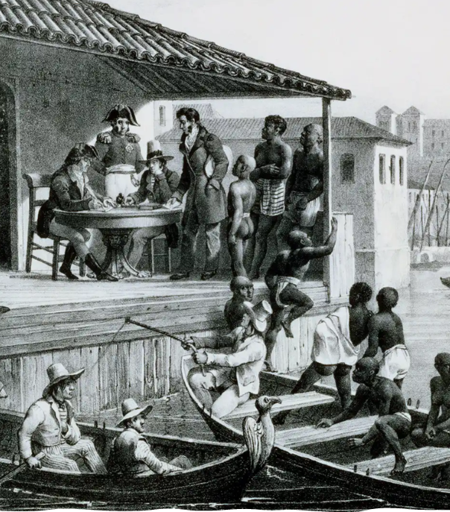
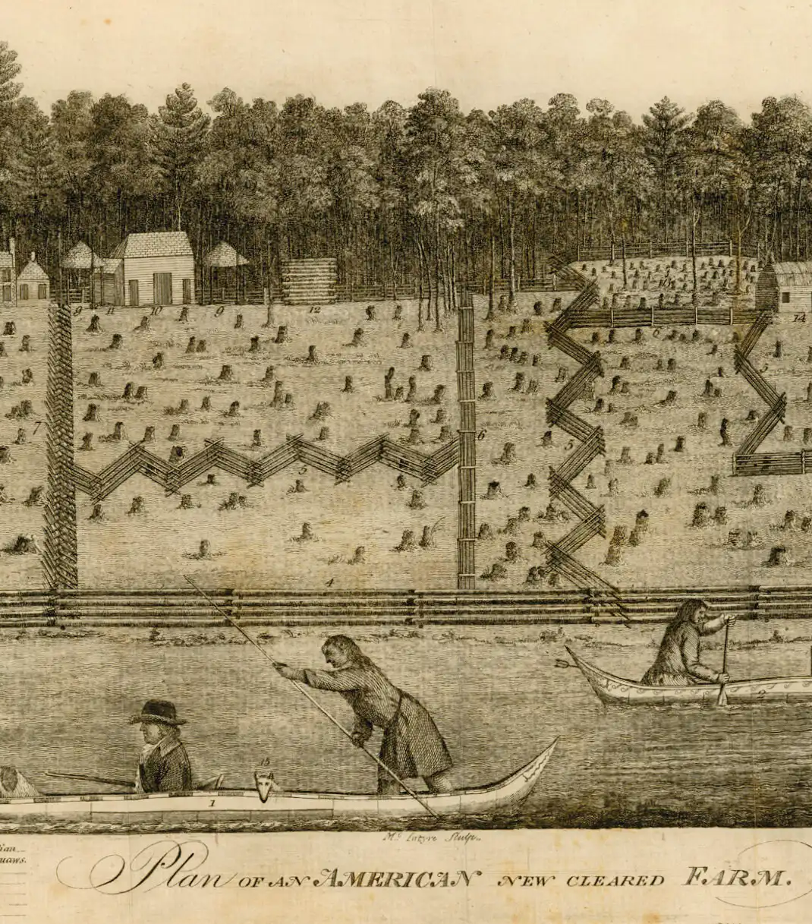
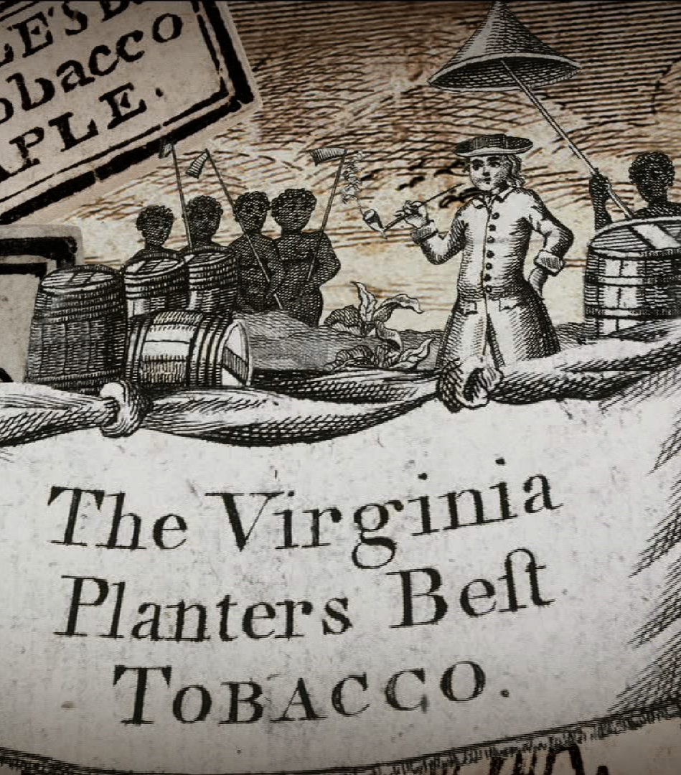
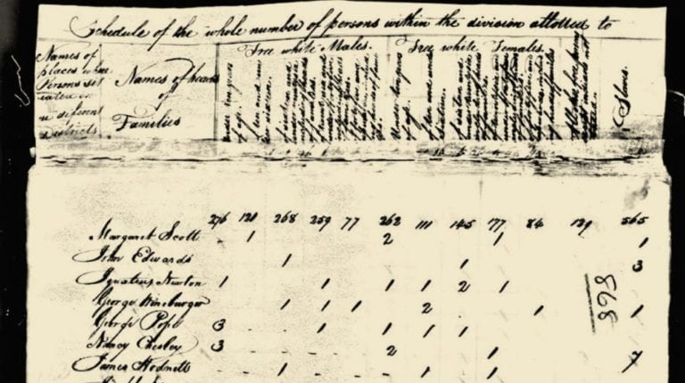
The Evolution of Slavery
Initially, the status of these Africans was unclear.
Over time, slavery became hereditary and racially based.
By the late 17th century, slavery was deeply entrenched in the colonies, driven by economic interests and racial prejudice.
Virginia Slave Codes

Slide 6
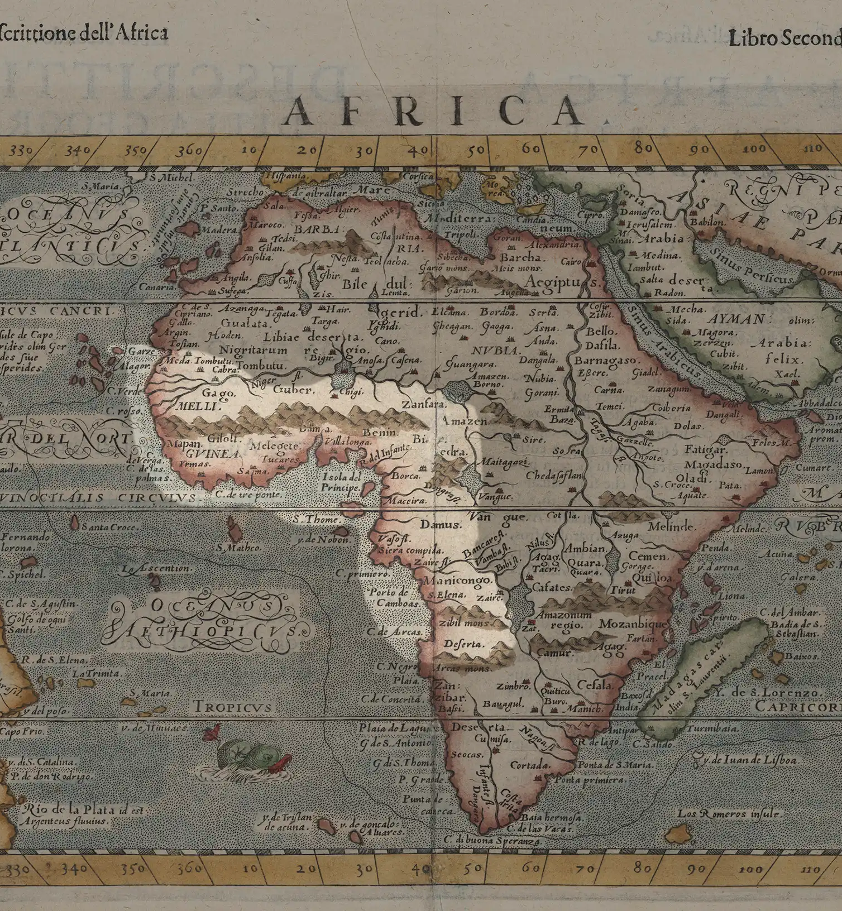
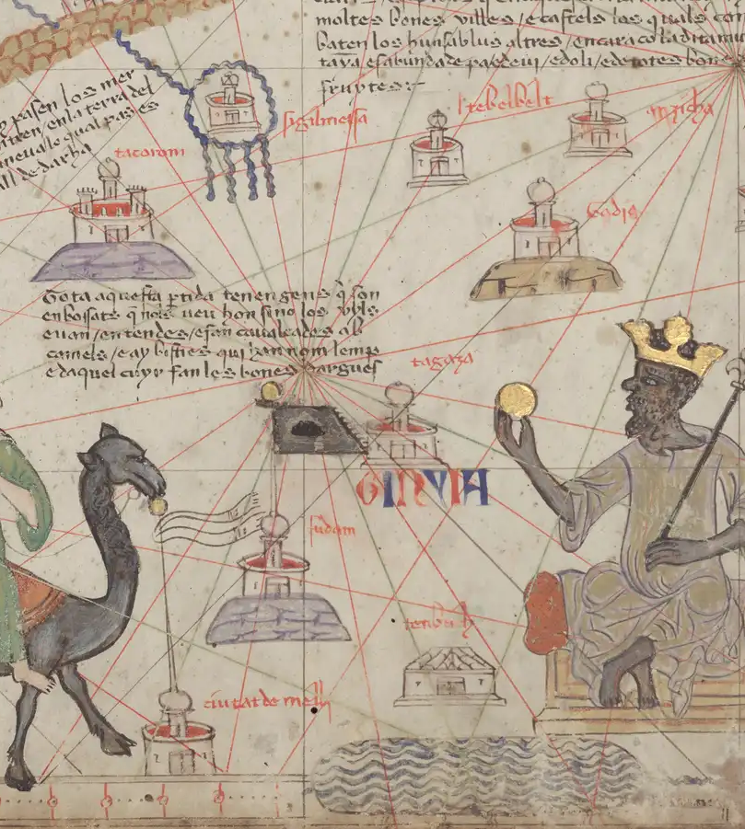
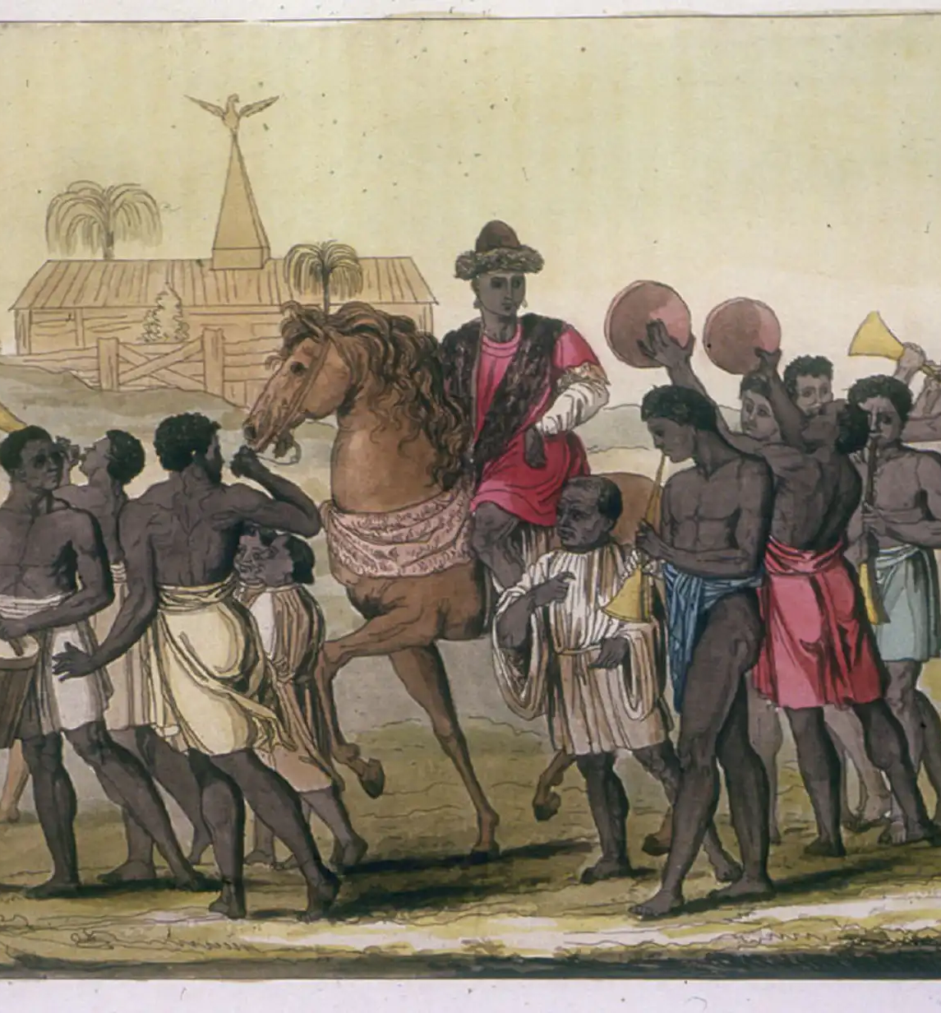
African Societies Before Enslavement
Africa was rich in diverse cultures before the transatlantic slave trade.
Kingdoms like Mali, Songhai, and Benin flourished, with complex systems of governance, trade, and artistic expression.

Slide 7
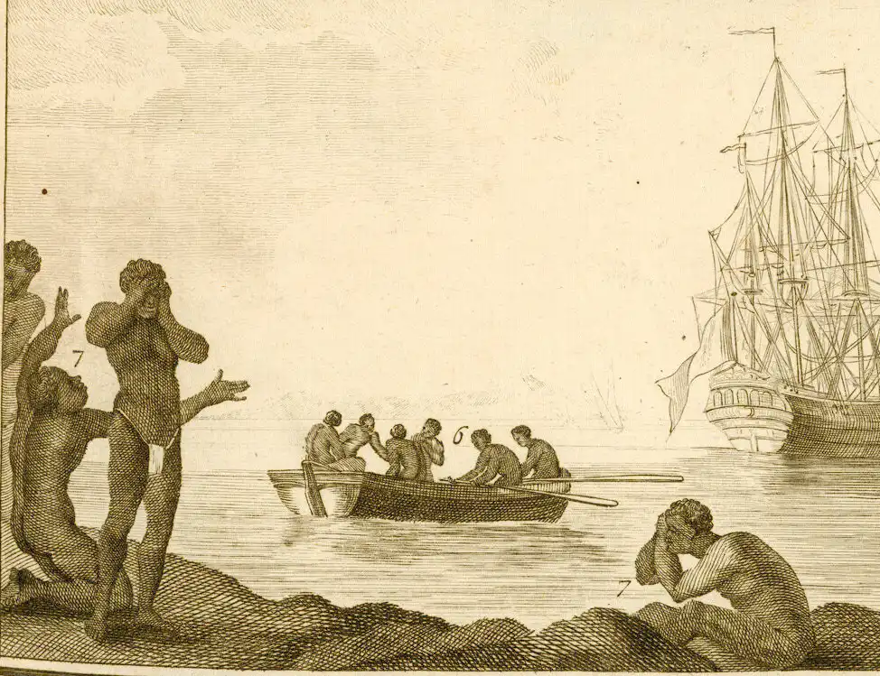
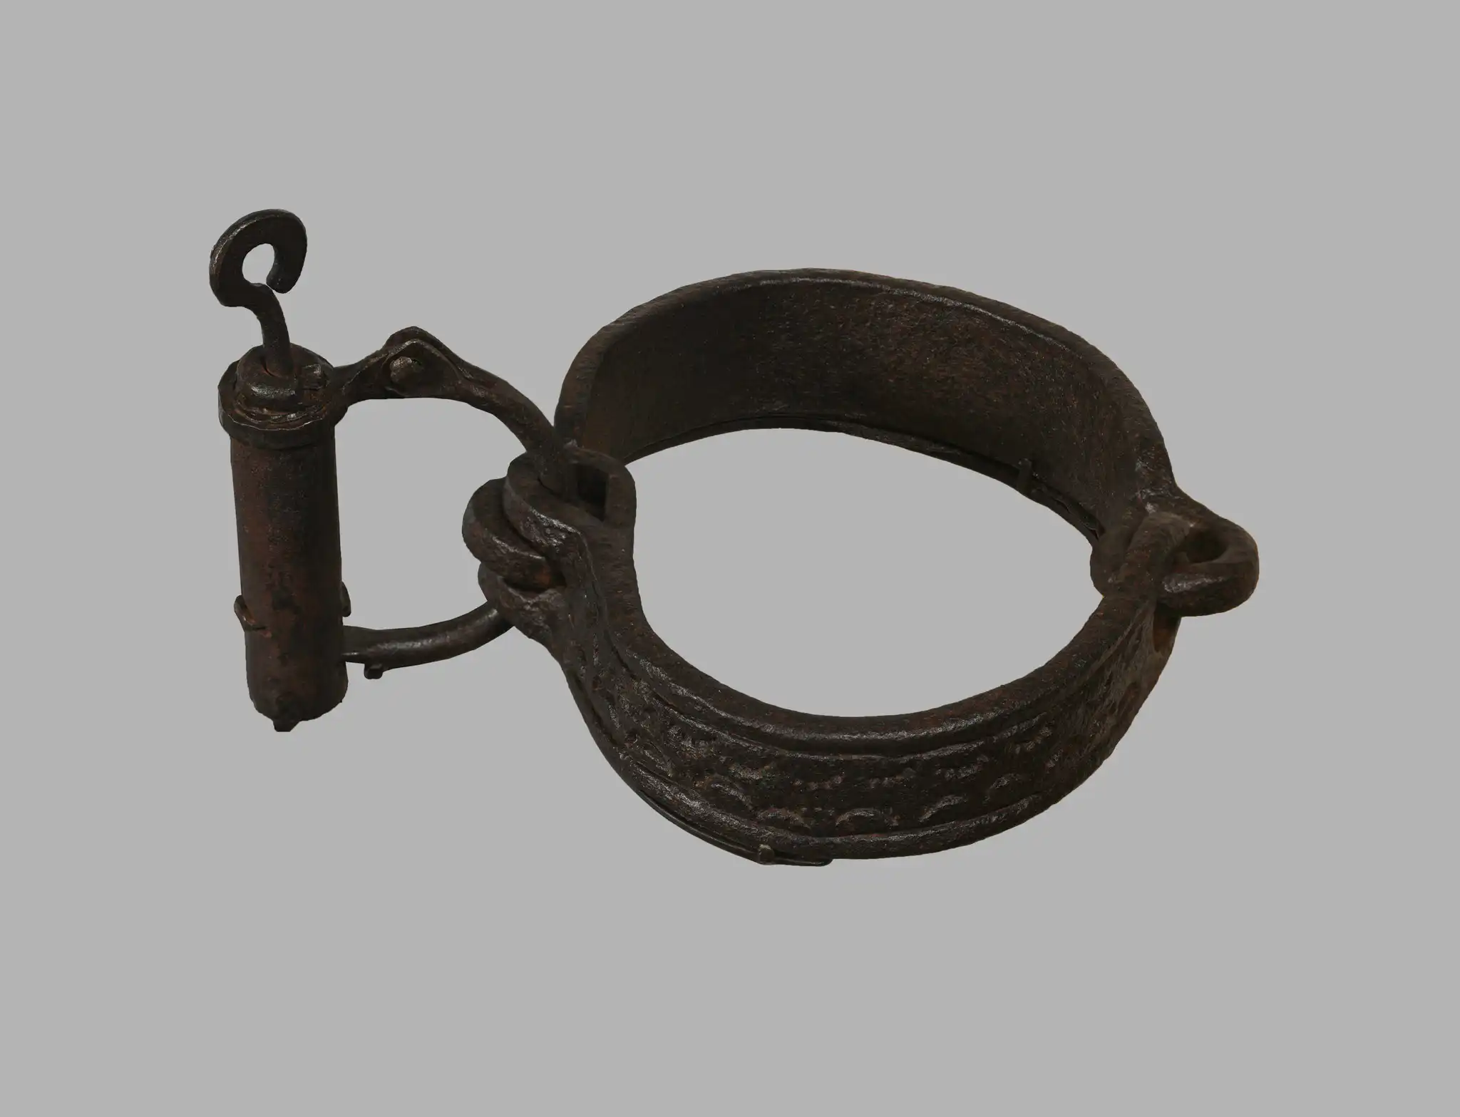
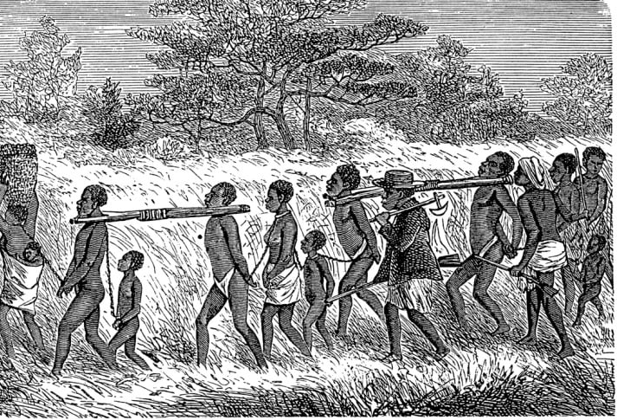
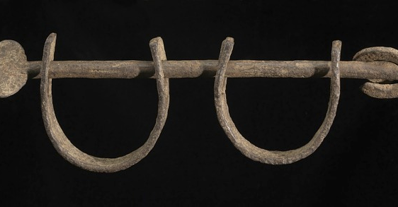
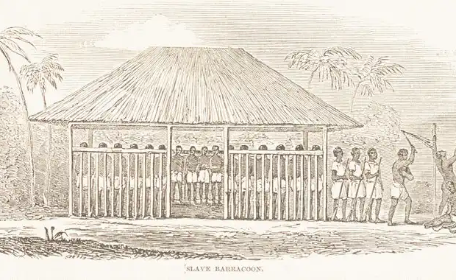
The Capture and the Middle Passage
Powerful African kingdoms like Dahomey and Ashanti participated in the slave trade.
Enslaved Africans were marched to the coast and held in dungeons or barracoons before being loaded onto ships.
The Middle Passage was a nightmarish voyage across the Atlantic, with horrific conditions.

Slide 8
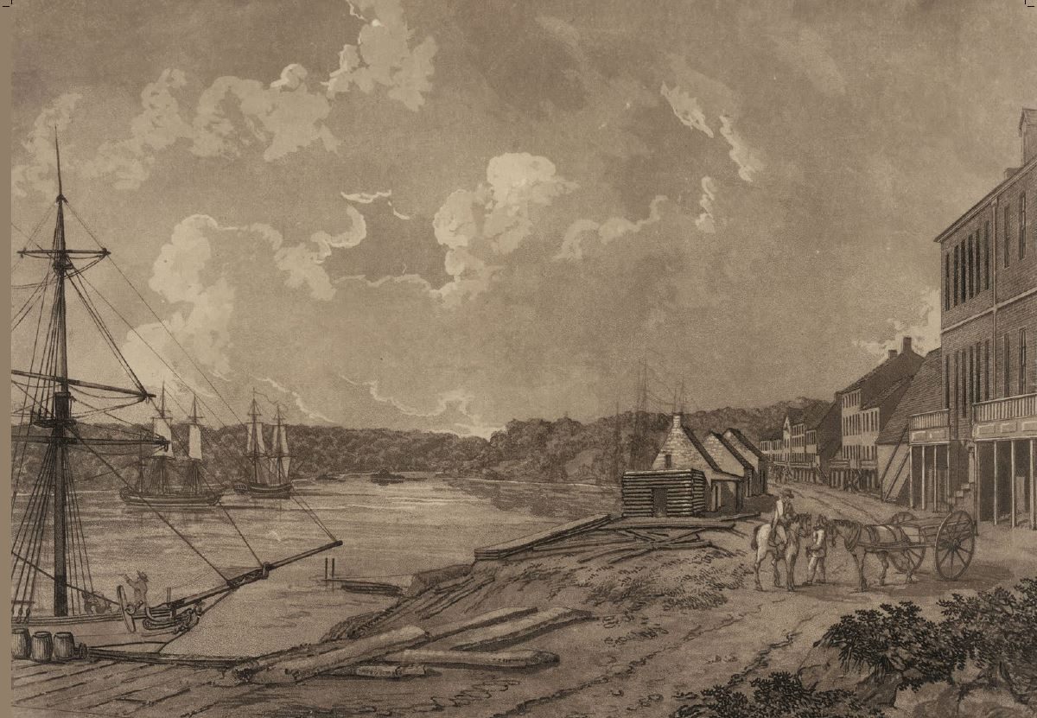
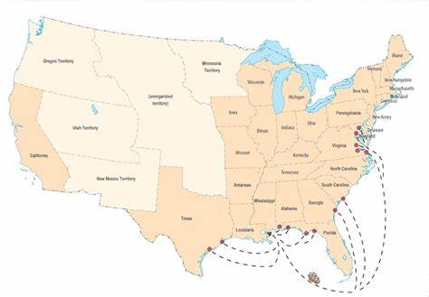
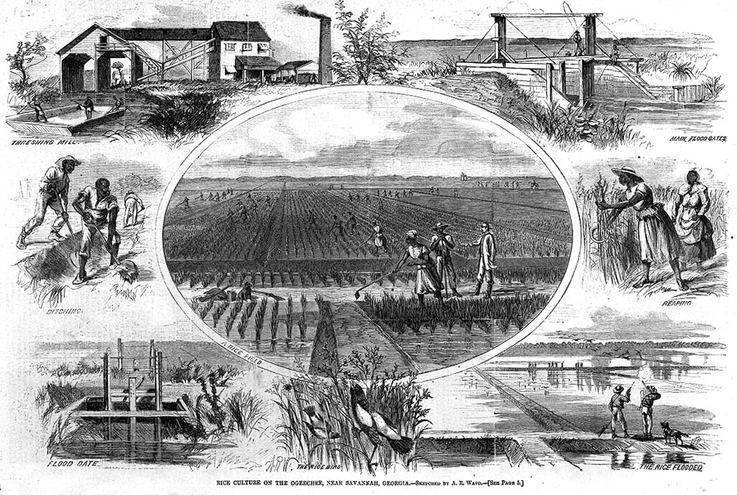
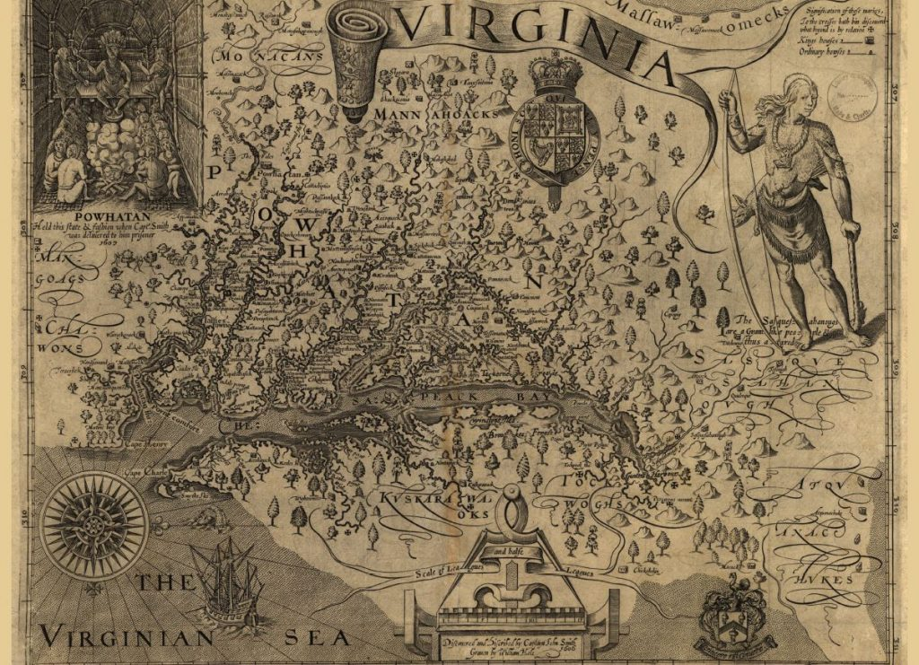
Arrival in the Americas: North America
Enslaved Africans arrived in various ports along the North American coast.
They worked on plantations, cultivating crops like tobacco, rice, and indigo, and building colonial infrastructure.

Slide 9
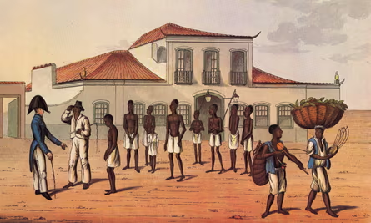
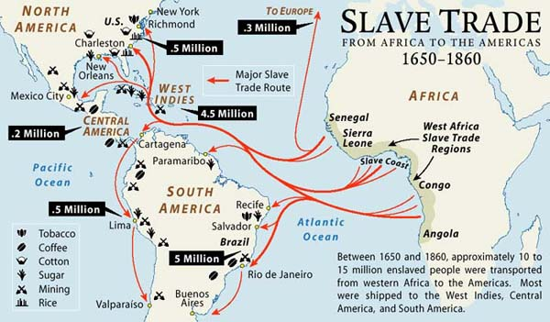
Arrival in the Americas: South America & the Caribbean
The majority of enslaved Africans were transported to South America and the Caribbean.
In these regions, they worked on sugar plantations, coffee plantations, and in mines under even harsher conditions.

Slide 10
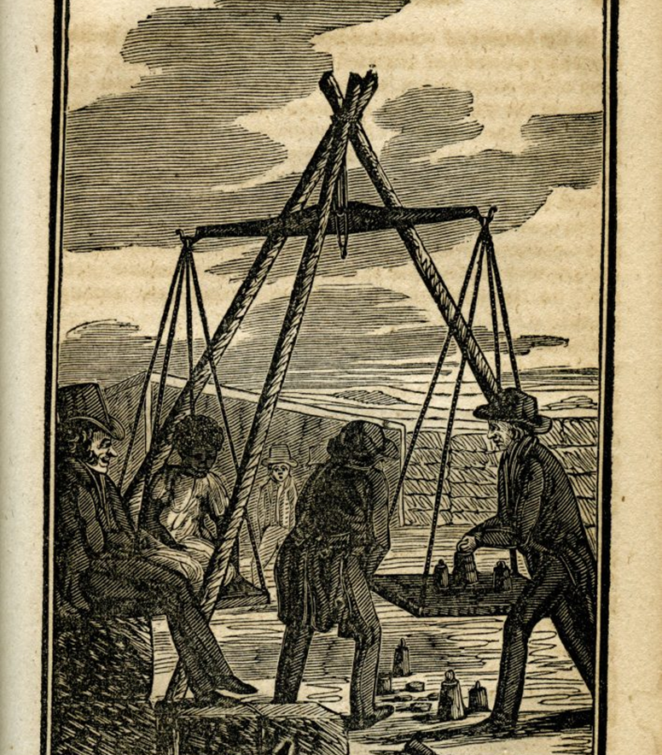
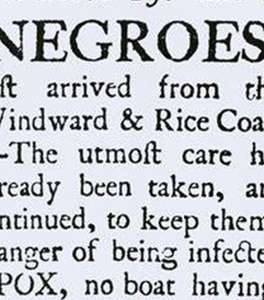
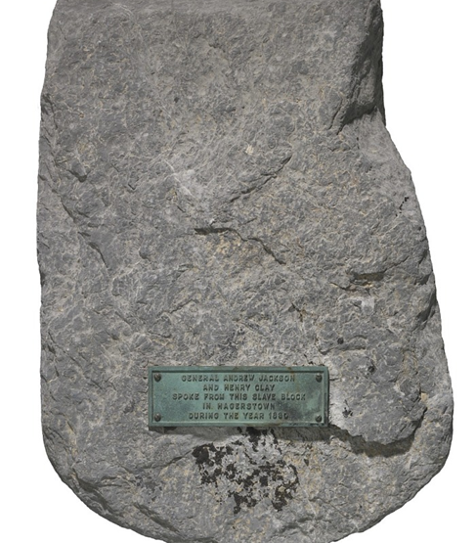
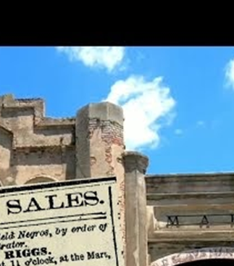
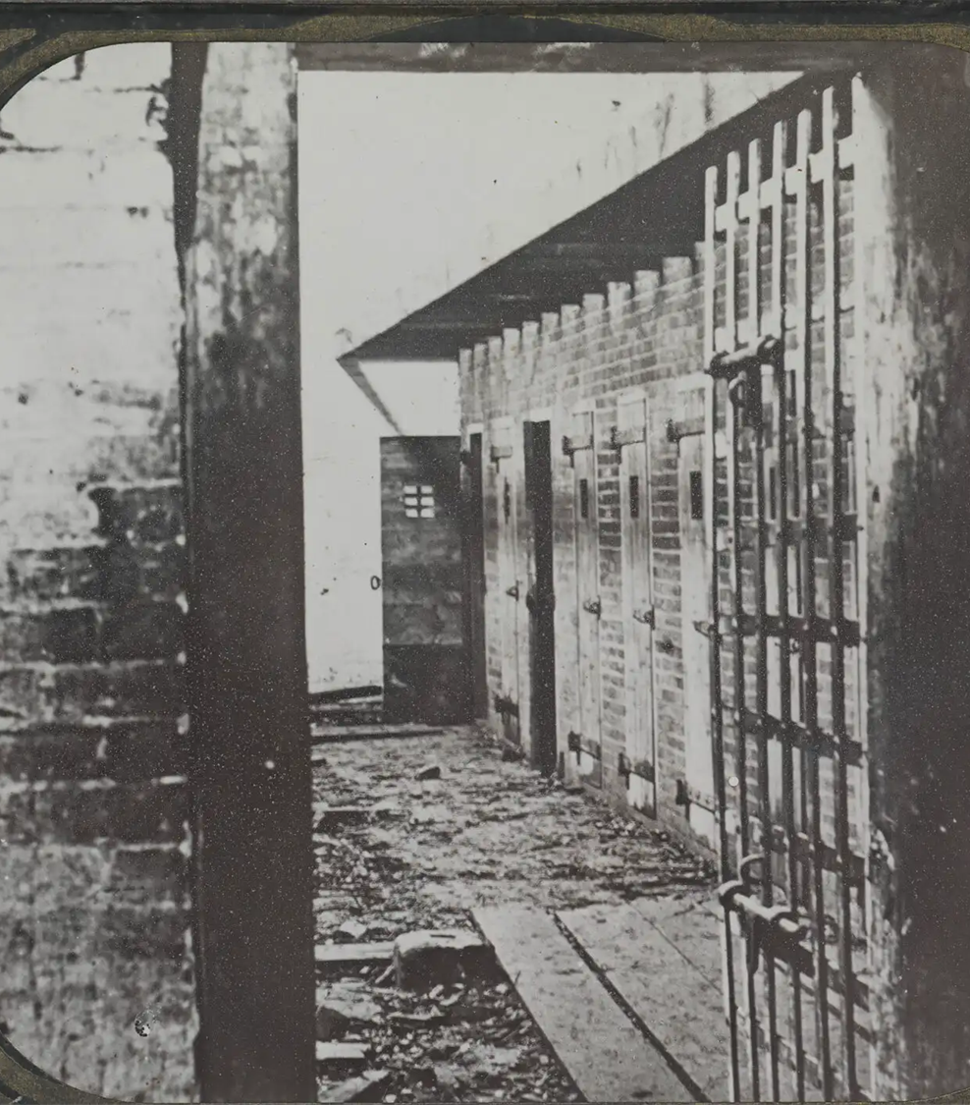
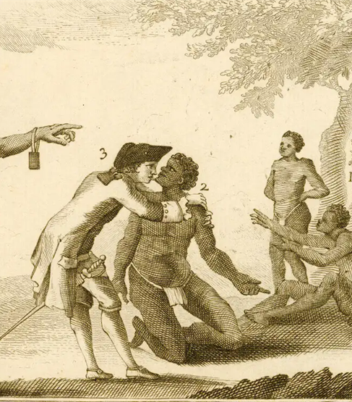
The Auction Block
Enslaved Africans faced dehumanizing experiences of being sold at auction.
They were stripped naked, inspected, and separated from their families.

Slide 11
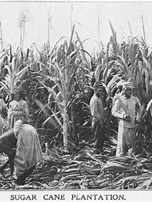
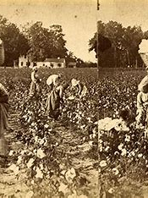
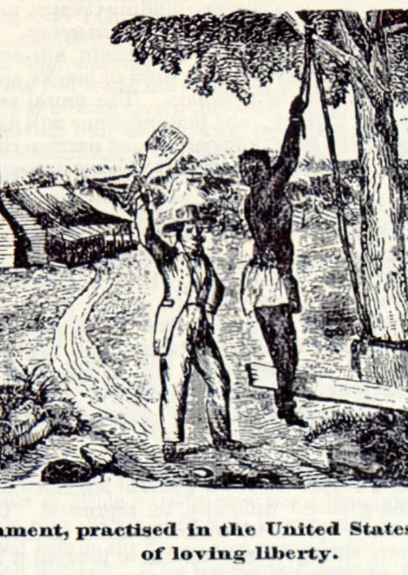
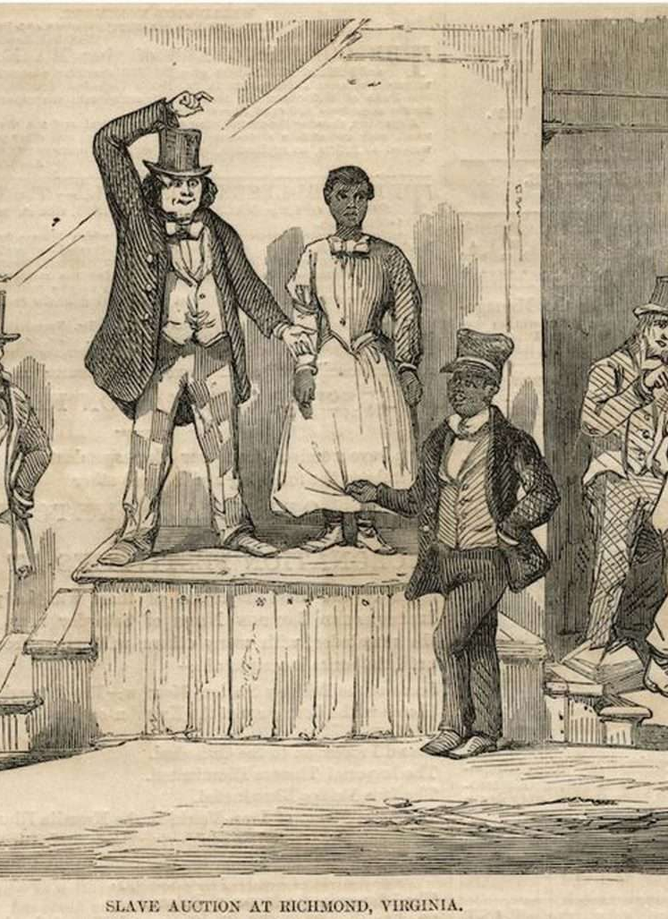

Life in Bondage: Oppression, Resistance & Cultural Survival in the 17th & 18th Centuries
Enslaved people performed backbreaking labor from dawn till dusk.Physical and sexual abuse were commonplace, and the threat of family separation loomed constantly.

Slide 12
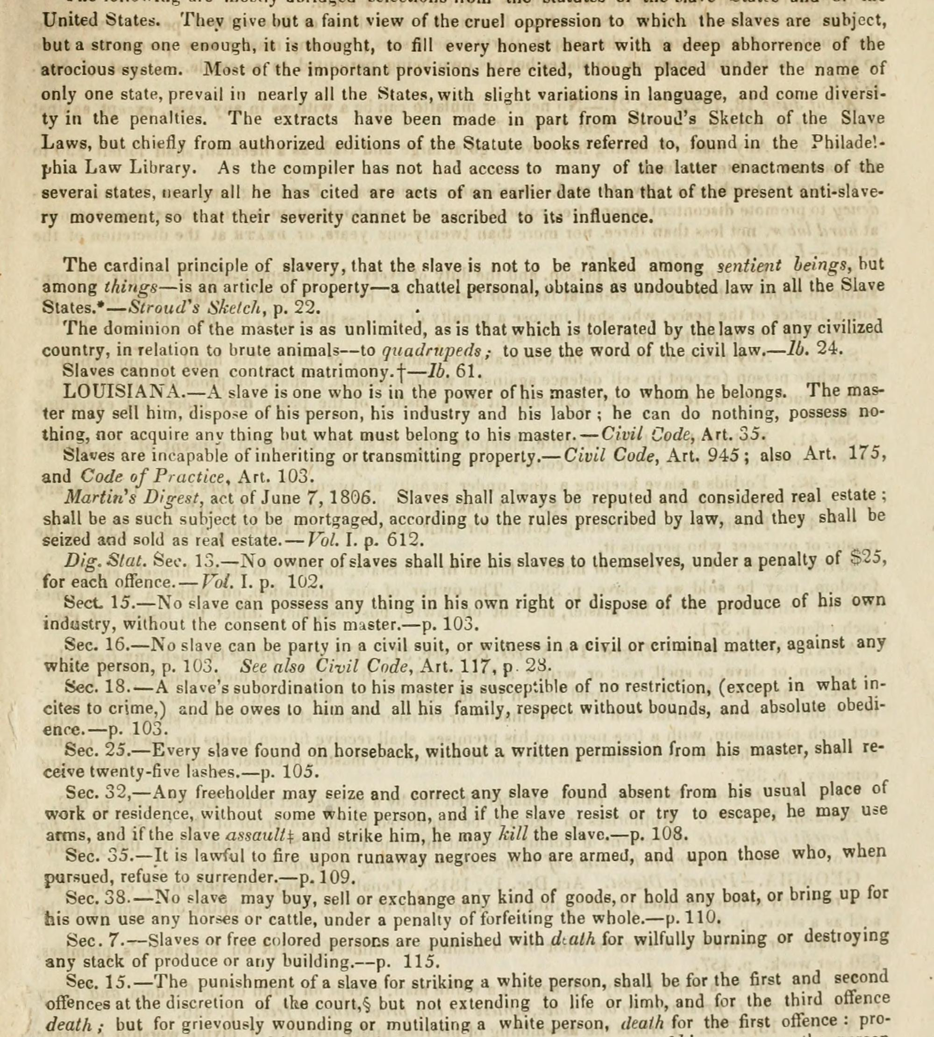
The Slave Codes
As slavery became more entrenched, colonies enacted slave codes.
Enslaved people were denied basic human rights and were considered property.

Slide 13
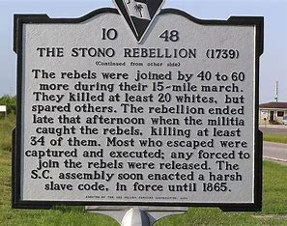
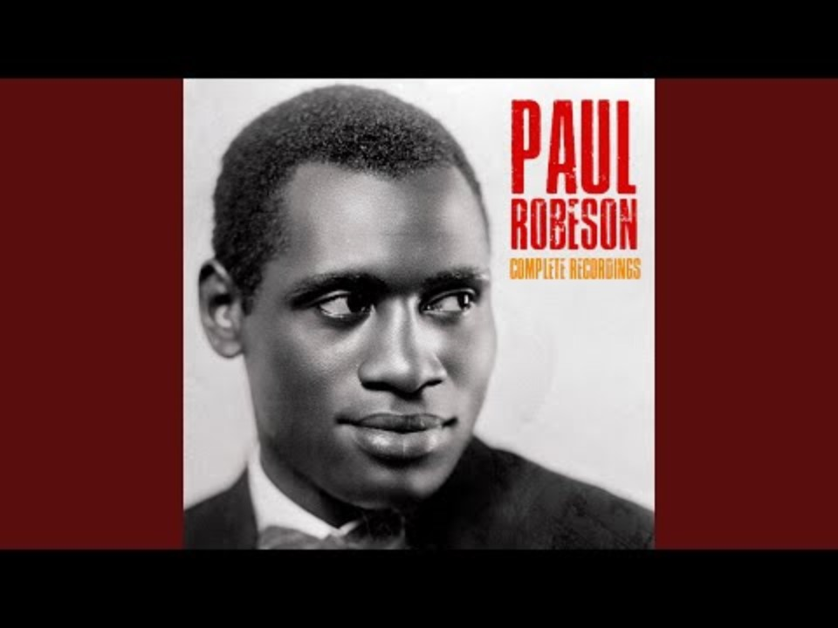
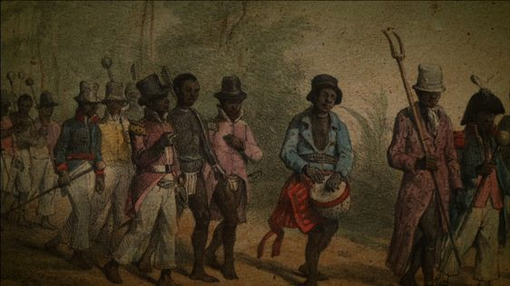
Forms of Resistance
Enslaved people resisted through defiance, escape, and rebellion.
The Stono Rebellion of 1739 is one of the many examples of enslaved people risking their lives for freedom.

Slide 14
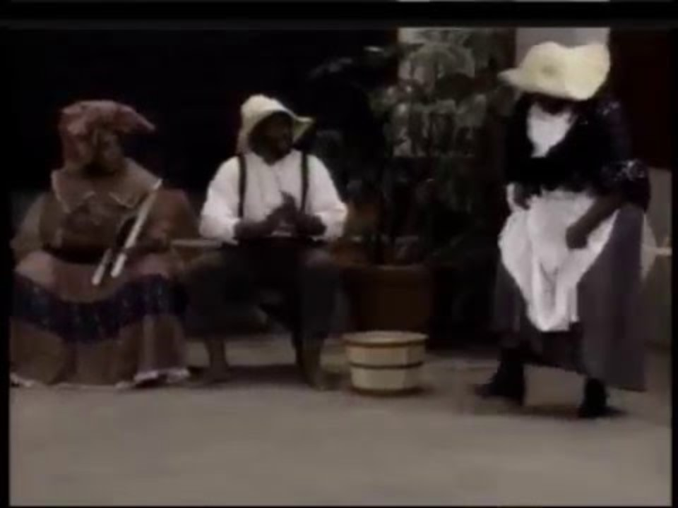
Preserving Cultural Identity
Music and Dance
  Despite oppression, enslaved people clung to their cultural traditions through music and dance.
  The ring shout, a circular dance with rhythmic clapping and singing, became a powerful form of expression.

Slide 15
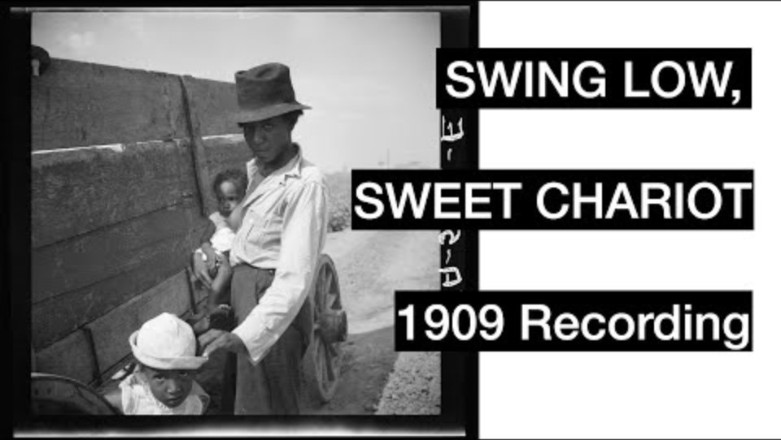
Preserving Cultural Identity
Religion
  Religion, often a blend of African traditions and Christianity, offered hope and community.
  Enslaved people reinterpreted Christian teachings to fit their experiences, emphasizing themes of liberation and justice.

Slide 16
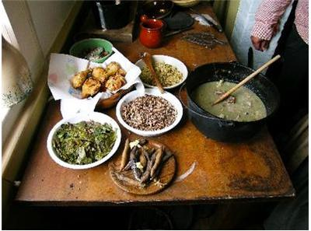
Preserving Cultural Identity
Storytelling and Foodways
  Storytelling and foodways played a major role in preserving cultural identity.
  Folktales like Br'er Rabbit helped pass down knowledge, while African crops and culinary techniques influenced American food.

Slide 17
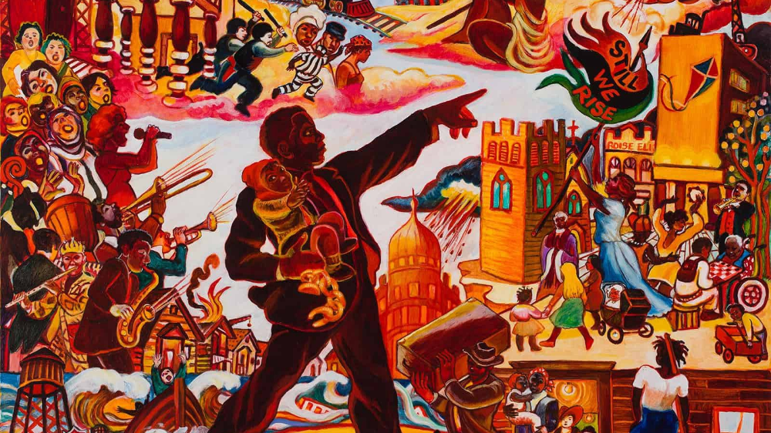
Despite unimaginable hardship, enslaved Africans resisted and preserved their cultural identity.
This period is a stark reminder of both human cruelty and the resilience of the human spirit.
The legacy of slavery continues to shape our society today.

