Slide 1
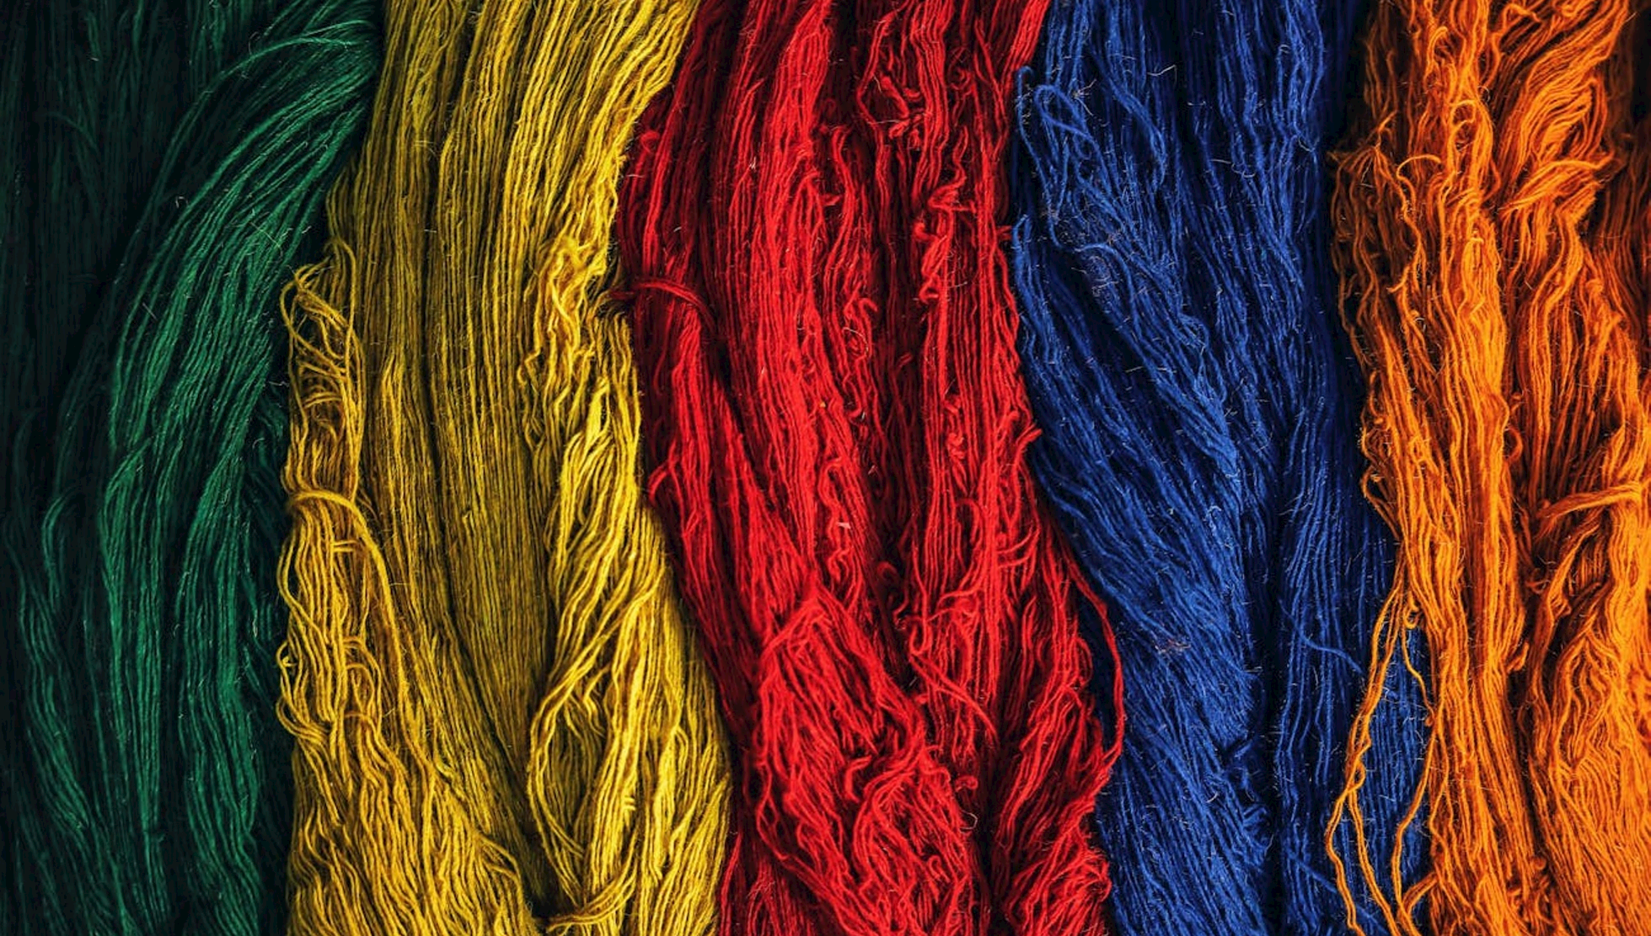
The Global Tapestry as seen through Mali's Influence
Exploring how Mali's wealth, trade, religion, and intellectual culture interconnected with the wider world during the 1200-1450 period.

Slide 2



Overview
CONSTRUCTING A GLOBAL TAPESTRY
SHARING FINDINGS
CONNECTING THE THREADS
We're building a 'global tapestry' by exploring how each group's findings interconnect with the rest of the world.
Each group will present their research on Mali's history, including its gold trade, intellectual culture, diplomacy, and more.
After the presentations, we'll discuss how these different 'threads' fit together to form a larger global picture.
BY WEAVING TOGETHER THE INSIGHTS FROM EACH GROUP, WE'LL GAIN A DEEPER UNDERSTANDING OF MALI'S PROFOUND INFLUENCE ON THE MEDIEVAL WORLD.

Slide 3
How This Works
CREATIVE PROMPTS
  Each group will answer a creative prompt that connects to Mali's gold trade, intellectual culture, diplomacy, or other key historical elements. Use the prompt as a springboard to think creatively about your group's topic and how it fits into the bigger global picture.
CLASS PRESENTATION
  Your group will share your findings with the class in a fun, engaging way. Think of it as presenting your group's part of the tapestry! Each group's presentation should answer the creative prompt and explain how Mali's history influenced the world in the 1200-1450 period.
WEAVING THE TAPESTRY TOGETHER (FINAL DISCUSSION)
  After all groups have presented, the class will come together to connect the different 'threads' of Mali's history. We'll explore how all these elements—Mali's wealth, religion, trade, intellectual culture, and the Black Death—fit together to form a global tapestry of history.

Slide 4
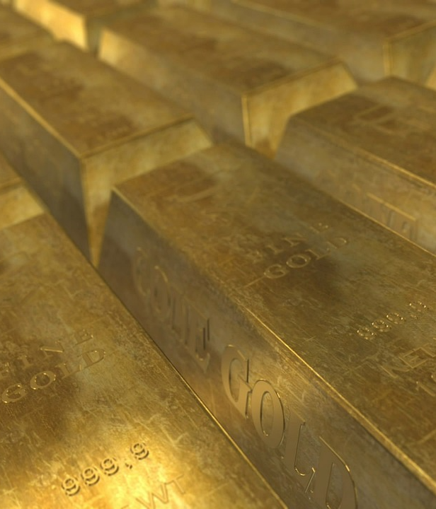
Mali's Gold Trade as 'Influencer Marketing'
Group: Gold Group
Prompt:
Mali’s gold trade made it one of the most famous empires in the world. Imagine Mali’s gold is like an "influencer" today. How did Mali use it to gain attention and build relationships with other regions? What would Mali’s “followers” (other empires) be like, and why were they interested in Mali’s gold?
Creative Ideas:
Mali’s Instagram Feed: Imagine Mali’s gold posted as #GoldGoals on Instagram—what would its most famous post be? Why?
Trade Collaborations: What kind of trade "collaborations" would Mali form with other regions, like the Song or even Polynesia?
TikTok Challenge: What would a viral TikTok dance based on Mali’s gold caravans and trade look like?

Slide 5

The Silk Road as “Global Networking”
Group: Red Group
Prompt:
Even though Mali wasn’t directly on the Silk Road, it still managed to make important trade connections. Imagine the Silk Road is like a global networking event. Who would Mali want to meet (like China, India, etc.)? What would Mali do to stand out at this event?
Creative Ideas:
Speed Dating for Traders: How would Mali pitch itself at a speed-dating style trade event? What’s the opening line to catch the attention of The Byzantines or the Aztecs (for example)?
Swag Bags from Mali: If Mali handed out “swag bags” to other traders, what goods would they include to impress them?
Trade Shark Tank: Mali walks into the "Shark Tank" of global trade—how does it convince other empires to invest in gold and salt?

Slide 6

Islam as Mali’s “Cultural Ambassador”
Group: Green Group
Prompt for Students:
Imagine Mali has sent Islam as its “Cultural Ambassador” to a high-profile global trade show, where empires from around the world have gathered. Islam’s job is to pitch Mali’s governance, trade, and legal systems—not just to Islamic empires like the Abbasid Caliphate, but also to non-Islamic powers like the Song Dynasty and the Mongol Empire. What would Islam’s flashy “booth” look like? How would Islam grab the attention of empires who care about different things—whether it's religion, trade, or military power?
Creative Ideas:
Islam’s Trade Show Booth: Picture Islam’s booth at a massive international expo—what flashy visuals, symbols, or objects would Islam use to attract visitors? Would there be golden trade artifacts or scrolls showcasing Mali’s legal system?
Diverse Sales Pitches: What’s Islam’s “elevator pitch” to different kinds of empires? Would it emphasize religious unity to the Abbasids, but focus on wealth and trade routes when talking to the Mongols or Song Dynasty? Imagine Islam tailoring the pitch based on what each empire cares about most!
Cross-Cultural Swag Bags: What “swag” would Islam hand out to different empires to win them over? Maybe custom Qur’ans for the Islamic states, and golden trinkets or trade maps for non-Islamic empires? How would these gifts reflect Mali’s diverse identity?

Slide 7

Timbuktu as “The World’s First Global University”
Group: Blue Group
Prompt:
Timbuktu was known as a center of learning. Imagine it as the first “global university.” What subjects would students study, and who would come from around the world to attend?
Creative Ideas:
Timbuktu’s Course Catalog: What would the most popular courses be at “Timbuktu University”—astronomy, poetry, medicine?
The Nobel Prize of Timbuktu: If Timbuktu gave out a global award for intellectual achievement, what groundbreaking ideas would win?
Recruitment Commercial: If Timbuktu made a recruitment ad, what would it say to scholars in Baghdad or Europe? “Come for the manuscripts, stay for the knowledge!”

Slide 8
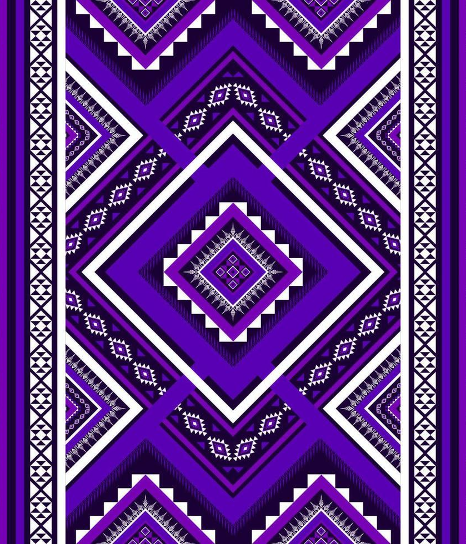
Empire Reality Show: “Survivor—World Edition”
Group: Purple Group
Prompt:
If Mali were competing in a reality show where empires have to outlast, outwit, and outplay each other in trade, military, and culture, what would Mali’s winning strategy be?
Creative Ideas:
Confessionals: What would Mansa Musa say in his reality show confessional? “I didn’t come here to play. I came here to dominate trade.”
Challenges: What "Survivor" challenges would Mali ace—trade negotiations, military strategy, or cultural influence? How?
Alliances and Rivalries: Who would Mali’s top rival be? The Mongols? The Song Dynasty? What alliances might form? Tell us about it!

Slide 9

“What If?”: Mali’s Battle Against the Black Death
Group: Gray Group
Prompt:
Picture Mali’s leaders in an emergency meeting as news of the Black Death arrives at their borders. The stakes are high: How will they protect Mali’s people and economy while keeping trade flowing? Create a crisis plan—what immediate actions does Mali take to stop the spread?
Creative Ideas:
Emergency Strategy Session: What would Mali’s leaders focus on in an emergency strategy meeting? Trade routes, health measures, or leadership decisions?
Propaganda Campaign: Imagine Mali creating a public health campaign to stop the Black Death—what would the slogan be?
Alternate History Documentary: If the Black Death hit Mali, what would a Netflix-style documentary about it say?

Slide 10
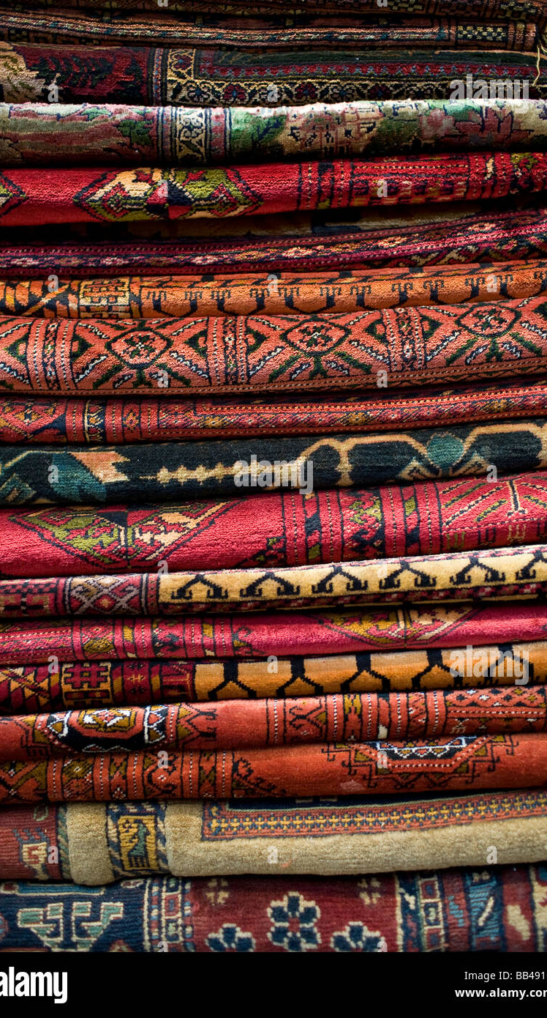
Weaving the Threads Together (Final Discussion)
Prompt:
Now that we’ve heard from each group, let’s think about how all these different threads—Mali’s wealth, trade, religion, intellectual culture, and global crises—fit together. What symbols or colors would represent Mali’s unique position in global history?
Design Your Own Tapestry
Pick a color, symbol, or pattern to represent each group’s topic (gold for wealth, green for Islam, etc.). How would you design a tapestry that tells Mali’s story in the global world of 1200-1450 CE?
Historical Playlist Creation
Create a global “playlist” to represent Mali’s role in the world. Each group adds a “track” that captures the essence of their topic—what’s the song for Mali’s gold trade? Timbuktu’s intellectual life? How do the songs flow together to tell a cohesive story of Mali’s global influence?
Legacy Time Capsule
Imagine you're building a time capsule that will be opened 500 years from now. Each group adds an object that represents their topic—Mali’s gold trade, intellectual life, or cultural diplomacy—and explains why it’s essential to understanding Mali’s legacy. What would you include in the time capsule, and how does it symbolize Mali’s lasting impact on the world?

