Slide 1
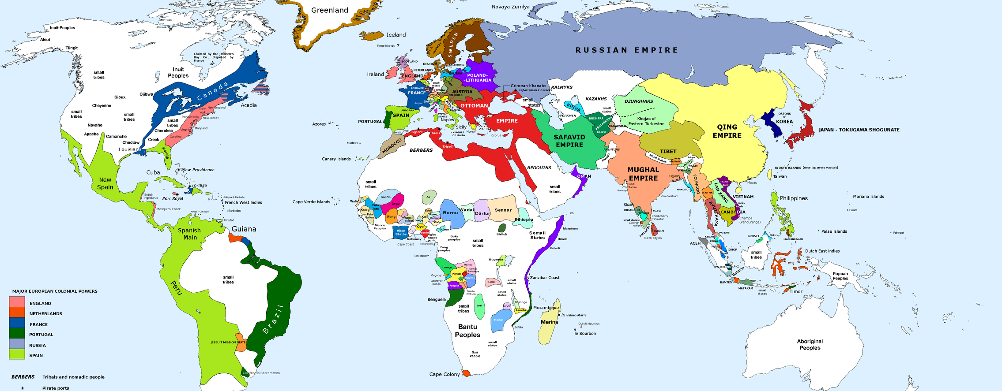
Analyzing and Building Empires (1200-1750 CE)
Exploring the political, economic, and social structures that contributed to the rise and fall of major empires between 1200 and 1750 CE

Slide 2



Overview
Examine Political Structures
Analyze Economic Factors
Understand Social Dynamics
Analyze how centralized governance and bureaucratic systems contributed to the rise and fall of empires.
Investigate the role of trade, agriculture, and resource extraction in driving imperial expansion and prosperity.
Explore how religious tolerance, cultural diversity, and social hierarchies influenced the cohesion and stability of these empires.
By understanding the complex interplay of political, economic, and social forces, we can gain deeper insights into the mechanics of empire-building that still resonate today.

Slide 3







Historical Context
14th Century
1299
Russia emerges from the Mongol Khanate's control and begins to expand its territory under Ivan III and Ivan IV.
Early 16th Century
Osman I founds the Ottoman Empire, which rapidly expands across Eastern Europe, the Middle East, and North Africa.
The Mughal Empire is founded by Babur, becoming one of the wealthiest and most culturally vibrant empires in the world.
18th Century
The Russian Empire becomes a vast empire stretching across Eurasia under the Romanov dynasty.
1368-1644
1453
The Ming Dynasty rebuilds China's centralized government based on Confucian ideals after the collapse of the Mongol-led Yuan Dynasty.
The Ottoman Empire's conquest of Constantinople under Mehmet II transforms it into one of the most powerful gunpowder states.
1644-1912
The Qing Dynasty, founded by the Manchus, expands China's territory to its greatest extent.

Slide 4
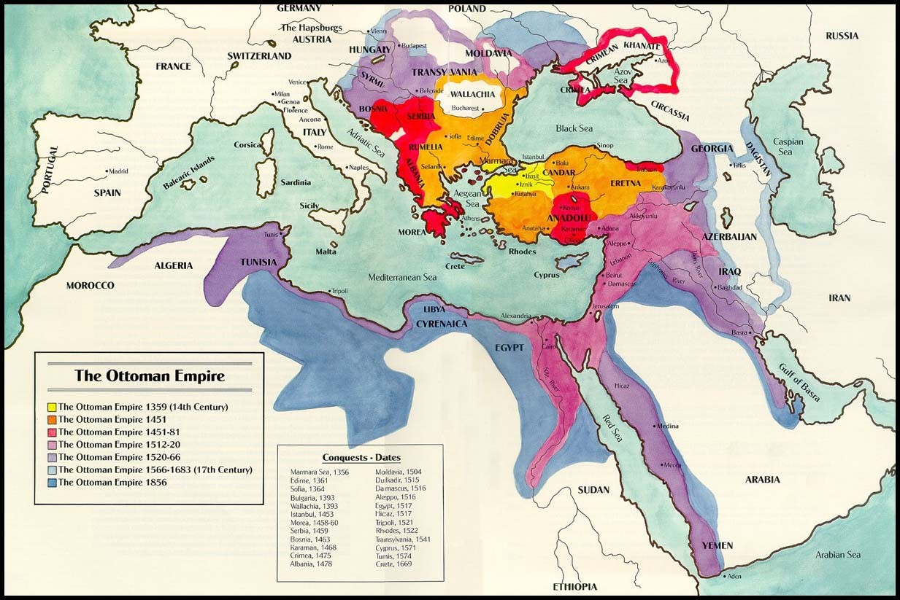
The Ottoman Empire
The Ottoman Empire rapidly expanded its control across vast territories in Eastern Europe, the Middle East, and North Africa. Under the leadership of rulers like Mehmet II, the Ottomans transformed into one of the most powerful gunpowder states, leveraging their formidable military and naval forces to conquer new lands.

Slide 5
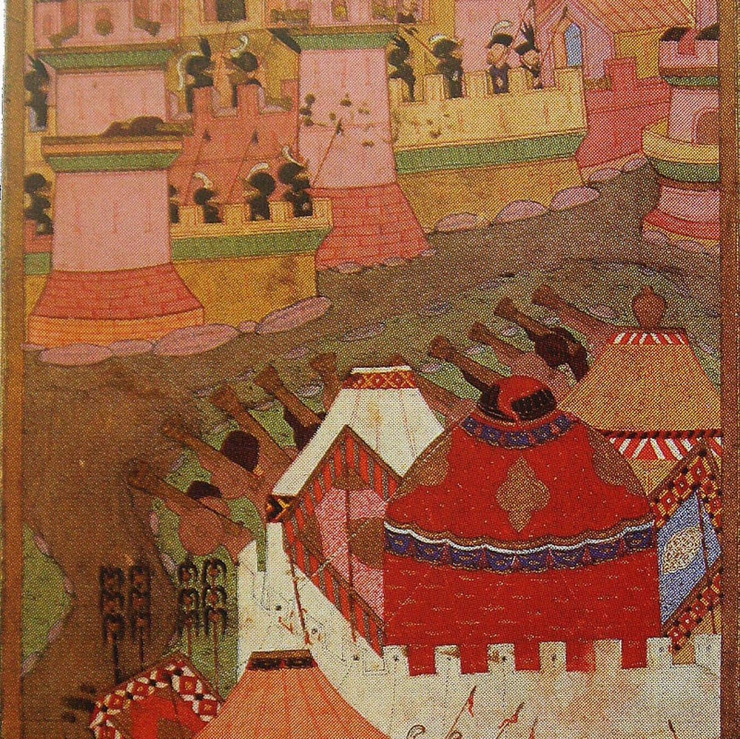
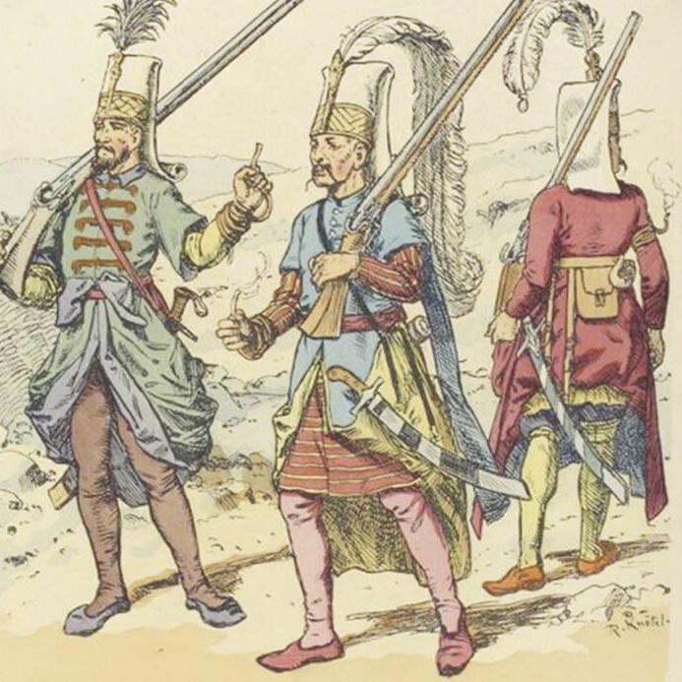
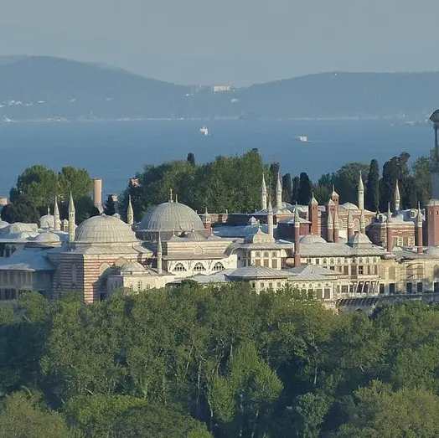
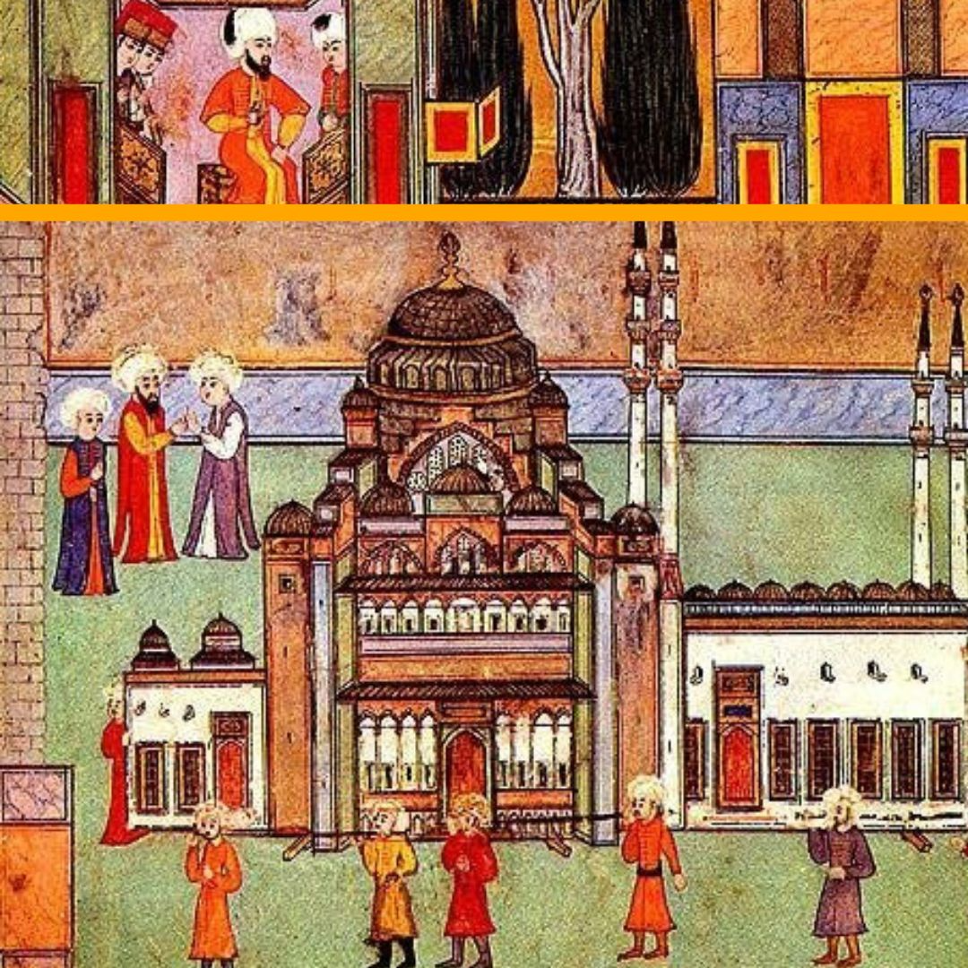
Ottoman Military and Government
Gunpowder Technology
Janissary Corps
Centralized Government
Millet System
The Ottomans were pioneers in the use of gunpowder weapons, including cannons and firearms, which gave them a significant military advantage over their enemies.
The Janissaries were an elite Ottoman infantry force composed of conscripted Christian boys, who were trained and converted to Islam. They were a highly disciplined and effective fighting force.
The Ottoman Empire was ruled by a centralized government under the Sultan, who held absolute power and made decisions on behalf of the empire.
The Ottoman government allowed a degree of autonomy for religious minorities through the millet system, which granted each religious community the right to govern itself in matters of personal law and education.

Slide 6
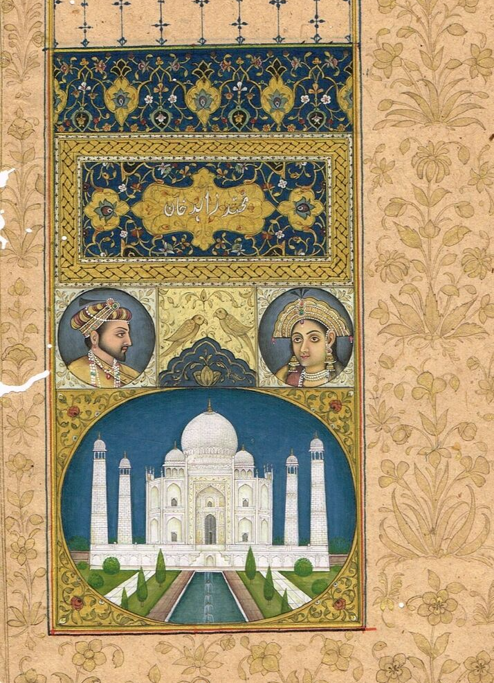
Mughal Empire
The Mughal Empire, founded in the early 16th century, was one of the wealthiest and most culturally vibrant empires in the world. Despite being led by a Muslim dynasty, the Mughals ruled over a majority Hindu population, fostering a rich blend of cultural and artistic achievements.

Slide 7
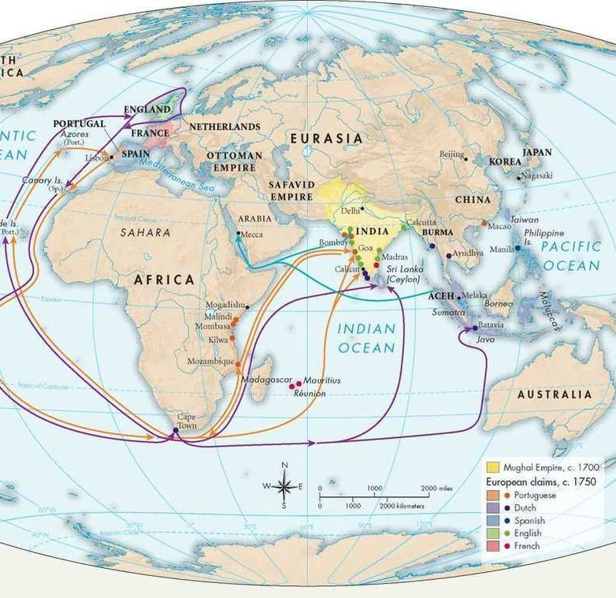
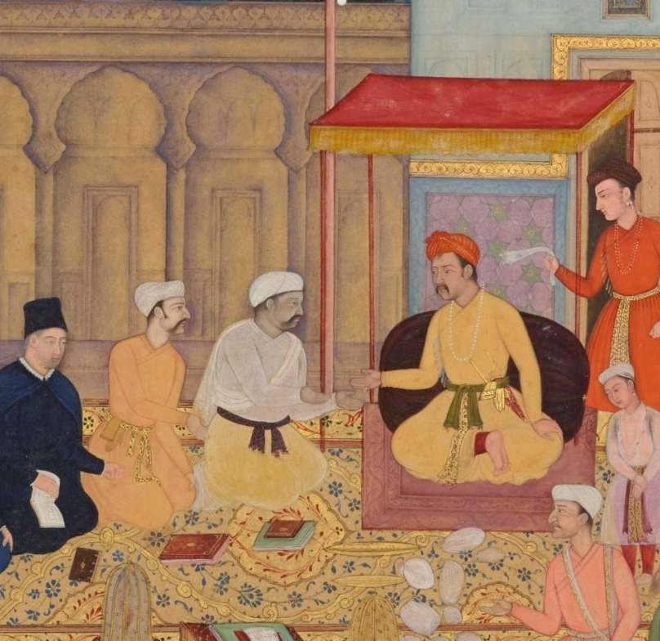
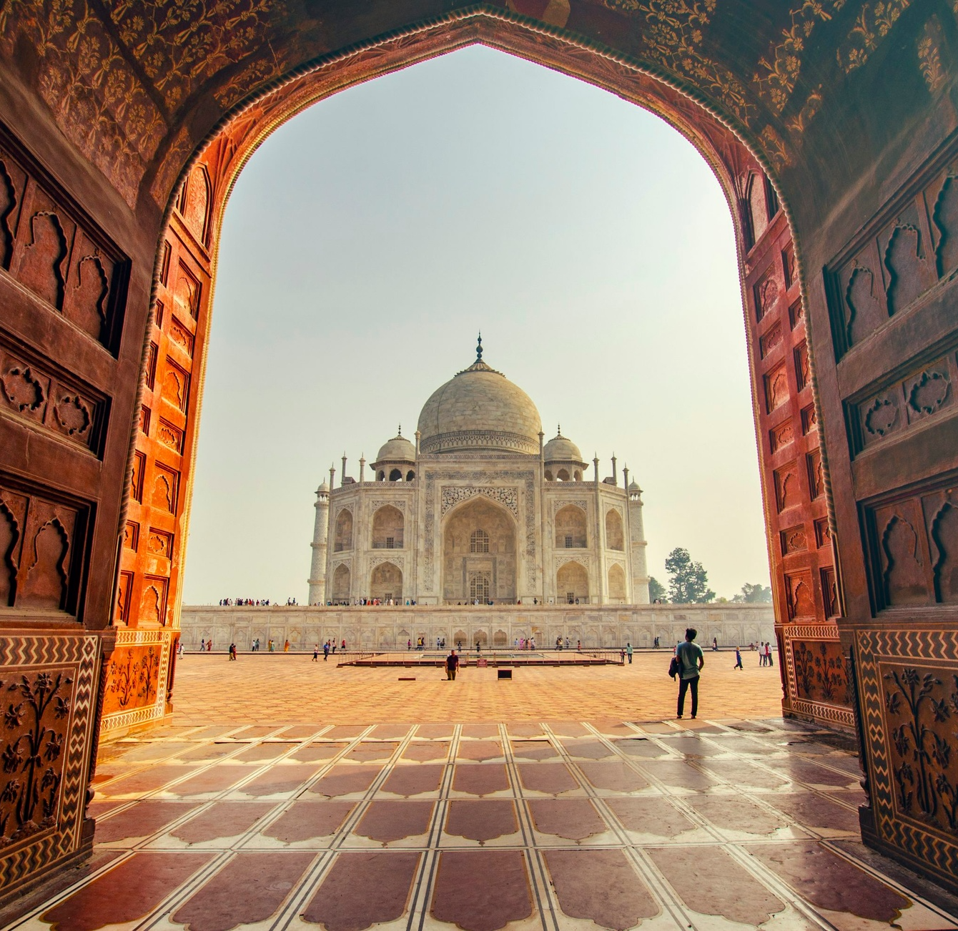
MUGHAL EMPIRE
The Mughal Empire's economic strength was rooted in its control over the lucrative Indian Ocean trade network, positioning India as a hub for textiles, spices, and luxury goods
The Mughal state was centralized under rulers like Akbar, who promoted religious tolerance and administrative efficiency. A strong bureaucracy allowed the empire to maintain control
The Mughals are known for their contributions to art and architecture, including the construction of the Taj Mahal, as well as their synthesis of Hindu and Muslim cultural elements

Slide 8
Ming and Qing Dynasties
Ming & Qing
Ming
1368
China was one of the wealthiest states during this time, with agricultural productivity supporting a large population.
The Ming Dynasty engaged in long-distance trade but eventually turned inward, focusing on consolidating power at home.
The Ming restored China's Confucian-based centralized government after Yuan's fall.
1368-1644
1644
1644-1912
The Ming government built an efficient, centralized civil service.
The Manchu-led Qing expanded China's domain to its peak.
The Qing upheld centralized bureaucracy to govern China's vast populace.

Slide 9
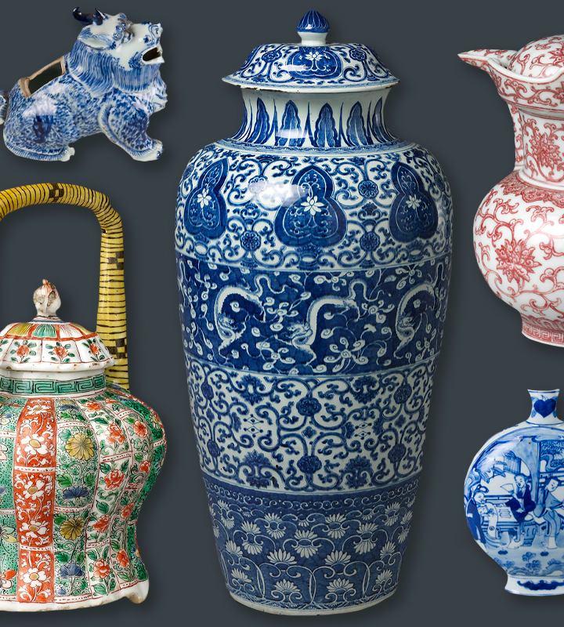
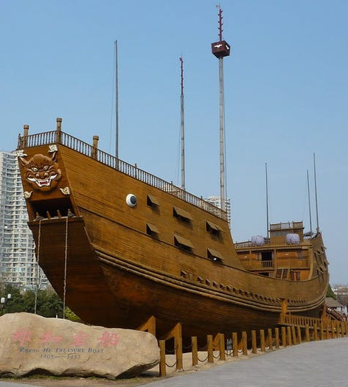
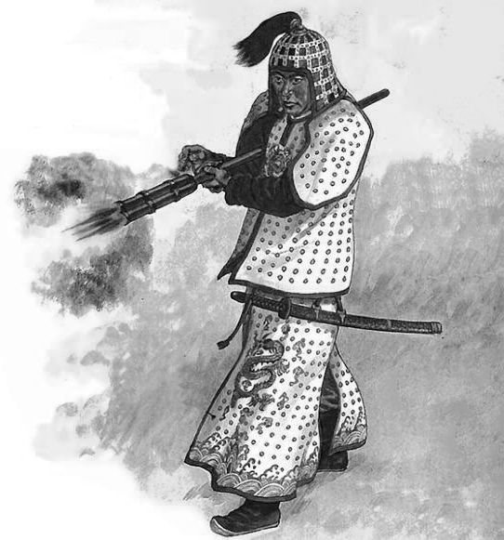
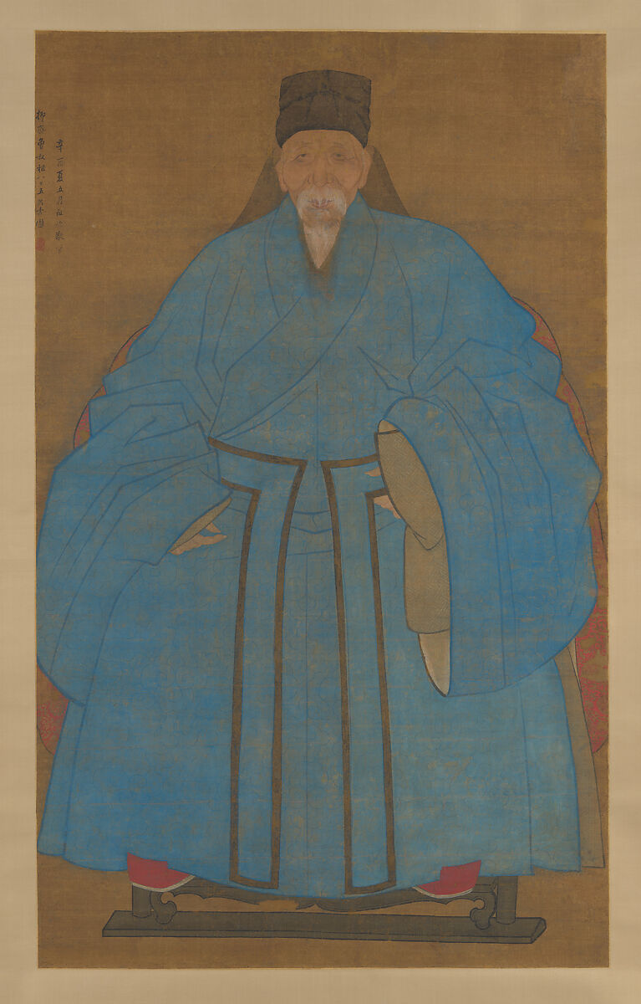
Ming and Qing Achievements
Porcelain Vase
Ming Treasure Ship
Gunpowder Weapons
Imperial Paintings
China was renowned for its intricate and elaborate porcelain production during the Ming and Qing dynasties, with the development of new techniques and designs.
The Ming dynasty's maritime explorations were supported by advanced shipbuilding capabilities, allowing the construction of massive 'treasure ships' that traveled across the Indian Ocean.
Chinese innovations in gunpowder technology during the Ming and Qing dynasties led to the development of various firearms and artillery, strengthening China's military capabilities.
The Ming and Qing dynasties fostered a vibrant arts and literature scene, with court-sponsored artists producing renowned paintings, calligraphy, and poetry.

Slide 10
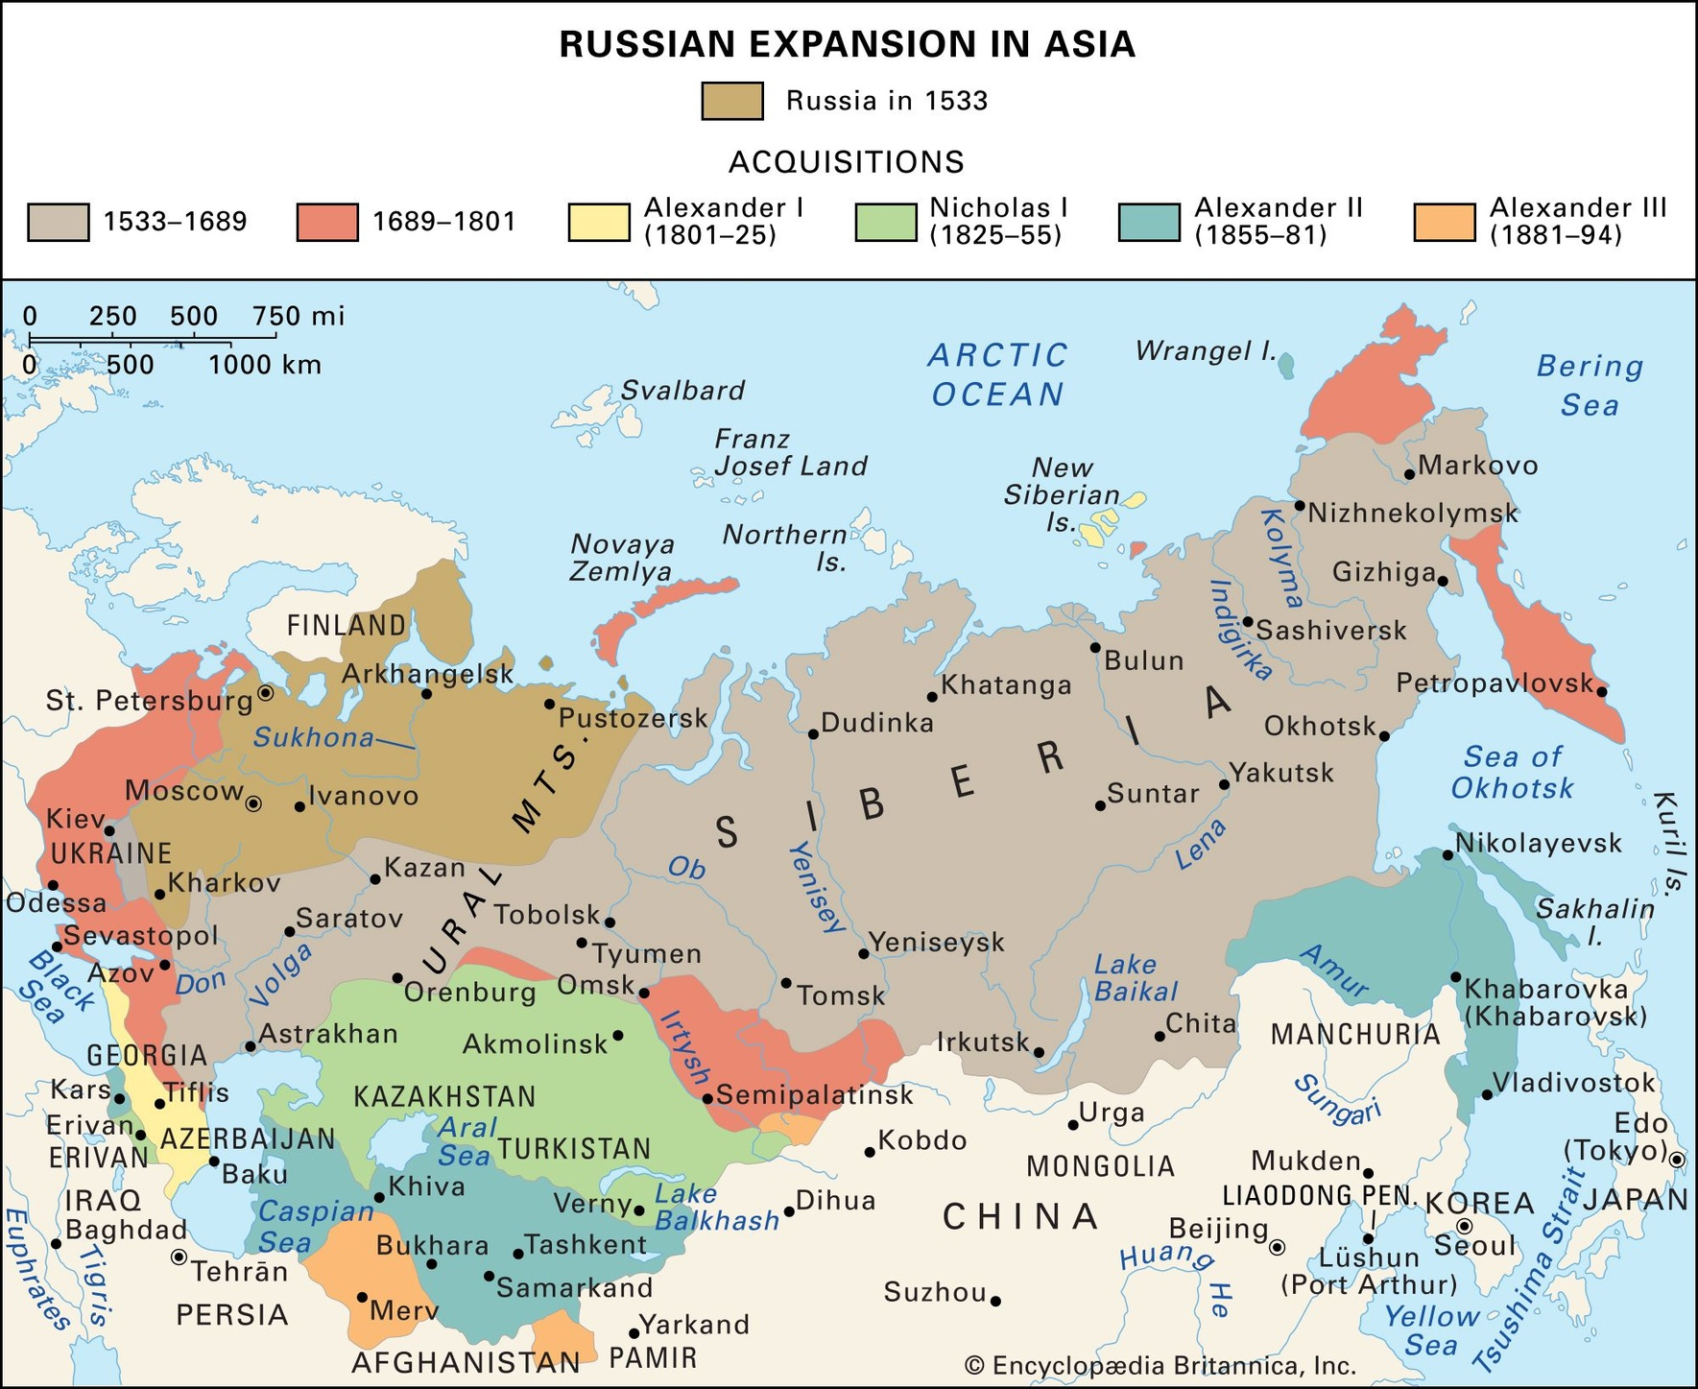
The Russian Empire
The Russian Empire, which emerged from the Mongol Khanate's control in the 14th century, underwent a significant expansion through military conquests. Under the Romanov dynasty, Russia was able to annex Siberia, Central Asia, and parts of Eastern Europe, solidifying its autocratic rule and transforming itself into a vast Eurasian empire.

Slide 11
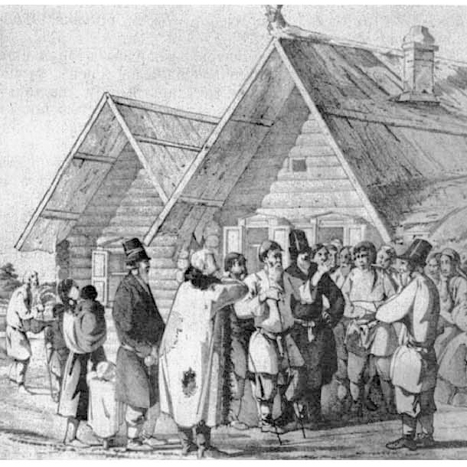
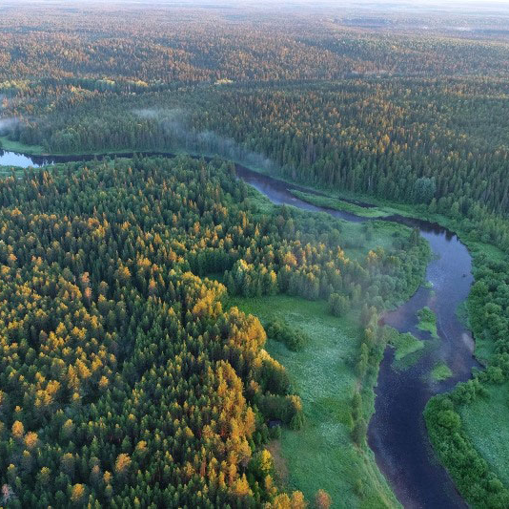
Russian Empire-Building
Russia expanded through military conquests, annexing Siberia, Central Asia, and parts of Eastern Europe, its military might being key in its growth, though it lagged behind Western Europe technologically
Russia's rigid social hierarchy placed immense power in the hands of the boyars (nobles) while the majority of the population lived as serfs, bound to the land and heavily taxed
Fur trading and the exploitation of natural resources such as timber were key economic drivers during Russia's early territorial expansion, which continued to strengthen the empire's economic base as it grew

Slide 12



In-Class Exercise
Analyze Historical Empires
Build Your
Present Your Empire
Using the provided articles, compare the political structures, economic systems, military strengths, social hierarchies, and weaknesses of the Ottoman, Mughal, Ming/Qing, and Russian Empires.
Select the best features from at least three categories (political, economic, military, social) of the historical empires to create your own powerful and resilient
Present your Frankenstein Empire to the class, providing justifications for your choices based on evidence from the readings and lectures.

Slide 13
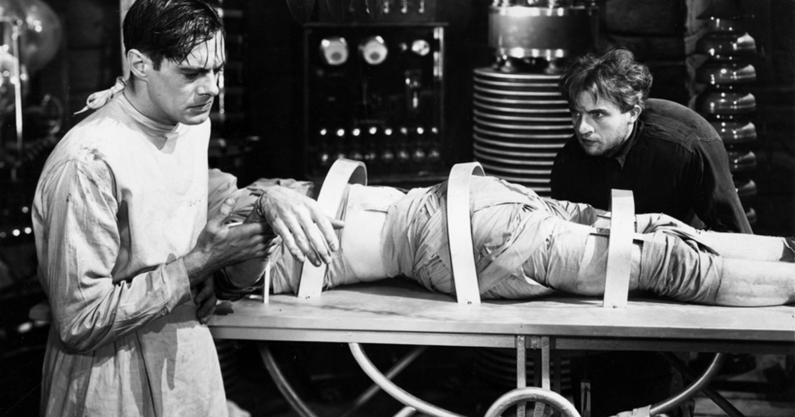
The rise and fall of empires offers valuable insights into the long-term viability of political and economic systems that continue to shape the modern world.

