Slide 1
The Internet and the World Wide Web

Slide 2
What is a web page, really?
Words & Images | HTML | CSS | JavaScript & Server Programs
Notes:
Content
Structure
Style
Behavior *

Slide 3
Web Languages / Technologies
Content and Structure: Hypertext Markup Language (HTML)
Style: Cascading Style Sheets (CSS)
Behavior: JavaScript
Asynchronous JavaScript and XML (AJAX)
JavaScript Object Notation (JSON)
PHP Hypertext Processor (PHP)
Structured Query Language (SQL)
Notes:
Content: Hypertext Markup Language (HTML): used for writing web pages
Style: Cascading Style Sheets (CSS): stylistic info for web pages
Behavior: JavaScript: interactive and programmable web pages
Asynchronous JavaScript and XML (AJAX): accessing data for web applications using fetch requests and promises
JavaScript Object Notation (JSON): file format for organizing human-readable data
PHP Hypertext Processor (PHP): web services for handling and responding to client requests
Structured Query Language (SQL): interaction with databases

Slide 4
The Internet
Wikipedia: http://en.wikipedia.org/wiki/internet
Notes:
A connection of computer networks built on the Internet Protocol (IP)
Layers of communication protocols (click the next slide)
So's the difference between the Internet and the World Wide Web (WWW)?

Slide 5
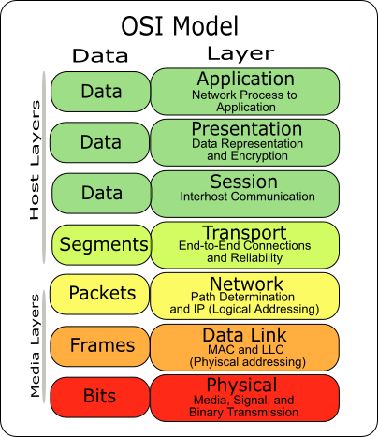
Layered Architecture
Physical layer
Data Link Layer
Network/Internet Layer
Transport Layer
Application Layer
From Web Stepp Book Chapter 1
Notes:
Physical layer: devices such as ethernet, coaxial cables, fiber-optic lines, modems
Data Link Layer: basic hardware protocols (ethernet, wifi, DSL PPP)
Network/Internet Layer: basic software protocol (IP)
Transport Layer: adds reliability to network layer (TCP, UDP)
Application Layer: implements specific communications for each kind of program (HTTP, POP3/IMAP, SSH, FTP)

Slide 6
The World Wide Web
Web server
Apache
Microsoft Internet Information Server (IIS)
(part of windows)
NGINX
Web browser
Mozilla Firefox
Google Chrome
Microsoft Internet Explorer (IE) and Edge
Apple Safari
Opera
Notes:
Web server: software that listens for web page requests
Apache
Microsoft Internet Information Server (IIS) (part of windows)
NGINX
Web browser: fetches/displays documents from web servers
Mozilla Firefox
Google Chrome
Microsoft Internet Explorer (IE) and Edge
Apple Safari
Opera

Slide 7
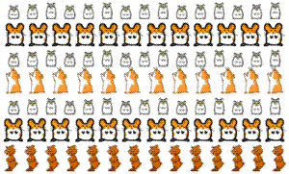
The Internet: A Brief History
The origins of the internet are rooted in the USA of the 1950s.
At this time, computers were large, expensive machines exclusively used by military scientists and university staff.
No one person invented the internet. What we understand to be the internet began as a US Department of Defense network called ARPANET (1960s-70s)
Initial services: electronic mail, file transfer
Opened to commercial interests in late 80s
WWW created in 1989-91 by Tim Berners-Lee
Popular web browsers released: Netscape 1994, IE 1995
Then... all this: http://www.evolutionoftheweb.com
Other notable web events:
Amazon.com opens in 1995; Google in January 1996
Hamster Dance web page created in 1999
Facebook founded in February 2004
Chrome released in September 2008
Snapchat created in September 2011
Notes:
Unlike technologies such as the light bulb or the telephone, the internet has no single “inventor.” Instead, it has evolved over time. The internet got its start in the United States more than 50 years ago as a government weapon in the Cold War. For years, scientists and researchers used it to communicate and share data with one another. Today, we use the internet for almost everything, and for many people it would be impossible to imagine life without it.

Slide 8
Key Aspects of the Internet
Notes:
Subnetworks can stand on their own
Computers can dynamically join and leave the network
Built on open standards; anyone can create a new internet device
Lack of centralized control (mostly)
Everyone can use it with simple, commonly-available software

Slide 9
Who "runs" the Internet? Who is responsible for overseeing it?
Internet Engineering Task Force (IETF)
Internet Corporation for Assigned Names and Numbers (ICANN):
Notes:
Internet Engineering Task Force (IETF): Internet protocol standards
Internet Corporation for Assigned Names and Numbers (ICANN): decides top-level domain names
World Wide Web Consortium (W3C): web standards
IETFICANNW3C
These protocols are carried out in large part by Internet service providers and other companies and organizations who build Internet-related products and applications

Slide 10
The World Wide Web (WWW) --- Wait, how is it different than the Internet again?
Uniform Resource Locator (URL)
An identifier for the location of a document on a web site
A basic URL:
Hypertext Transport Protocol (HTTP)
GET filename: download
POST filename: send a web form response
PUT filename: upload
Notes:
The Internet describes all the interconnected devices that use the "internet protocol." The World Wide Web is the subset of the Internet that uses the HTTP and HTTPS protocols, mostly to transmit "webpages.“
Uniform Resource Locator (URL)
An identifier for the location of a document on a web site
Upon entering this URL into the browser, it would:
Ask the "DNS" server for the IP address of courses.cs.washington.edu
Connect to that IP address at port 80
Ask the server to GET /courses/cse154/18au/index.html
Display the resulting page on the screen
Hypertext Transport Protocol (HTTP)
The set of commands understood by a web server and sent from a browser
Some HTTP commands (your browser sends these internally):
GET filename: download
POST filename: send a web form response
PUT filename: upload
We will learn more about GET and POST when we start the server-side programming module of this course

Slide 11
HTTP Error Codes
When something goes wrong, the web server returns a special "error code" number to the browser, possibly followed by an HTML document
Common Error Codes:
Number | Meaning
200 | OK
301-303 | page has moved (permanently or temporarily)
403 | you are forbidden to access this page
404 | page not found
418 | I'm a teapot
500 | internal server error
Complete list... as cats
Notes:
The Real Innovation
HTTP built resilience into the internet by creating the 404.
A website will always give a response, even if what a user wants isn't found.

Slide 12
What is a web page, really?
Content | Structure | Style | Behavior
Words & Images | HTML | CSS | JavaScript & Server Programs

Slide 13
Content
Words and Images

Slide 14
Structure
HTML

Slide 15
Style
CSS

Slide 16
Activity: Rebuilding the Internet
In brief, start from scratch and redesign the internet in any medium using only analog tools.
First, think about these questions:
What is the internet?
How does the internet work?
Where does the internet live?
Who lives there?
What is the internet for?
Then, read around, skim, browse Small Pieces Loosely Joined by David Weinberger. Start by glancing at the preface and chapter 1, but click around the site for the book. It offers one theory of what the web is.
More importantly, though, think about what the web is for you.

Slide 17
Rebuilding the Internet, continued
Now, working on your own or with a group, use only analog tools, like fingers, paper, scissors, mechanical (not digital) tools to represent, reassemble, reimagine the internet. Your work can be interactive or static, 2-dimensional or 3-dimensional, a conceptual map or a more literal one.
Remediate your work back into digital space by taking photograph(s) or video of it. Publish on Slack in the #rebuild-the-internet channel and include an artist’s statement describing the what, why, and hows of your process.

