Slide 1

Creating an exhibit

Slide 2
What is an Exhibit?
Exhibits are curated digital showcases combining images, text, audio, video, and other uploaded items into coherent narrative for people to browse. They tend to connect to the overarching themes of the site, contextualizing items with complementary narratives.
When building exhibits, it is important to remember that items cannot be created spontaneously in Omeka, but thought must be given to site structure from the outset. You have started to create the items, started to sort them into collections, and finally you will now exhibit them, perhaps pulling from multiple collections for one exhibit.

Slide 3
Omeka Projects (a sample)
The following is a list of well-known digital humanities projects that use Omeka Classic.
September 11 Digital Archive. Sheila Brennan, Sharon Leon, and the Project Team
Hurricane Digital Memory Bank. Sheila Brennan and the Project Team
Colored Conventions: Bringing Nineteenth Century Black Organizing to Digital Life. P. Gabrielle Foreman and Jim Casey
Last Seen: Finding Family After Slavery. Judy Giesberg and Jesse Nasta.
Baltimore 68: Riots and Rebirth. Langsdale Library Special Collections
Histories of the National Mall. Sharon Leon, Sheila Brennan, and the Project Team
Bracero History Archive. Sharon Leon, Tom Scheinfeldt, and the Project Team
Preserve the Baltimore Uprising 2015 Archive Project. Denise Meringolo and Joe Tropea
Fifteenth-Century Italian Art (Nicole Riesenberger)
Goin’ North
Ice Age Flood Explorer (Chad Pritchard, Larry Cebula, and Paul Lindholdt)
James Monroe Papers (Alexandra deGraffenreid, Seth Mintzer, MacKenzie Murphy, Chris Wright)
Fredericksburg: City of Hospitals (Jeffrey McClurken)

Slide 4
Omeka’s Internal Logic
Everything is organized into collections. Collections are composed of related items. Collections/items hierarchy is the base organization. Collections have their own descriptive metadata.
Exhibits are a way for you to showcase or contextualize items and pair them with text, timelines, etc. to tell a particular story.
Tags: Omeka allows you to add tags to items and collections. You can then browse by tags or search them. This is one way of mapping your own organization onto your content.
Simple Pages: Simple Pages allows you to create pages without digital objects (items).

Slide 5

Start to think about Organizing Your own Content
Omeka's internal organization maps closely to a physical museum’s organization.
Think of an item as a painting on the wall of a museum. Note that the item has accompanying metadata (information about its provenance and descriptive details).
The museum may organize items into permanent collections based on shared characteristics or donors.
Items from multiple collections may be combined and contextualized in an exhibit. Often, text accompanies the items and tells a story. Just as exhibits are temporary in museums, exhibits are unique to Omeka. You can export items and collections from Omeka, but you cannot export exhibits.

Slide 6
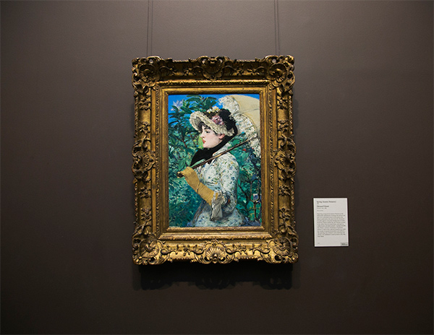
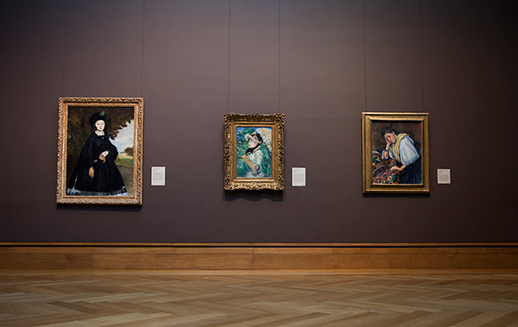
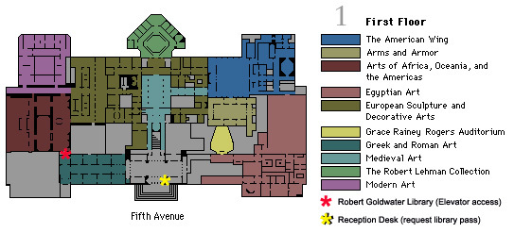
COLLECTION
ITEM
EXHIBITION | EXHIBIT
Notes:
Omeka’s organization is inflexible. Items are the base level. All content will be uploaded as items. Then items are assigned into thematic collections. Collections have their own metadata and you’ll need to give them a description, so it’s important that the items within a collection have something in common. Some kind of logical connection. Items can belong to only one collection. Exhibits exist a bit outside this hierarchy. You can think about them the way you’d think of museum exhibits.

Slide 7
Finding Digital Materal
As you search for Items to add to your collection, always be mindful of copyright restrictions.
If an image or text is from an electronic database (i.e., ARTStor) or a website owned by an organization, there are rules on how you can re-use and display their materials on your Omeka site. And while some materials are in the "public domain" there may be rules on how to use them if an organization manages their access.
The following resources will help you jump start your collection.
Digital Collections:
Wikimedia Commons
Internet Archive
DPLA
New York Public Library
Hathi Trust Digital Library
British Library Labs
There are more Resources on our class website’s Resources page as well as our Resources for Historians page.

Slide 8

Preparation
Prior to starting an exhibit, you will need to have two things accomplished:
1. Outline of exhibit, including text and image/files needed for display. This information should be located in your wireframe, outline, and Zotero files.
2. Load digital files into Omeka. For instructions on how to load content into Omeka, please see What is Dublin Core? Metadata, CMS, and Omeka

Slide 9
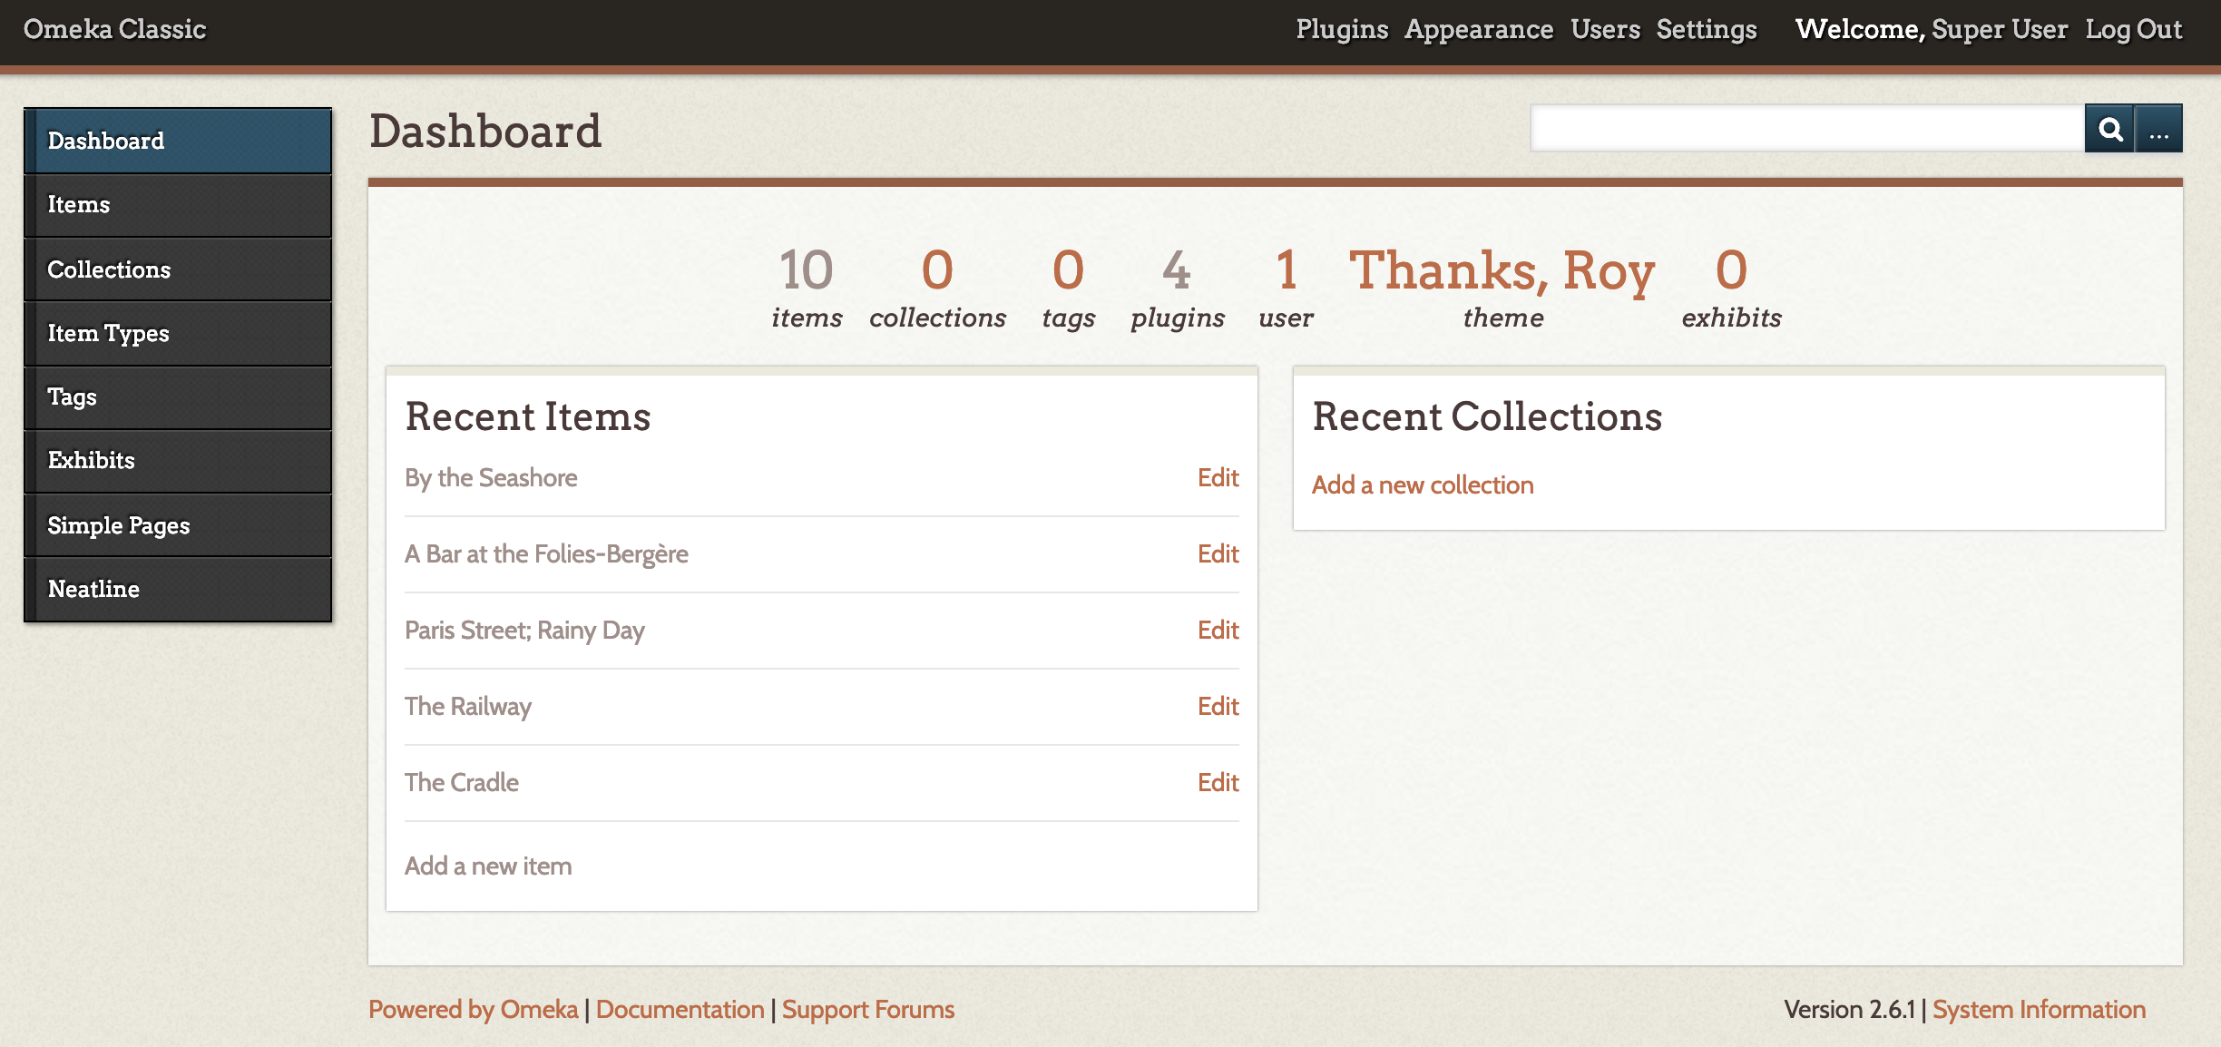
Navigate to your omeka dashboard

Slide 10
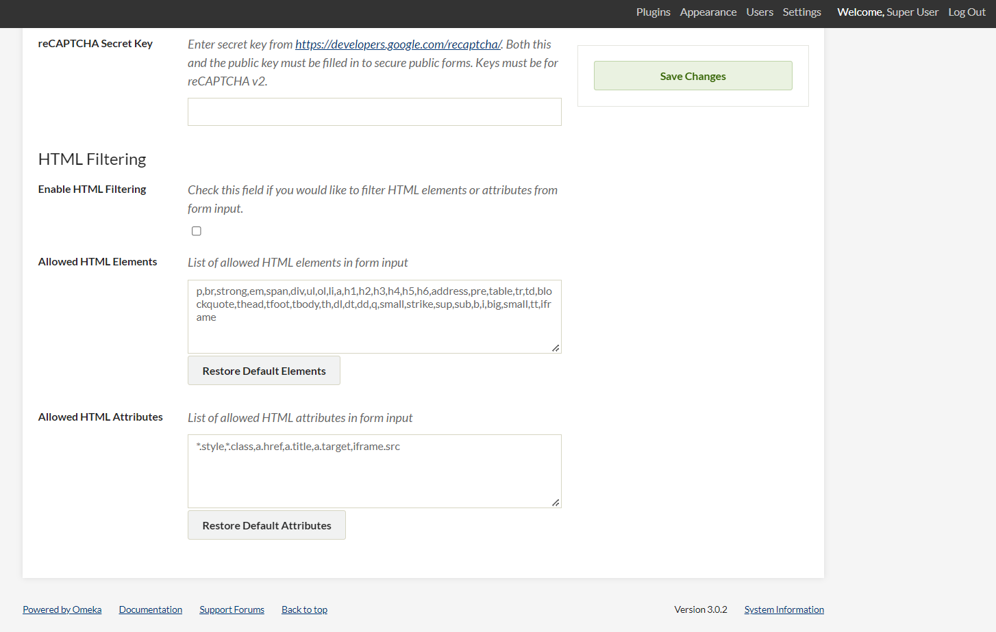
Housekeeping – adding iframes
Step 1: Navigate to “Settings” in the top right corner. Click.
Step 2: Click on the “Security Tab”
Step 3: Scroll down to “HTML Filtering”
Step 4: add iframe to “Allowed HTML Elements”
Step 5: Add iframe.src to “Allowed HTML Attributes”
Step 6: Save changes.

Slide 11
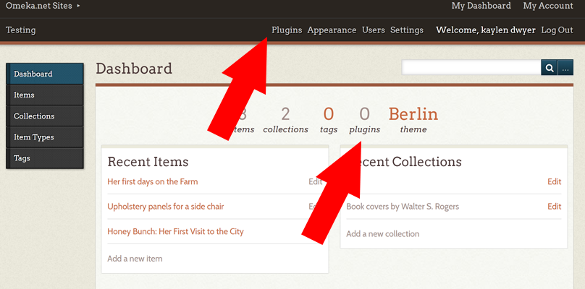
Add the exhibit builder plugin
To build an exhibit, you must first install the Exhibit Builder Plugin.
Access plugins from your dashboard either from the top menu or from the main dashboard menu on the home screen.
Notes:
We have no exhibits currently defined. In fact, we don’t yet have the capability to even create exhibits. Let’s fix that now. As you may remember from the first tutorial, when we want to add functionality to Omeka, we can activate plug-ins. Exhibit Builder is one such functionality. To enable this Plug-In, choose Plugins from the top menu and click the Install button beside the Exhibit Builder.

Slide 12
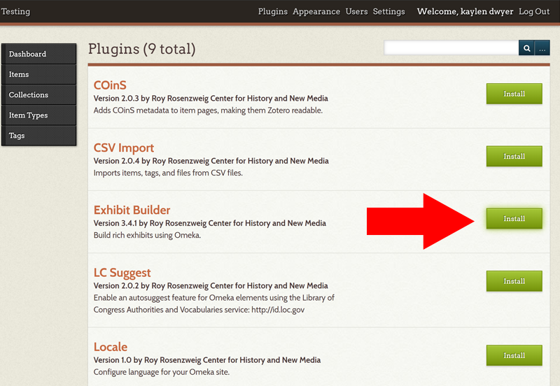
Install the Exhibit Builder plugin from the list of plugins.
After installing the plugin, you may choose whether users will browse the exhibits by date added, alphabetically by name, or by most recent.

Slide 13
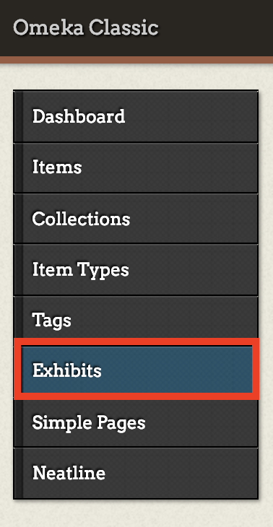
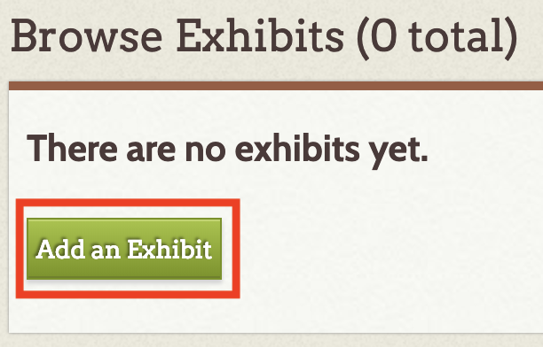
STARTING A NEW EXHIBIT
Click the exhibits tab in the left-hand navigation bar.
Then click the “add an exhibit” button.
Notes:
Although we have no exhibits (yet) the button to create one is right there. Choose ‘Add an Exhibit’. Much as we have already seen, you are asked to create metadata describing the new Exhibit. The Exhibit is in fact a digital object itself.

Slide 14
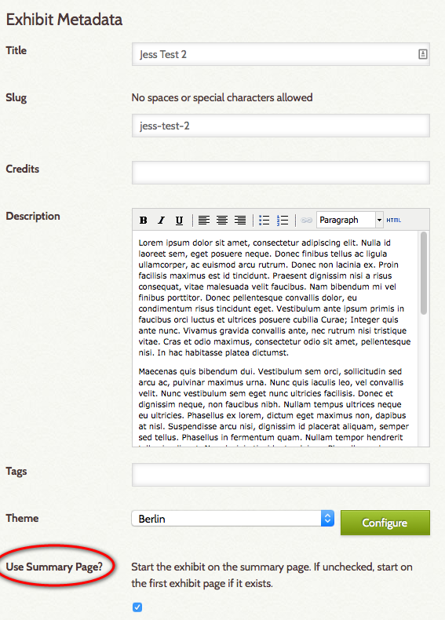
Provide Metadata for your exhibit
Fill out the metadata fields to describe your exhibit.
Choose a Title for your exhibit and a short memorable ‘slug’ that will appear in the URL address for the exhibit (descriptive portion of the URL that indicates the exhibit name).
You can input information about the credits (you) and provide a short description about the exhibition to aid potential users – a short, catchy abstract if you wish.
  Note: The description will appear in the “Browse Exhibits” list created in Omeka’s public interface. Keeping this text to a minimum will create a better user viewing experience for the user later on.
  If you fill in the "Description" box on your "Exhibit Metadata" page and use this as the first page in your exhibit by leaving "Use Summary Page?" box checked.
  Uncheck the "Use Summary Page?" box to make the top Exhibit Page the first page in your exhibit
At the top right hand corner, click on “Save Changes” to save the work done so far. Checking the box for “Public” or “Featured” will allow the exhibit to be viewable to the public or featured on the main page. These options can be selected at this time, if desired, but it is advisable to wait until after the exhibit is finalized to select these options.
  Note: The exhibit creator has the option to “View the Public Page” at any point without making the exhibit public. This option becomes visible once the exhibit has been saved for the first time.

Slide 15
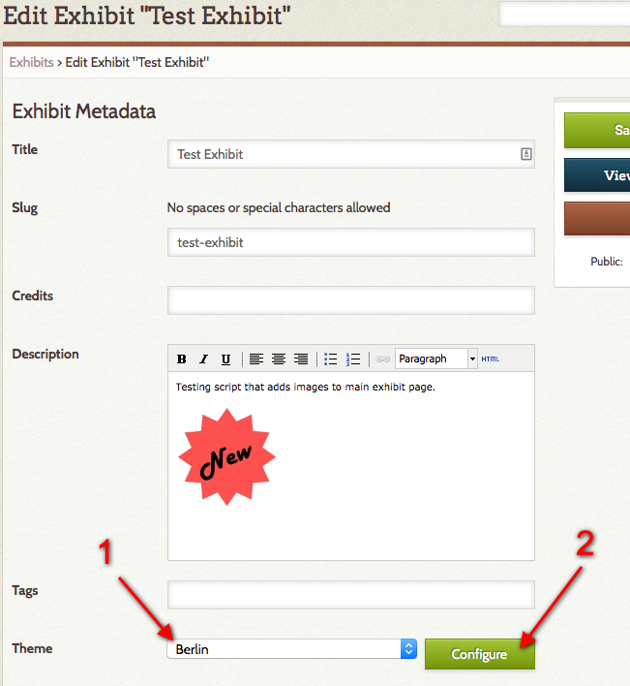
Exhibit Themes and Custom Banners
At this point, or any point later on, it is possible to change the layout of the exhibit using the “Theme” option on this main page. The default is set to the “Current Public Theme” which means that the exhibit will have the same layout and theme as the main Omeka website
  Additional theme options are based on what themes have been loaded onto your Omeka site, similar to how plugins are added. We will go over how to add new themes and plugins later, but, first, let’s review the “Berlin” theme.
To add an exhibit banner image to your Omeka exhibit, go to your exhibit Edit screen.
Next, select "Berlin" from the Theme drop-down menu (1) and click the green "Configure" button (2).

Slide 16
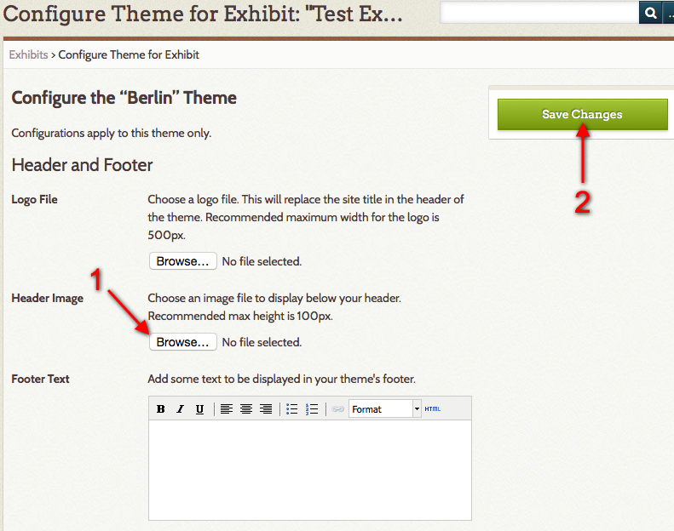
Configuring your theme
On the configuration screen, upload a banner image as a "Header Image" by clicking the Browse button (1) and selecting your banner image for upload.
Note: For optimal display, size your banner image to be 100 pixels in height
Then click “Save Changes” (2).
This banner image will display on all of your exhibit pages.

Slide 17
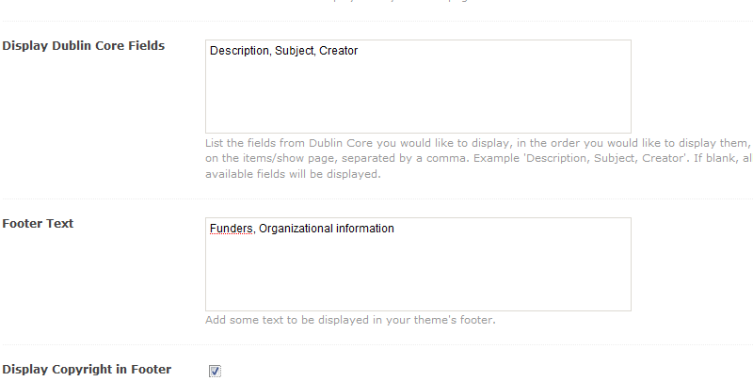
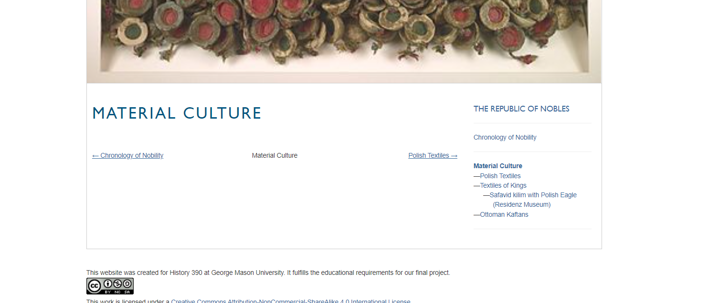
Configuring your theme, Continued
Homepage Text: Add some text to be displayed on your homepage above the Featured Items. This is a good place to add a very short tagline or description of your site. Save longer explanations for an About page.
Footer Text: Add some text to be displayed in your theme’s footer. This can be a good place to add credits, information on the website is for educational purposes
Display Copyright in Footer: Check this box if you wish to display your site’s copyright information in the footer.
  Site copyright information is found in the General Settings section. This is where you will put your Creative Commons or Copyright information.
Click “Save Changes” at the bottom of the screen to save all of your customizations.

Slide 18
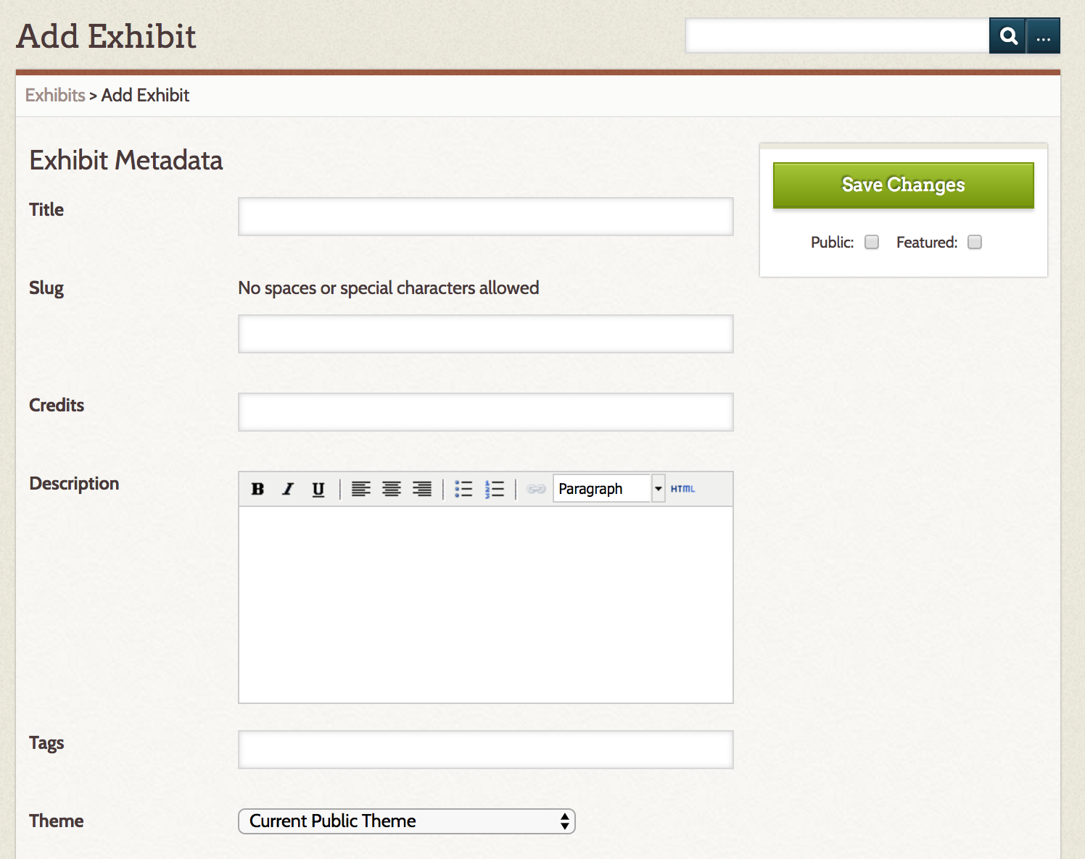
Saving your exhibit
!
At the top right hand corner, click on “Save Changes” to save the work done so far.
Checking the box for “Public” or “Featured” will allow the exhibit to be viewable to the public or featured on the main page.
  These options can be selected at this time, if desired, but it is advisable to wait until after the exhibit is finalized to select these options.

Slide 19
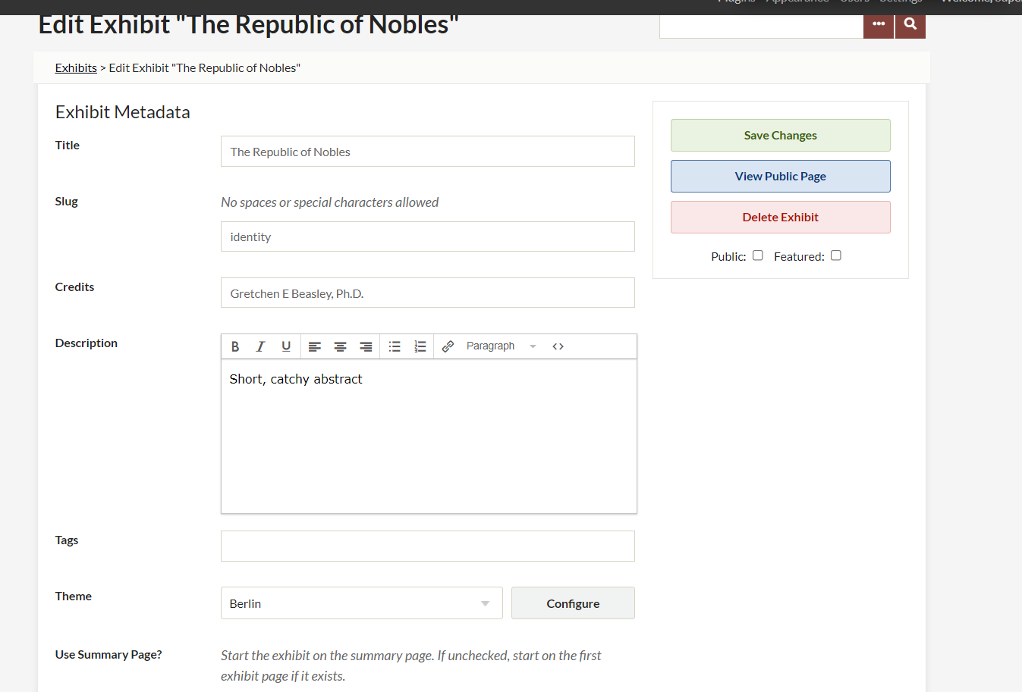
VIEWING your exhibit
Note: The exhibit creator has the option to “View the Public Page” at any point without making the exhibit public. This option becomes visible once the exhibit has been saved for the first time.
Once the exhibit is saved, a “View Public Page” button will appear below the “Save Changes” button. This allows for immediately viewing the collection as a patron would view it.
  It is a good way to test your work.

Slide 20
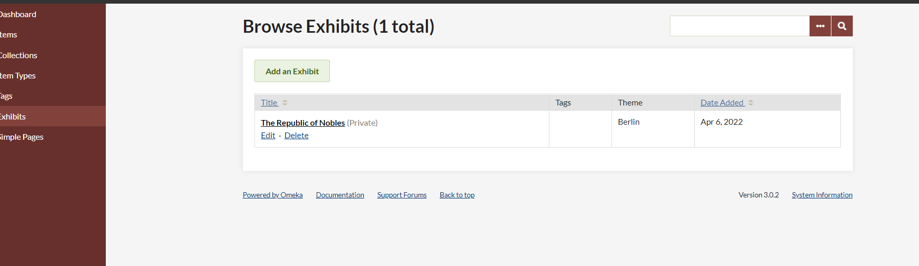
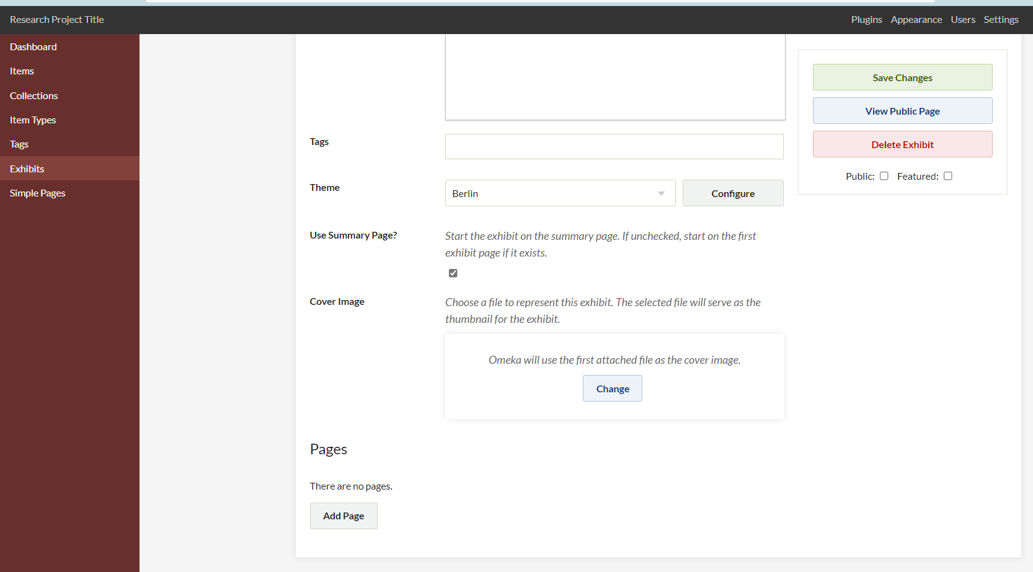
ADDING PAGES
Exhibits are composed of dynamic pages that combine items from your repository with narrative to tell a story.
Best practice in creating an exhibit would involve sketching out your objectives and structure in (your outline and wireframe) – for purposes of this tutorial we are going to work to a predefined path.
Choose the Edit link from below the Exhibit title, hit “Edit” and scroll to the bottom of the project metadata page.
You will see a button inviting you to ‘Add Page’. Go ahead – press it.

Slide 21
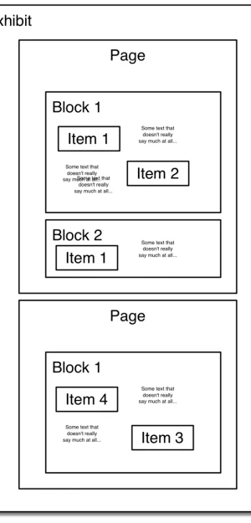
Note: Exhibits are composed of individual pages which are themselves composed of a series of blocks each of which can contain items drawn from Omeka as well as text and captions that you create to narrate your exhibit.
This schematic illustrates this hierarchy.
Let’s move on to the Page Builder screen.

Slide 22
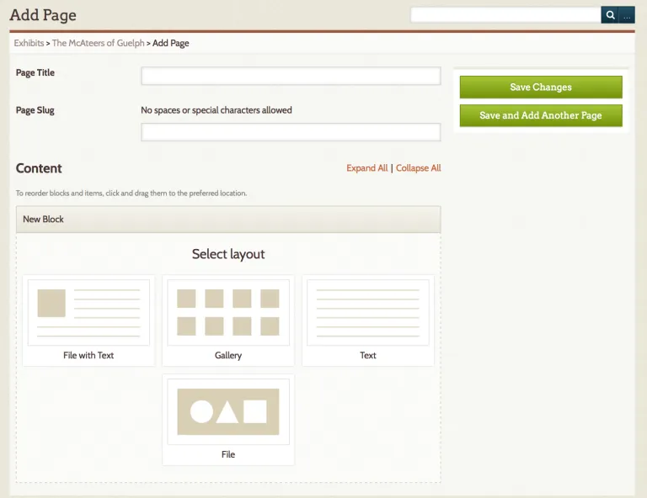
Each exhibit needs to have pages filled with the content for that exhibit.
Pages are composed of blocks of text and items. Give your page a title (which will be used for navigation) and a slug for use in the URL.
I like to start off with an introduction (but make sure to name it something other than “Introduction”).
To begin creating content we choose a layout for the first block.

Slide 23
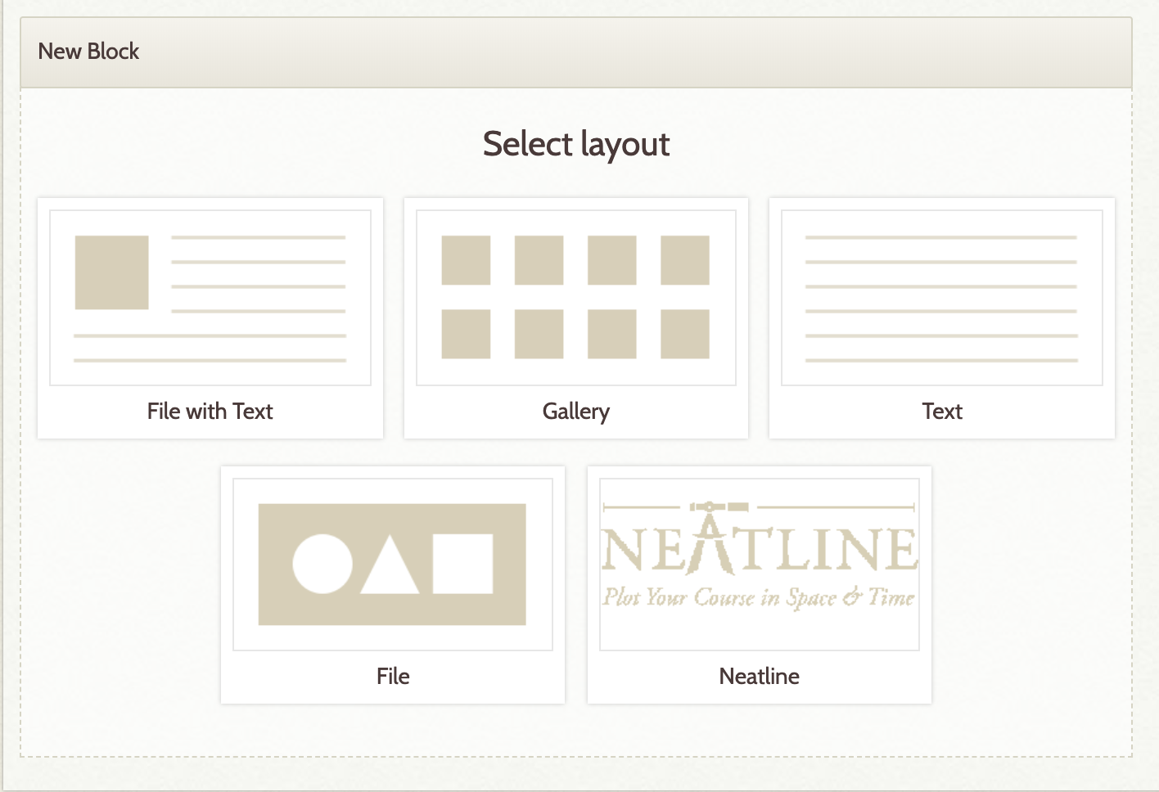
To begin creating content we choose a layout for the first block. Let’s kick off by choosing a ‘File with Text.
Choose one of the following content blocks to populate your exhibit's page:
* File with Text: Digital file that can be anchored left or right with surrounding text. *
* Gallery: Layout concentrates on digital files, but some text is allowed.*
Text: Layout includes text only, with no associated digital files.*
*File: Digital files without surrounding text *
* Neatline (don't worry about this function yet).

Slide 24
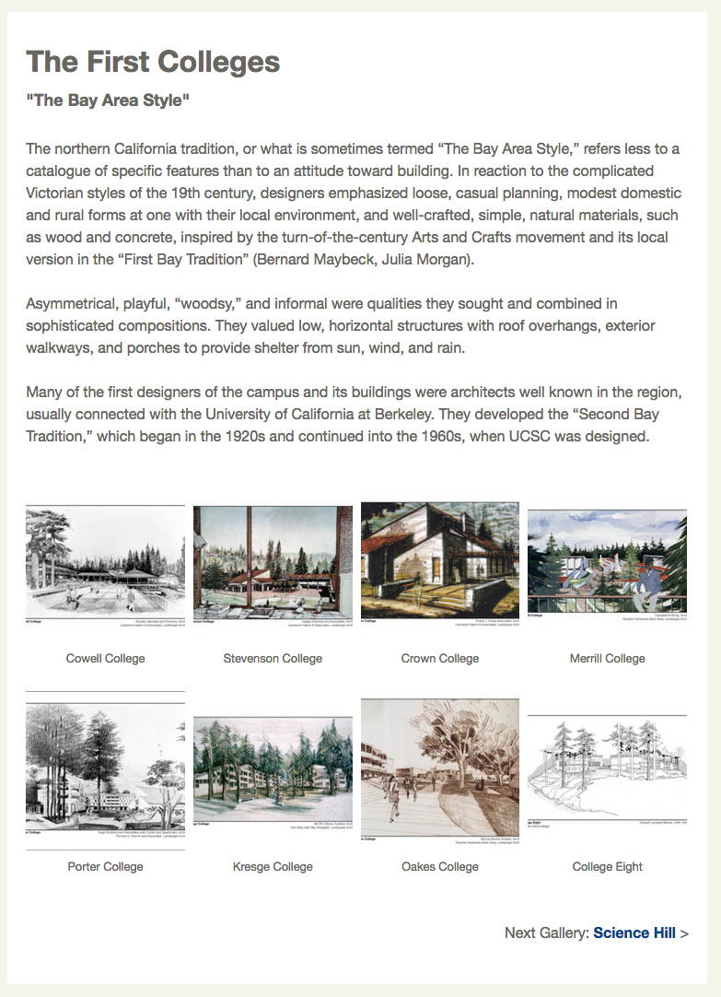
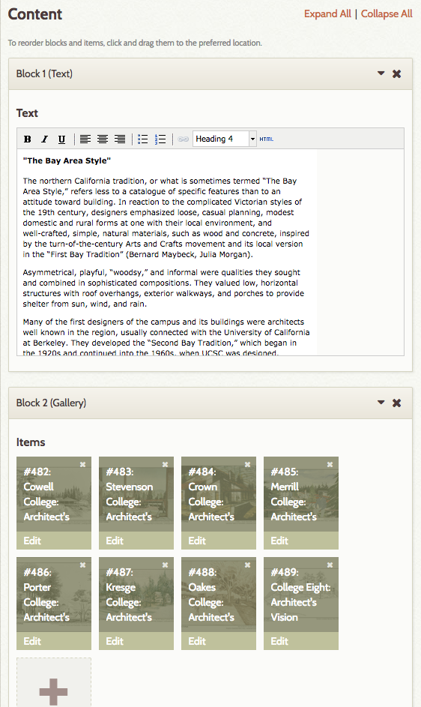
Examples of Page blocks
Same Page in Public view
Content Blocks on a Page in Admin view

Slide 25
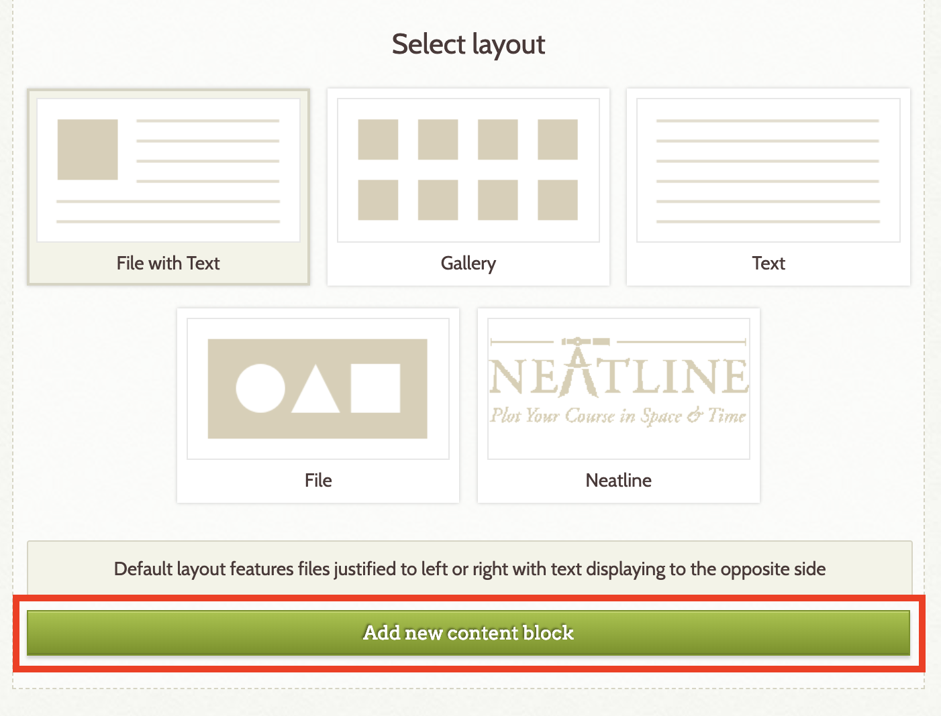
Let’s add Our First Block by selecting ‘Add New Block’ beneath the “Select layout” section.

Slide 26
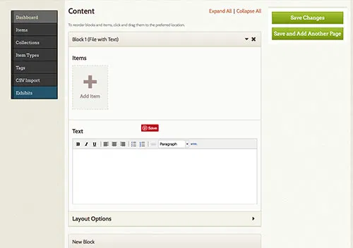
Clicking the ‘Add Item’ will let you select from all of the items in your collection.
Choose an image of interest.
NOTE: You can add multiple views of the item here (The images will be stacked).

Slide 27
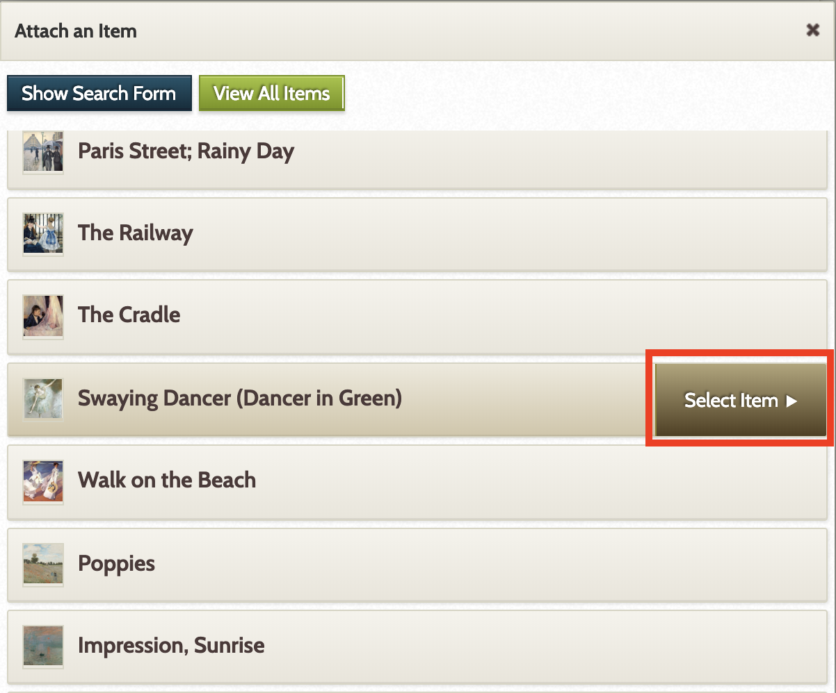
Next you should see the "Attach an Item" window, where you can browse the Items that have been uploaded to your Omeka site.
You will be presented with a list of the items in your install.
Click the item you want to add to your exhibit page's content block and click “select item”.
If you have a large quantity of Items available on your site, you may prefer to use the Search Form to locate the Item you are interested in adding to your exhibit. To access these search options, click the blue "Show Search Form" button.

Slide 28
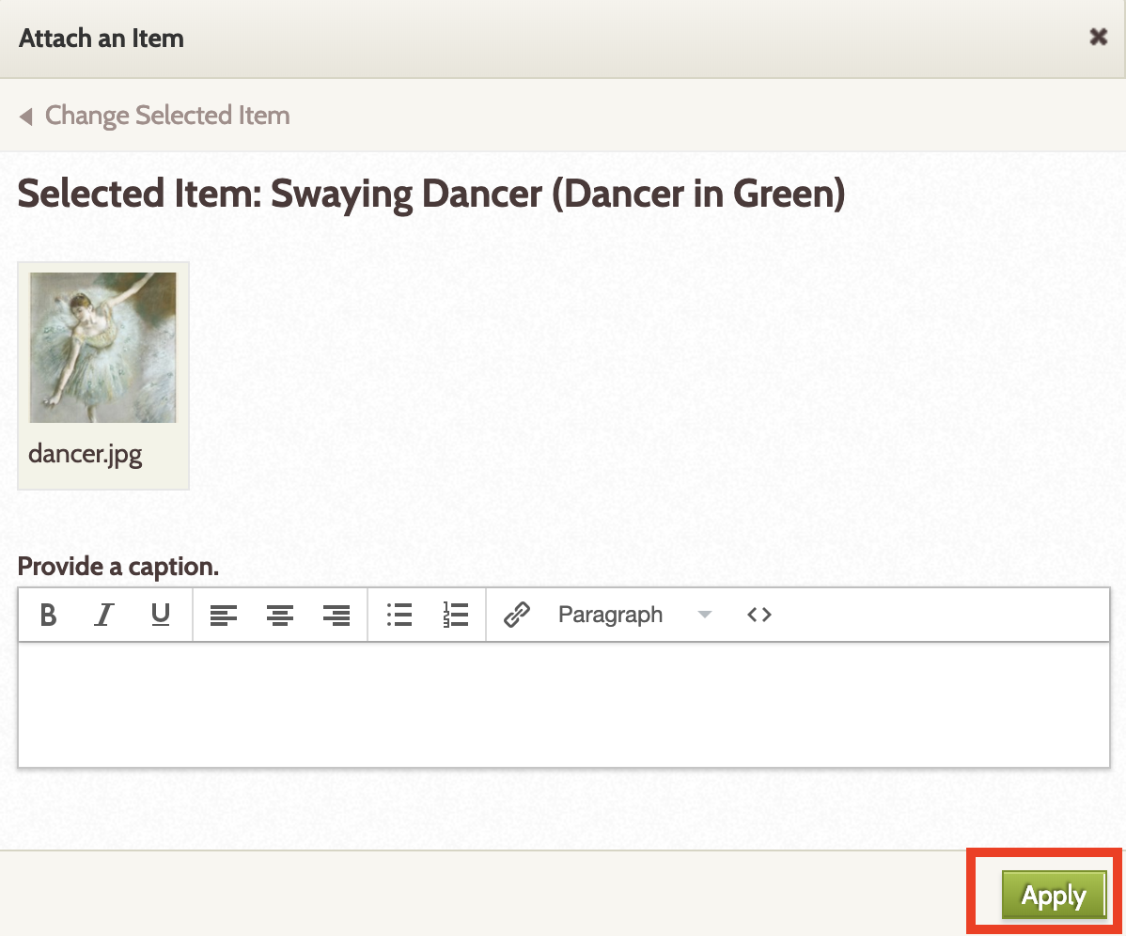
Omeka then allows you to add a caption to the item you insert.
  The caption can simply be a title or more of a discussion about the image.
    For example, you can have a caption that states “The Medieval Machine Gun”. There is no need to add anything else because the metadata lives in the item CMS.
  Or, you can add more information about the image, itself. Something that is important to understand the image, but not necessarily part of the textual narrative that you are writing for the exhibit.
  “The Medieval Machine Gun
    Lightweight and portable, the English longbow was the super-weapon of its time. Accurate at distances over 200 meters, an archer could shoot over 12 arrows every minute. Shot in volleys, these arrows created an inescapable and deadly cloud.”
Repeat this process until all digital files needed for the content block are loaded. Digital files can be rearranged by clicking and dragging the thumbnails. They can also be deleted by clicking on the “x” in the upper right-hand corner of the thumbnail.
Click “Apply” when done.

Slide 29
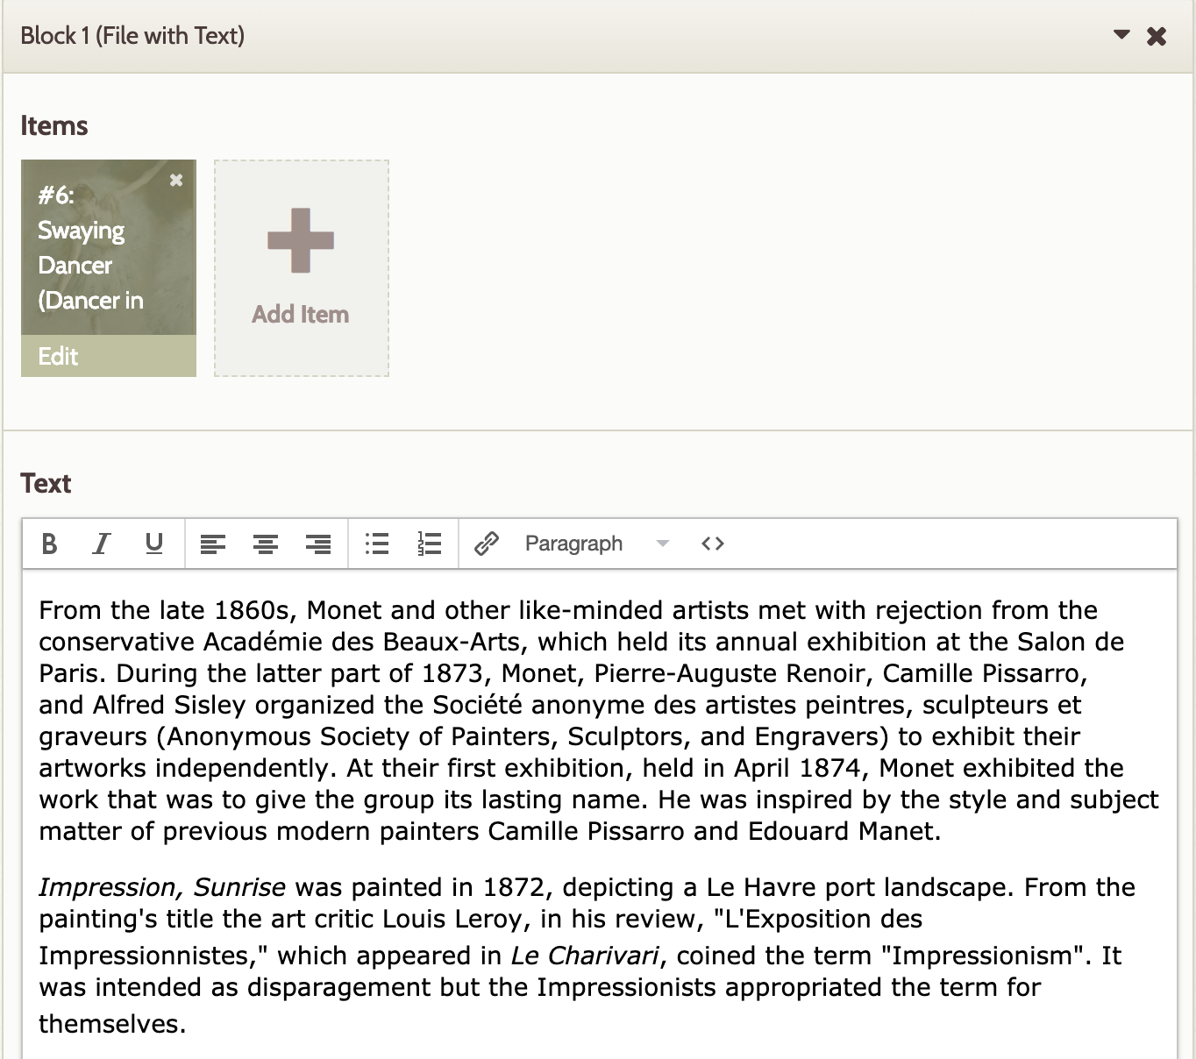
When adding text to any content block you may use the basic text editor (shown to the right)
  or the HTML Source Editor, a more advanced option that will allow you to write and edit the code directly. To open the HTML Source Editor, click “< >" in the basic text editor.
You can then add additional text that will be work with the item; this will be displayed on your exhibit page..
You can also add HTML links here.
  Highlight the text that you wish to link
  Click the chain icon on the top bar
  Enter the link URL in the "Link URL" field
  Click "Insert"
When you are finished, click the "Update" button to save your changes.

Slide 30
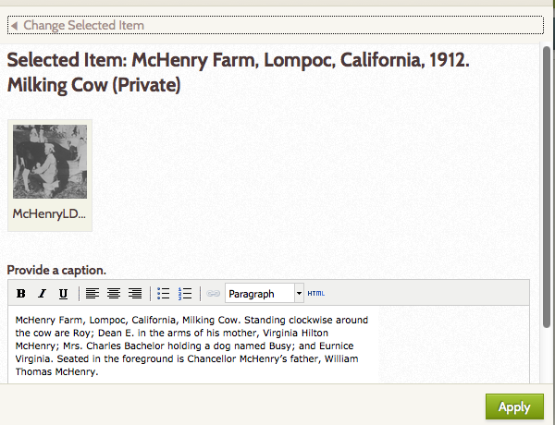
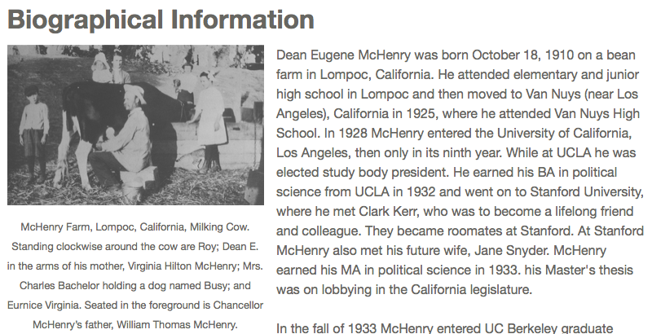
Examples A PAGE WITH IMAGE CAPTION
Same Page in Public view
ITEM WITH CAPTION in Admin view

Slide 31
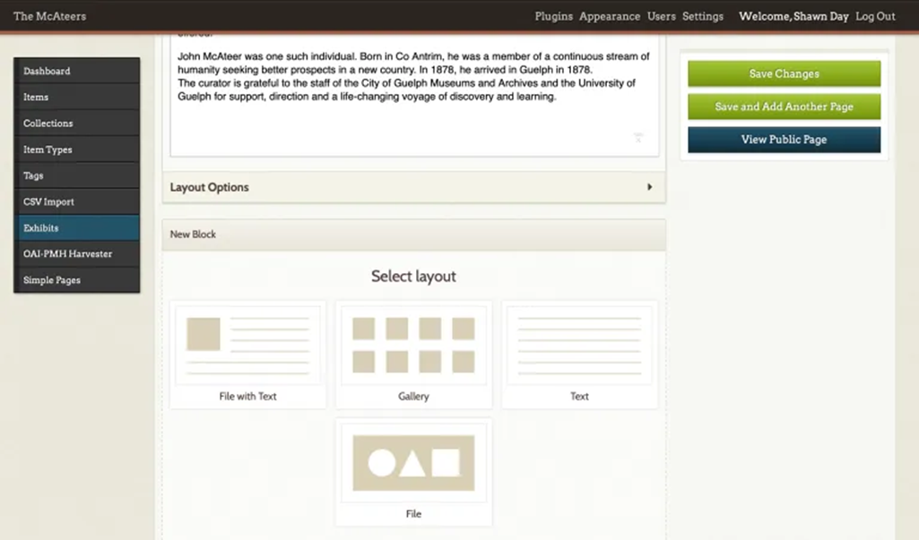
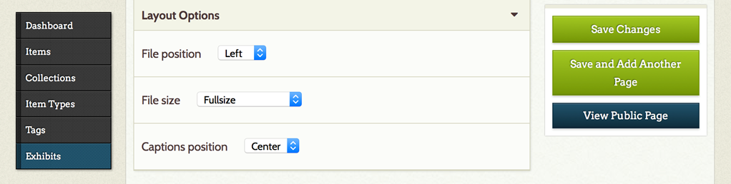
You can also fine-tune the various layout objects you insert by choosing layout functions.
  Click the arrow next to "Layout Options" to expand the list of formatting options. This will allow you to select the File position, File size, and Caption position for the content block.
    The layout options are as follows:
      File position: Left or Right
      File size: Fullsize, Thumbnail, or Square Thumbnail
      Caption position: Center, Left, or Right
This allows you to orient your images to the left, right or center and provide limited formatting.

Slide 32
LAYOUTs
If the digital file is located on the left, the layout looks like this:
If adding more than one file, please note that the Omeka Exhibit Builder will stack the images one above the other, with the orientation according left or right, according to the what is indicated in the layout options
If the digital file is located on THE RIGHT, the layout looks like this:
NOTE: To get digital files to line up horizontally across the content block or to be shown in a gallery, consider the “Gallery” option.

Slide 33
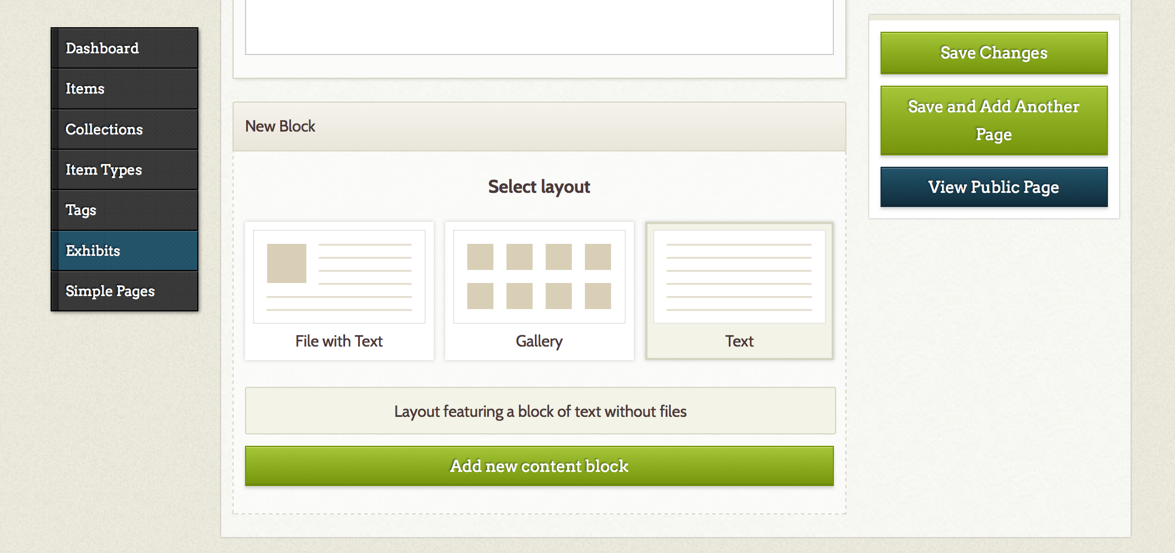
You can add additional blocks containing additional items, text, or combination of the two to your page construction.
  Remember, each page can contain multiple blocks (see slide 18). The pages build the sections of your exhibit.
Let’s practice by adding a Gallery Block to this page.

Slide 34
GALLERY CONTENT BLOCKS
Gallery content blocks are generally used to display more than one digital file, but this is not required.
This content block provides more flexibility for layout and includes the option of text.
A gallery that does not include text looks can look like this:
Adding text will change that gallery layout to:
There is a lot you can do with the Gallery Content Block. For more information, click here:
gebeasley.org/DH390/galleryblocks

Slide 35

When you have finished the page construction, you save the changes to your page.
You can also save the changes and immediately create another page. In this way, you can build your exhibit in sequence.
Save the page and then choose to View the Public Page and preview the page you have created.
You are able to edit or delete your exhibit on the exhibits page, which you can reach by clicking on the Exhibits tab on your left-hand navigation bar.

Slide 36
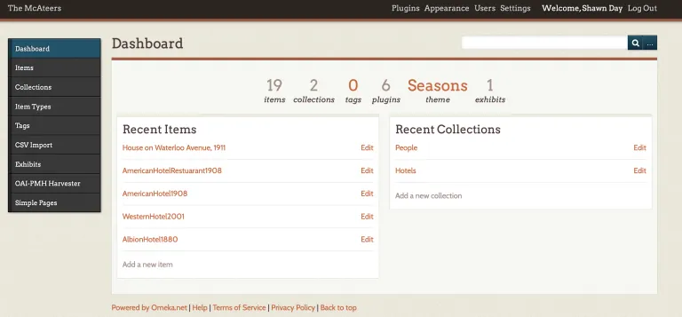
Adding Additional Pages AFTER INITIAL CREATION
Return to our Admin Dashboard and note that we now also have 1 exhibit indicated as created.
If you click on the digit for the “1 exhibit” you will get a list of exhibits for further editing.
Click the Edit button under your exhibit and you can start to add all the pages you would like to have in your exhibit.
From the Exhibit detail screen choose to add a new page after the single existing page. Title the page. Choose a useful ‘slug’ and then choose ‘Save and Add Another Page‘. In a similar fashion, we can quickly add all of the pages that we will have in our exhibit. The complete list appears in the Text file we downloaded earlier which also contains useful text to populate the pages. Don’t enter the text yet, but do create a couple more pages. When you do so, you can choose to ‘View Public Page’. This allows you to see the exhibit as your users will.
As you can see, a list of pages now appears down the side of the Exhibit display.

Slide 37
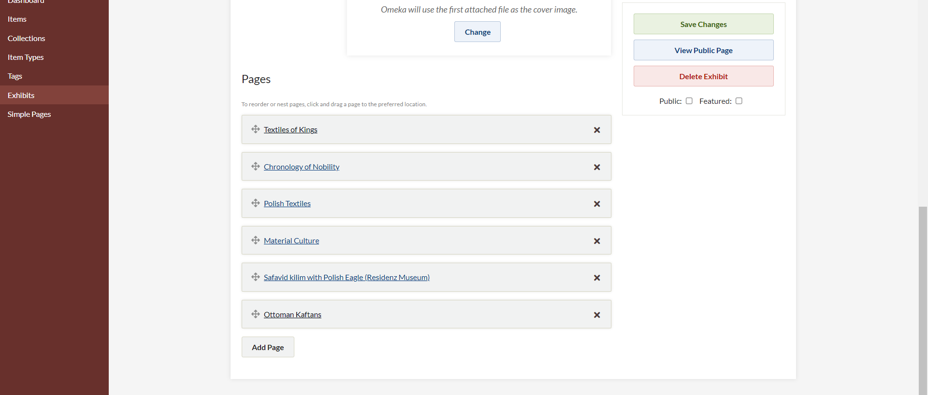
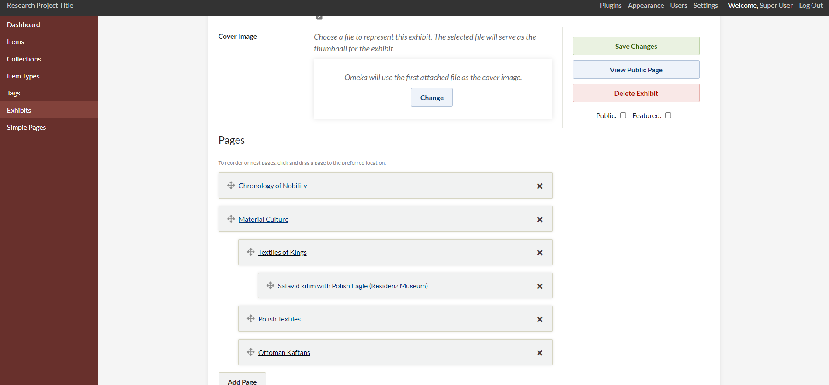
ORGANIZING YOUR EXHIBIT PAGES
1
MAKE SURE TO “SAVE CHANGES
AFTER YOU ORGANIZE YOUR NAVIGATION
Tip: You can re-arrange your pages or designate sub-pages by dragging and dropping the pages in Admin view: “Edit Exhibit”.
Pages can be re-ordered and edited at any time to alter your delivery. Choose to ‘edit’ the Exhibit again from the list of exhibits.
All of your pages are shown below the description of the exhibit itself on this screen.
  Note that a page can be clicked and then dragged to another position in the order. The same holds true on individual pages when you wish to reorder blocks of text and items
Think of writing a paper – What are headers and sub-headers?
  In the case of digital projects, these are called parents and children (and possibly grandchildren)
  Once you have decided an order or a nesting, simply drag and drop to organize your navigation.
2

Slide 38
Publishing, Featuring, Editing, and Deleting an Exhibit

Slide 39
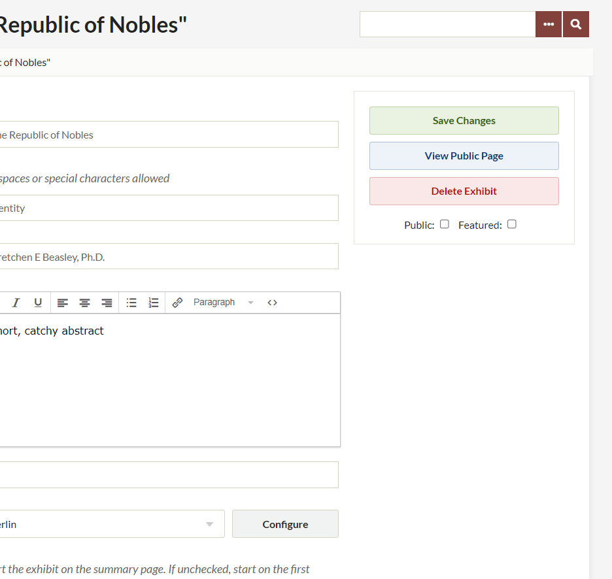
Publishing/Featuring an Exhibit
1
Once finished, an exhibit can be published and featured by checking the “Public” or “Featured” box below “Save Changes.” (see Ex. 1)
Exhibits not marked as “Public” are listed as “(Private)” in the exhibit list. (See Ex. 2) Checking the “Featured” box will allow the exhibit to appear in the “Featured Exhibit” section on the main front page.
  Having more than one exhibit with the “Featured” box checked will mean that each time the main page is loaded a different featured exhibit will appear. Having only one exhibit checked with “Featured” will set the same exhibit be featured every time the main page is loaded.
2

Slide 40
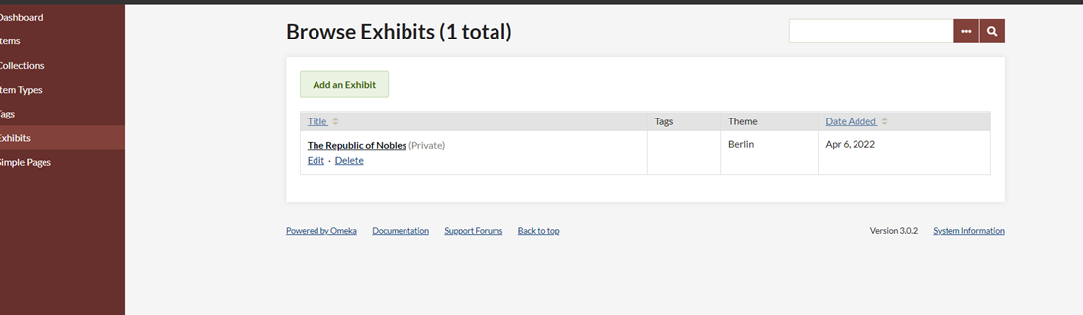
Editing an exhibit
At any time, an exhibit can be edited by clicking on “Edit” below the title of the exhibit in the exhibit list.

Slide 41
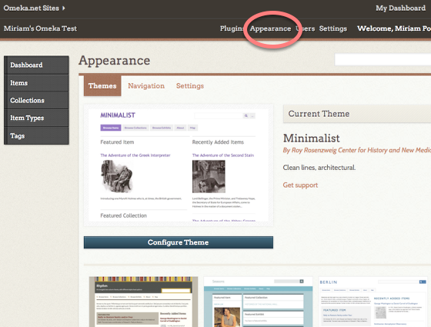
If you want to Switch themes
Omeka allows you to change the look of your public-facing site by switching themes.
To do this, click on Appearance (at the top right of your dashboard).
Switch themes by selecting one of the options on the page.
Press the green Use this theme button to activate your new theme.
Then visit your public site by clicking on the name of your site at the top left of the page.

Slide 42
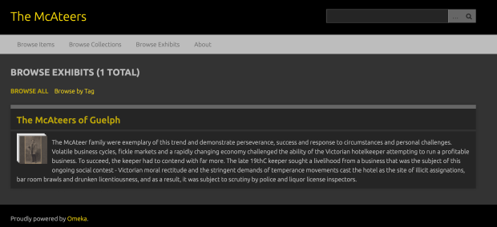
Navigating Exhibits
Now we have the beginnings of an exhibit. If you visit the home page of your Omeka site you will see that users can choose from browsing items, collections and now exhibits.
If a user chooses the first exhibit you have created they are taken to the home screen of that exhibit.

Slide 43
You have a new Exhibit!
Now, let’s see what else we can do with our exhibit.
LAYOUT AND SIMPLE PAGES

Slide 44
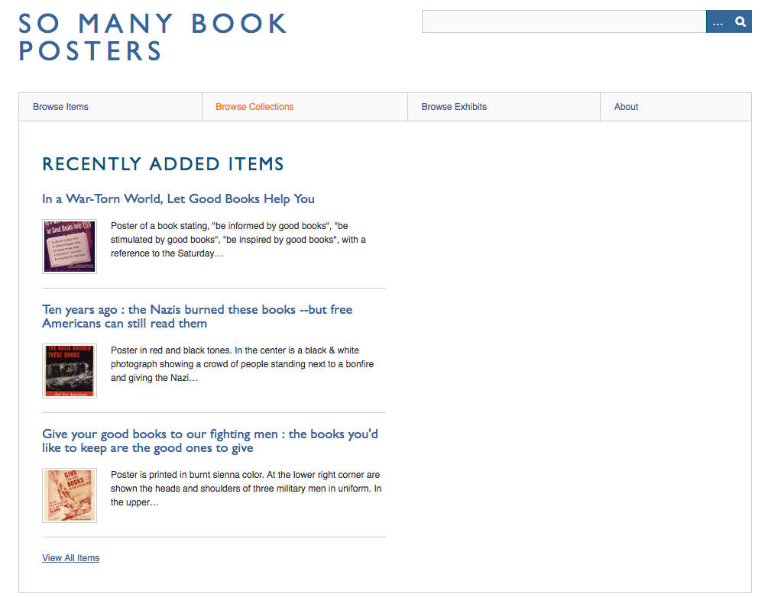
Layout and simple pages
Right now, in the examples being built for this tutorial, there isn't much customization for how the front page looks. It shows the user recently added items by default, and there are a couple options to browse collections and exhibits associated with the site.
If I want to add an introductory essay, or feature my items in a different way, I want to customize the look of my site further.

Slide 45
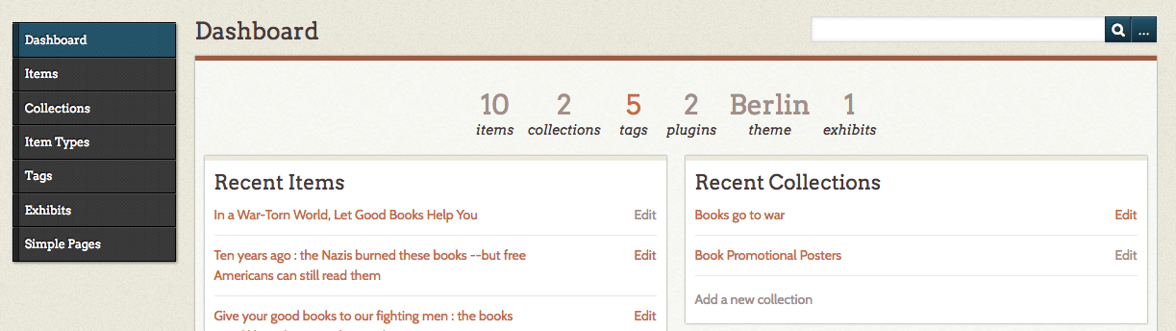
Layout, Continued
On the Omeka dashboard, I'm going to click on the theme option, in this case "Berlin" in order to change my site navigation.

Slide 46
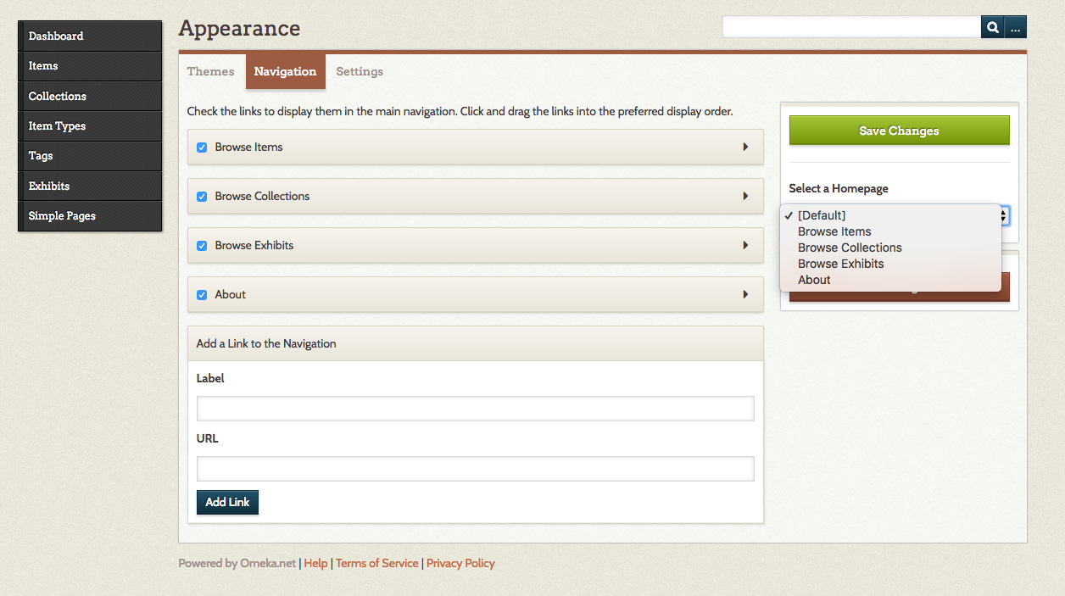
Layout, Continued
Here, you also have the option to select a homepage other than the default, and you can turn off some of the default browse options for items, collections, and exhibits, if you would prefer to have a different type of homepage.
TIP: Just like your exhibit pages, you can drag and drop your links/pages to Reorder or Remove links/pages.
You can also add external links here.

Slide 47
HOW ARE SIMPLE PAGES DIFFERENT THAN EXHIBITS?
Simple pages can be added to describe your project as a whole in more detail.
They become part of the overarching site navigation. Exhibits provide a way to bring items from an Omeka site together in conversation with one another through descriptive text.
With the Simple Pages plug-in, you can create an “About” page for your site, a page for an essay about the materials on your site, and more. Before you start creating Simple Pages, it can be helpful to review (think about) your site structure.
Remember that creating a site wireframe may be helpful before you start adding pages.
Simple pages are a great way to add navigation links to your homepage. They will be accessible on the main navigation bar.

Slide 48
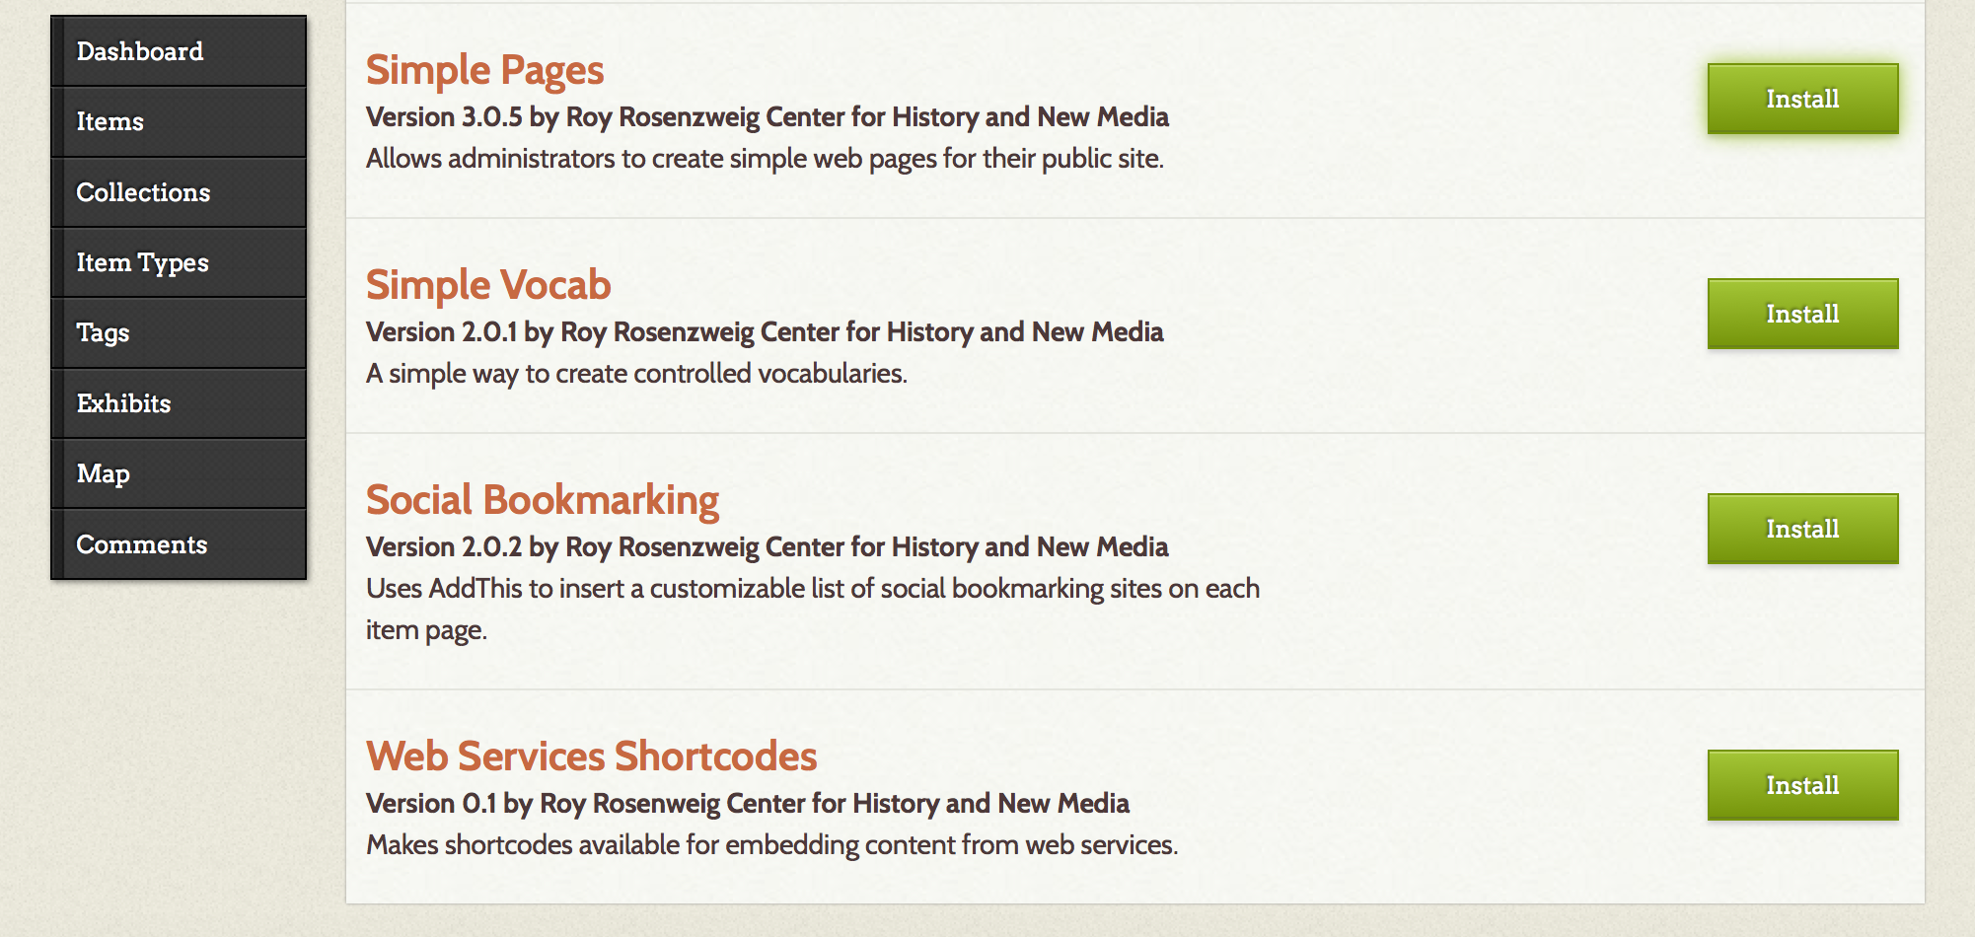
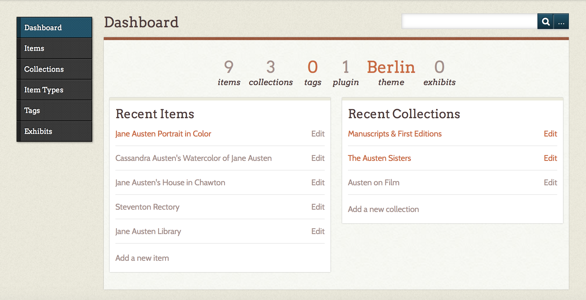
Adding a simple page
Install the Simple Pages Plugin
Starting from the site Dashboard, navigate to the Plugins page from either the top menu bar or the main menu.
On the Plugin screen, locate the Simple Pages plugin and select Install.

Slide 49
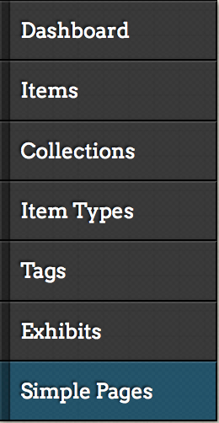
Adding a simple page continued
A new Simple Pages tab should appear on your Omeka site. This means that the installation was successful and you are ready to create a Simple Page.

Slide 50
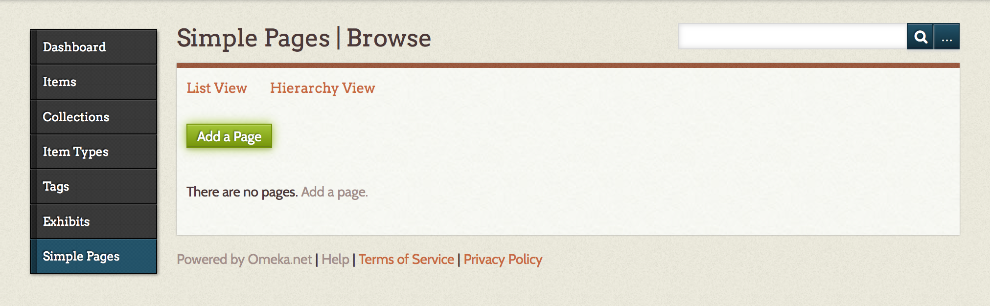
Create a simple page
To create a new Simple Page, use the left navigation menu to select Simple Pages. From the Simple Pages screen, you will be able to browse, edit, and create simple pages on your Omeka site. To create a new simple page, select Add a Page.

Slide 51
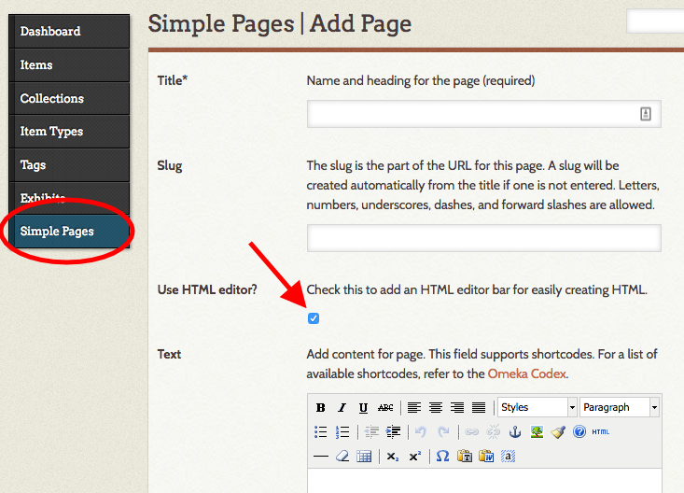
Add a new simple page
Assign a Title (required)
Assign a Slug / URL (optional)
Click the "Use HTML editor?" box to enable the options (bold, image upload, linking, etc.) in the Text editor box
.

Slide 52
Add a new simple page
Assign a Title (required)
Assign a Slug / URL (optional)
Click the "Use HTML editor?" box to enable the options (bold, image upload, linking, etc.) in the Text editor box
.

Slide 53
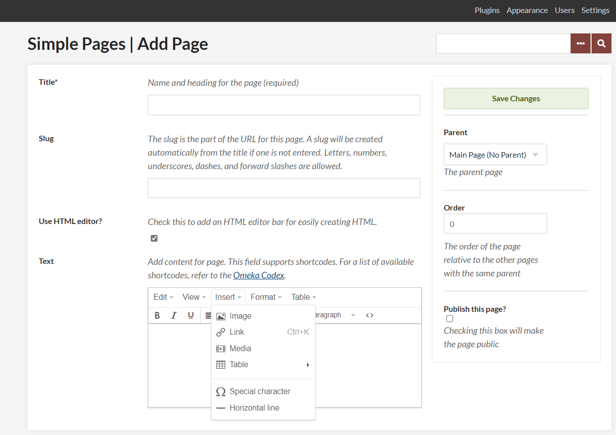
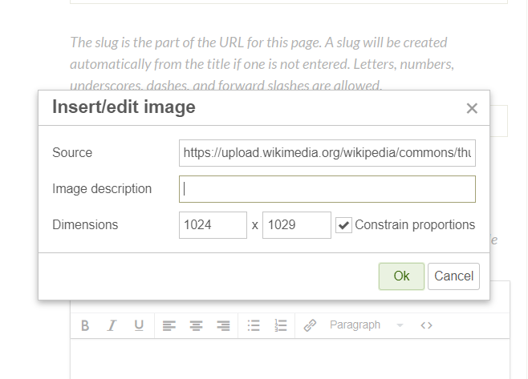
Adding images to your simple page
After clicking “Use HTML editor?” the Text box will pop up with options. Select “Insert” Then select “Images”
You will either use the URL from one of your images uploaded as an “Item” or you can add a URL to an outside link (like we did with our HTML)

Slide 54

Embedding videos into your simple page (OR EXHIBIT PAGE)
Get the embed code
In YouTube or Vimeo, select "Share“
Copy the entire "Embed" code
Make sure your code includes “iframe”
You can embed videos and other items (we will use this for your timeline, maps, etc.) onto your Simple Pages or on the Exhibit Pages (it works the same)

Slide 55

Embedding videos into your simple page (OR EXHIBIT PAGE), CONTinued
Add the Embed Code to Your Page
Click the “Source Code" button in your text editor
In the pop-up box, paste the entire embed code (you will use a bit of HTML here)
Click “OK"
You can embed videos and other items (we will use this for your timeline, maps, etc.) onto your Simple Pages or on the Exhibit Pages (it works the same)

Slide 56

Now What can I do with the Simple Page I just Created?
With the new page I've just created, I can adjust the settings and appearance of my site.
Click on the name of your site theme, and go to the navigation tab. There are many options.
Let’s see what one looks like as a new home page.

Slide 57


SIMPLE PAGE IDEAS
Here's an example of an adjustment to make, taking off a couple of the browse options and selecting a custom homepage from the bar on the side.
The site now has a different theme and navigation. These can be adjusted at any time from the “Appearance” section.

Slide 58
You are all set to start to create!
I suggest adding a Simple Page called “Portfolio”

