Slide 1
Copyright, Fair Use, & Creative Commons

Slide 2
Purpose of Copyright
Under the current law, copyright protection is automatic and begins the moment any “original work of authorship is fixed in a tangible medium of expression.

Slide 3
The Copyright act gives copyright holders a set of exclusive rights to:
making copies of the work
distributing them
public performance or display of the work
creating derivative works
The actual language of the law is from Title 17 of the United States Code, section 106:

Slide 4
What is Eligible For Copyright?
literary works
musical works, including any accompanying words
dramatic works, including any accompanying music
pantomimes and choreographic works
pictorial, graphic, and sculptural works
sound recordings
architectural works
computer programs (were considered “literary works” since 1964, and formally protected by law in 1976)
engineered DNA sequences are even being considered for copyright protection (this is far from settled though)

Slide 5
What is Copyrightable, What is Not
Certain categories of things are not eligible for copyright. Perhaps the most important category is that of ideas. Copyright only applies only to the expression of an idea (the expression that is fixed in a tangible form per the first criteria above), not the idea itself.
Other categories that are not eligible for copyright include
Ideas, procedures, methods, systems, processes, concepts, principles, or discoveries (NOTE: patent law may apply to this category.)
Titles, names, short phrases, and slogans (for example “Haters gonna hate“) (NOTE: trademark law may apply to this category.)
Familiar symbols or designs (NOTE: trademark law may apply to this category.)
Mere variations of typographic ornamentation, lettering, or coloring
Mere listings of ingredients or contents
Works of the Federal Government per 17 USC 105 (The copyright status of works prepared by state governments is governed by the laws the individual states. In most states the copyright status of state government works is ambiguous.)

Slide 6
Criteria for Copyright
#1: A work must be set down in a fixed format. According to 17 USC 102, a work must be “fixed in any tangible medium of expression, now known or later developed, from which they can be perceived, reproduced, or otherwise communicated, either directly or with the aid of a machine or device.”
#2: There must be some level of originality and creativity to the work, but again the bar is pretty low.
“Child drawing age 3 crayon on paper” by Teresa is licensed under CC BY-SA 3.0

Slide 7
INTELLECTUAL PROPERTY
Copyright
Trademarks: protect marks that distinguish goods and services such as brand names, logos, and symbols.
Patents: apply to new and useful inventions, granting the owner exclusive rights to make, use, or sell the invention.

Slide 8
Public Domain
The public domain refers to the body of works to which copyright never applied (for example works of the federal government) or in which the copyright has expired.

Slide 9
PubLIC DOMAIN SOurces
Finding Public Domain Books
Authorama
Christian Classics Ethereal Library
Google BooksYou will need to enter "public domain" as a search term
Internet Archive Text Collection
Online Books (UPenn)
Project Gutenberg
Finding Public Domain Sound Recordings
Internet Archive Audio Collection
Library of Congress National Jukebox
Musopen
Project Gutenberg Recorded Music Collection
Finding Public Domain Images
Atla Digital Library Many of the images contained in the Atla Digital Library are in the public domain. Refer to the rights statement for more information.
British Library on Flickr
Public Domain Sherpa An extensive list of public domain photos.
Getty Open Content
Metropolitan Museum of Art

Slide 10
Timeline of copyright
Copyrights do not last forever
1790: The first copyright law in the United States granted a monopoly on copying and distributing textual works for a period of seven years
Today the copyright term for most works is the life of the author plus 70 years
Works published in the United States prior to 1923 are now in the public domain
Figuring out the copyright status of a work published after 1923 and before 1989 is challenging, but there are some good websites online to help you out (for example this Copyright Slider)
Works in the public domain you are free to copy, distribute, perform, and adapt at will
At Project Gutenberg you can download over 5000 public domain books in multiple formats. The Public Domain Review is an interesting website for keeping up on what works are entering the public domain, and searching for (really weird and Halloween appropriate) stuff that people created back in the day. A lot of material entered the public domain on January 1, 2019.

Slide 11
Fair Use
There are various exceptions to the absolute power of the copyright holder to control all copying, distribution, and adaptations, including exceptions for classroom use (section 110), for online teaching (TEACH Act) and for libraries (section 108). But the biggest and most important exception is that of Fair Use. According to 17 U.S.C. section 107:
the purpose and character of the use, including whether such use is of a commercial nature or is for nonprofit educational purposes;
the nature of the copyrighted work;
the amount and substantiality of the portion used in relation to the copyrighted work as a whole; and
the effect of the use upon the potential market for or value of the copyrighted work.
Without this far reaching exception many important activities would be considered infringement.

Slide 12
Four FACTORS OF FAIR USE
What is the purpose in reusing copyrighted material?
The nature of copyrighted work
The amount that the work is used
Effect on the market for the original

Slide 13
Transformative use
The Fair Use clause was codified into US law relatively recently, in 1976
The idea of Fair Use can be traced back to the case of Folsom v. Marsh in 1841
A list of cases involving Fair Use issues can be found in the Copyright Fair Use Index
The 1994 Supreme Court case Campbell v. Acuff-Rose Music ruling
The rap group 2 Live Crew took the song Pretty Woman by Roy Orbison and made a parody song
The court found in favor of 2 Live Crew saying:
“Although such transformative use is not absolutely necessary for a finding of fair use, the goal of copyright, to promote science and the arts, is generally furthered by the creation of transformative works. Such works thus lie at the heart of the fair use doctrine’s guarantee of breathing space within the confines of copyright, and the more transformative the new work, the less will be the significance of other factors, like commercialism, that may weigh against a finding of fair use.” ~Campbell v. Acuff Rose Music, 510 U.S. 569 (1994)
In this case, a sort of fifth factor was introduced: transformative use.
Transformative use refers to uses that are completely new and unexpected, and hinges on whether new expression is added to the source work, whether it expresses new insights or a different aesthetic

Slide 14
Four FACTORS OF FAIR USE
What is the purpose in reusing copyrighted material?
The nature of copyrighted work
The amount that the work is used
Effect on the market for the original

Slide 15
Strengthening Your Case
Be able to articulate why you had to use this particular work.
Use only as much as you absolutely need to make your point.
Attribute the original.

Slide 16
Joint authorship
Another scenario: when there is more than one person contributing to the creation of a work. Section 101 defines a joint work as one “prepared by two or more authors with the intention that their contributions be merged into inseparable or interdependent parts of a unitary whole.”

Slide 17
Licensing agreement
At a minimum, a licensing agreement (either exclusive or nonexclusive) should:
identify the copyrighted work(s) covered by the license
identify the copyright holder (licensor) and the licensee
indicate whether the license is exclusive or nonexclusive
state the rights that are granted by the license
expressly state time limitations (if any) on the license (i.e. how long the license will last)
expressly state geographic limitations (if any) of the license (i.e. worldwide license vs. a license limited to a particular country)
expressly state any format limitations (if any) of the license (ex. limited to print or digital)
describe compensation (if any) owed to the licensor (payments, royalties, etc.)
include the licensor signature and date of signature

Slide 18
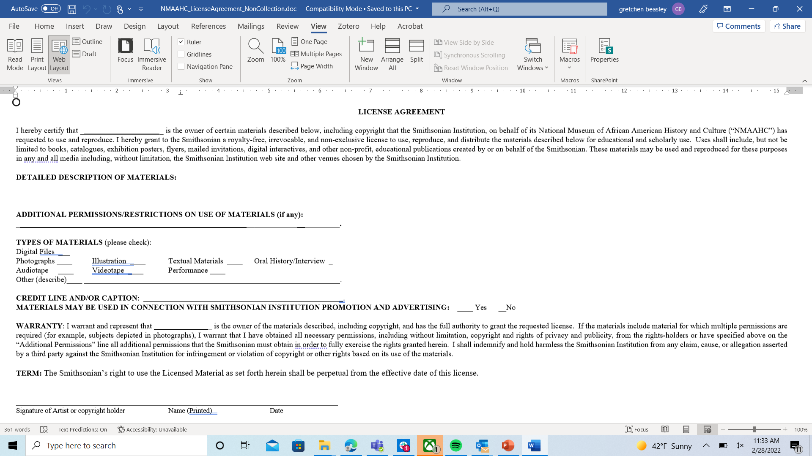

Slide 19
Copyright Analysis Framework
The five questions that form this framework for copyright analysis are:
Is the work protected by copyright?
Is there a specific exception in copyright law that covers my use?
Is there a license that covers my use?
Is my use covered by fair use?
Do I need permission from the copyright owner for my use?

Slide 20
Copyright and Fair Use REsources
CHEER (Copyright Educational Resources for Higher Education)
Copyright and Cultural Institutions: Guidelines for Digitization for U.S. Libraries, Archives, and Museums (Open Access eBook)
Copyright for Educators and Librarians (Coursera MOOC)
CopyTalk Webinars (ALA)
Owning and Using Scholarship: An IP Guide for Teachers and Researchers (Open Access eBook)
Code of Best Practices in Fair Use for Academic and Research Libraries This Code of Best Practices identifies eight scenarios where fair use principles commonly apply and steps libraries should take to help assure fair use.
"The Good News About Library Fair Use" (Infographic)Infographic produced by ARL and based upon Code of Best Practices
Fair Use EvaluatorA tool developed by the ALA Copyright Advisory Network to assist libraries in evaluating whether a proposed use is fair.
Thinking Through Fair UseInteractive fair use checklist, from the University of Minnesota, to assist with fair use analysis.
U.S. Copyright Office Fair Use IndexThe Fair Use Index tracks a variety of judicial decisions to help both lawyers and non-lawyers better understand the types of uses courts have previously determined to be fair—or not fair.
Fair Use WeekFair Use Week is an annual celebration held the last week of February. Various resources, including handouts, images, and a calendar of events by participating institutions are available at the Fair Use Week website.
Fair Use: 12 Myths and RealitiesWant to learn more about the myths surrounding fair use? Check out this an examination of 12 common myths about the application of fair use and the reality of fair use law.

Slide 21
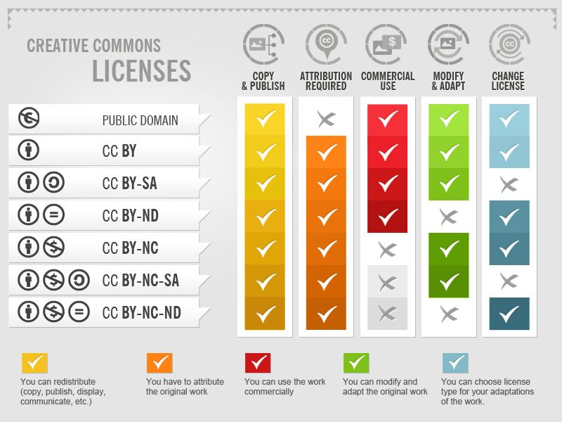
Creative Commons
The Creative Commons organization was founded in 2001 as a means of permitting creators to license their work for public use under conditions they specify. Although not an alternative to copyright and not an indication that a work is part of the public domain (unless the Public Domain Dedication mark is selected), Creative Commons licenses permit the holders of copyright to define how their works may be used and give users of copyrighted works greater creative freedom when they know, without question, how copyrighted works can be incorporated into new creations

Slide 22
More on Creative Commons
Watch this short video, A Shared Culture,
For a creative take on Creative Commons and copyright, check out this song by Jonathan “Song-A-Day” Mann about his choice to use CC licenses for his music. The XKCD comics guy also uses Creative Commons licenses on his work.

Slide 23
Creative Commons
Attribution
BY condition: In other words, all of the licenses require that the creator be attributed in connection with their works
Non Commercial
Share Alike
No Derivatives

Slide 24
Adaptations
As a legal matter, at times it is tricky to determine exactly what is and is not an adaptation. Here are some handy rules about the licenses to keep in mind:
Technical format-shifting (for example, converting a licensed work from a digital format to a physical copy) is not an adaptation regardless of what applicable copyright law may otherwise provide.
Fixing minor problems with spelling or punctuation is not an adaptation.
Syncing a musical work with a moving image is an adaptation regardless of what applicable copyright law may otherwise provide.
Including an image in connection with text, as in a blog post, a powerpoint, or an article, does not create an adaptation unless the photo itself is adapted.

Slide 25
CC License Layers
The legal code is the base layer. This contains the “lawyer-readable” terms and conditions that are legally enforceable in court. Take a minute and scan through the legal code of CC BY to see how it is structured. Can you find where the attribution requirements are listed?
The commons deeds are the most well-known layer of the licenses. These are the web pages that lay out the key license terms in so-called “human-readable” terms. The deeds are not legally enforceable but instead summarize the legal code. Take some time to explore the deeds for CC BY and CC BY-NC-ND and identify how they differ. Can you find the links to the legal code from each deed?
In order to make it easy for websites and web services to know when a work is available under a Creative Commons license, there is a “machine readable” version of the license—a summary of the key freedoms granted and obligations imposed written into a format that applications, search engines, and other kinds of technology can understand. When this metadata is attached to CC licensed works, someone searching for a CC licensed work using a search engine (e.g., Google advanced search) can more easily discover CC licensed works.

Slide 26
Creative Commons Resource
Locating Creative Commons Licensed Content
When searching sites such as Google Images or Flickr, always remember to add the Creative Commons license appropriate to your proposed use to your advanced search.
Below are links to resources where you can locate music, images and other content that have been licensed through Creative Commons.
Creative Commons Search Newly revised mega search by Creative Commons
CC Mixter Community music remixing site featuring remixes and samples licensed under Creative Commons licenses.
JamendoA wide catalog of more than 500,000 tracks shared by 40,000 artists from over 150 countries all over the world.
Photos for Class This tool allows users to search through Creative Commons images that are appropriate for the classroom. Citation information is automatically included when the images are downloaded.
Wikimedia Commons Fully searchable access to media, including images, sounds and videos. Most of the content is available under some sort of Creative Commons license and licensing information is clearly provided at the bottom of each page.

